Slide 1
YOUTH EMPOWERMENT

Slide 2
COURSES BEFORE 10TH

Slide 3
COURSES
AFTER
10TH

Slide 4
Sl.No. | SUBJECT | COURSES | SUBJECTS
1 | PUC 11th & 12th Std | ARTS | History, Geography, English, Psychology, Economics, Political Science, Sociology, and Philosophy
 |  | COMMERCE | Business Studies, Statics, Economics, Mathematics, English, Computer, Accountancy, etc.
 |  | SCIENCE | Group A – Mathematics, Physics, Chemistry
 |  |  | Group B – Biology, Physics, Chemistry

Slide 5

DIPLOMA COURSES

Slide 6
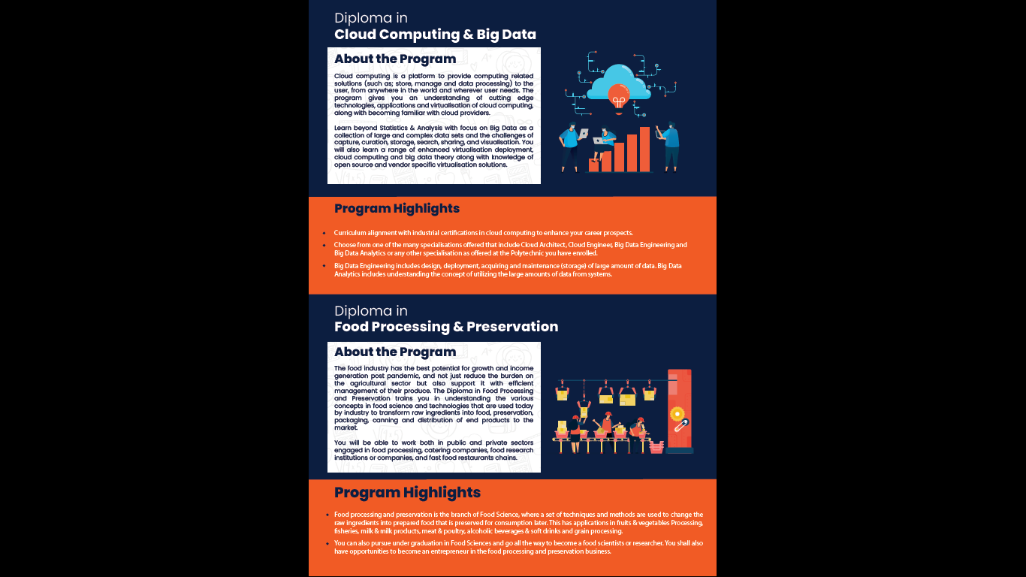

Slide 7
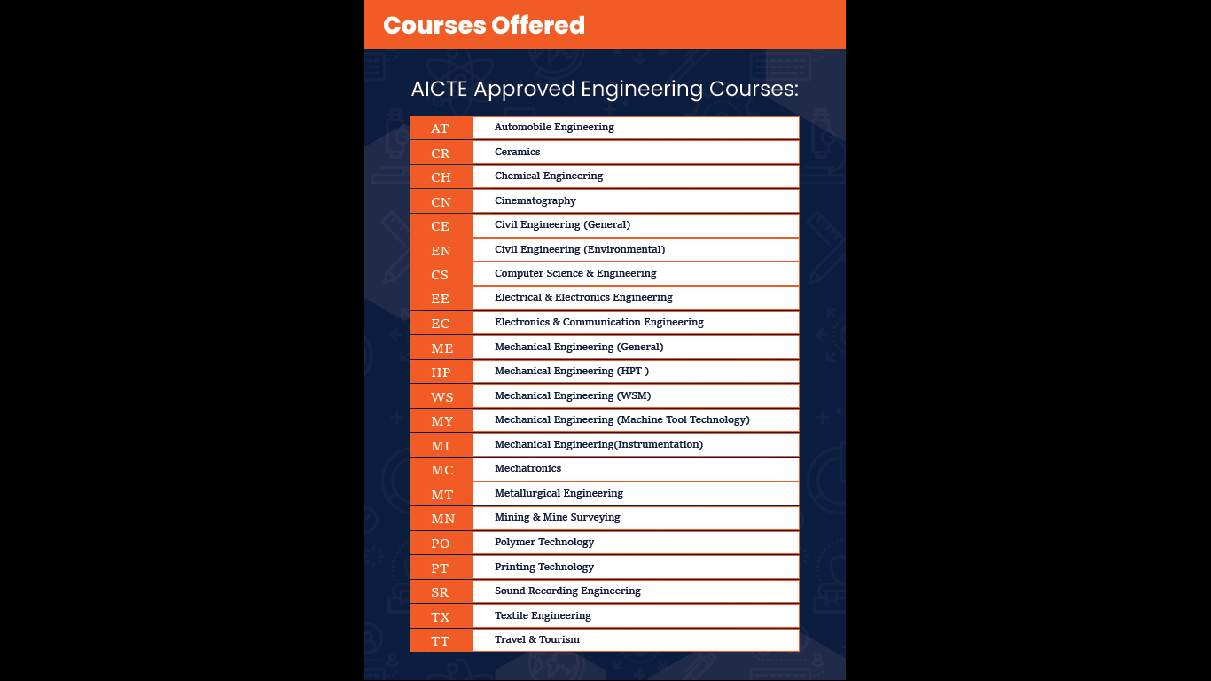

Slide 8
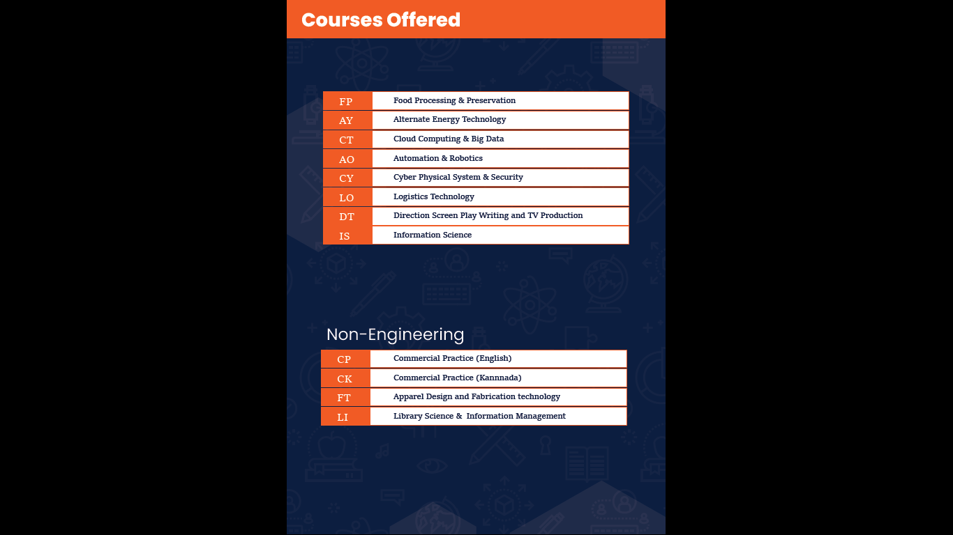

Slide 10
COURSES UNDER PARA-MEDICAL BOARD
Courses coming under the jurisdiction of the Para Medical Board are:
1 | Diploma in Medical Laboratory Technology.
2 | Diploma in X-Ray Technology.
3 | Diploma in Health Inspector.
4 | Diploma in Medical Records Technology.
5 | Diploma in Operation Theater & Anaesthesia Technology.
6 | Diploma in Dialysis Technology.
7 | Diploma in Ophthalmic Technology.
8 | Diploma in Dental Mechanics.
9 | Diploma in Dental Hygiene.

Slide 11
DURATION OF THE COURSES
The duration of the above courses will be of two years for PUC candidates.
The candidates with SSLC qualification shall study for three years. English, Physics, Chemistry and Biology of PUC standard shall be taught in the first year of the course to these students.
List of Paramedical Courses after 10th
Sl. No. | Diploma | Sl. No. | Diploma
1 | General Nursing and Midwifery (GNM) | 16 | Diploma in Medical Lab Technology
2 | Auxiliary Nurse Midwifery (ANM) | 17 | Diploma in Hearing Language and Speech
3 | Diploma in Radiology | 18 | Diploma in Operation Theatre Technology
4 | Diploma in Gynaecology and Obstetrics | 19 | Diploma in OT Technician
5 | Diploma in Child Health | 20 | Certificate in Research Methodology
6 | Diploma in Rural Health Care | 21 | Certificate in Lab Assistant/Technician
7 | Diploma in Community Health Care | 22 | Certificate in Nursing Care Assistant
8 | Diploma in Orthopaedics | 23 | Certificate in Operation Theatre Assistant
9 | Diploma in Ophthalmology | 24 | Certificate in Dental Assistant
10 | Diploma in Optometry | 25 | Certificate in ECG and CT Scan Technician
11 | Diploma in Dermatology | 26 | Certificate in HIV and Family Education
12 | Diploma in Clinical Research | 27 | Certificate in Nutrition and Childcare
13 | Diploma in Dermatology, Venereology and Leprosy | 28 | Certificate in Rural Health Care
14 | Diploma in Medical Record Technology | 29 | Certificate in Home-Based Health Care
15 | Diploma in Medical Imaging Technology

Slide 12
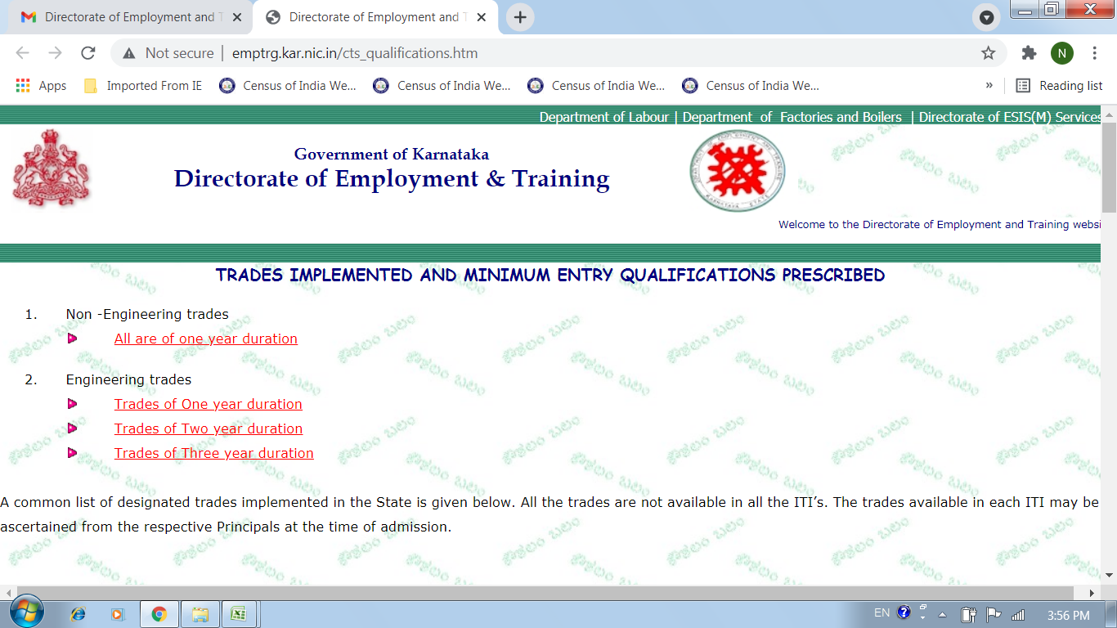
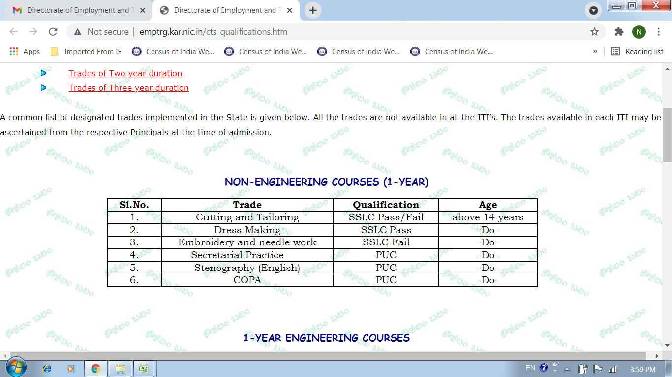
ITI COURSES

Slide 13
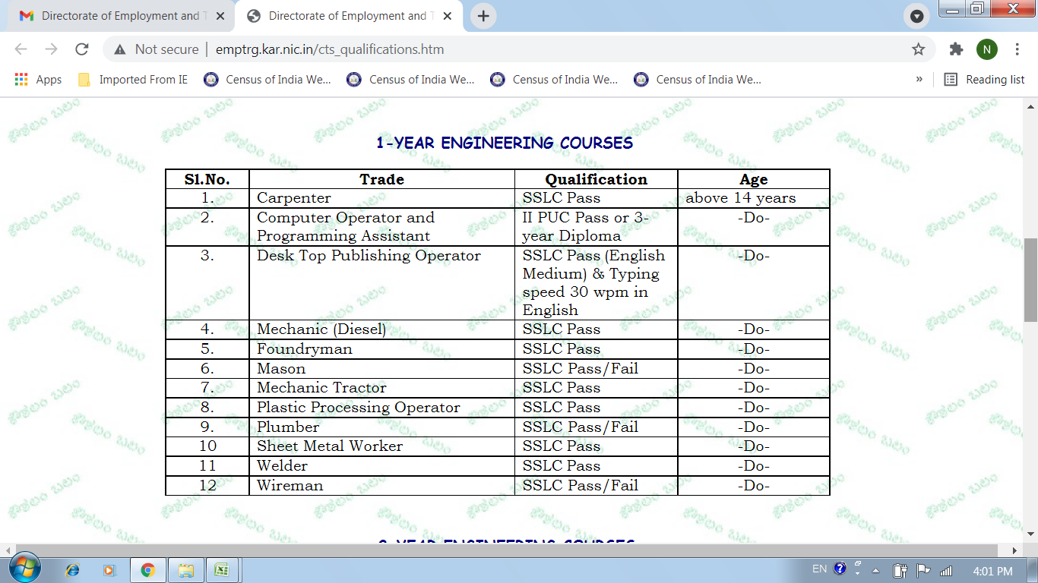

Slide 14
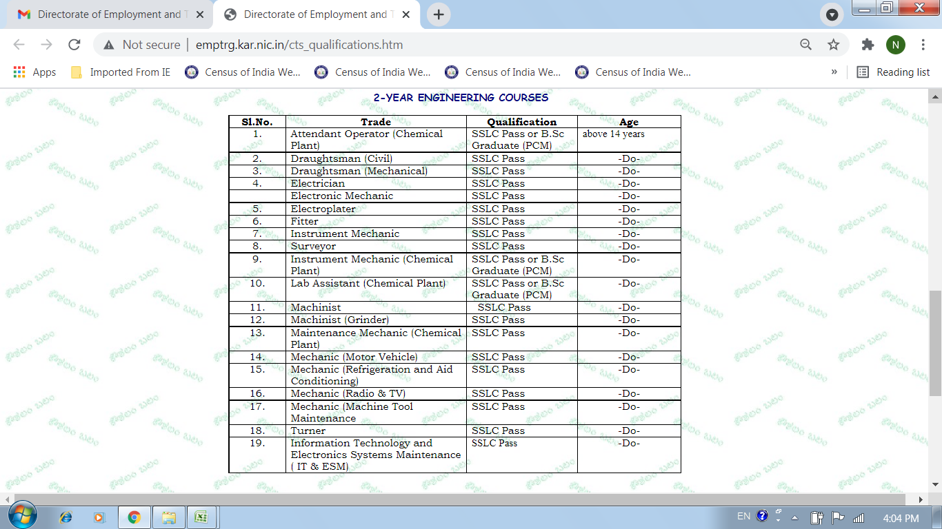

Slide 15
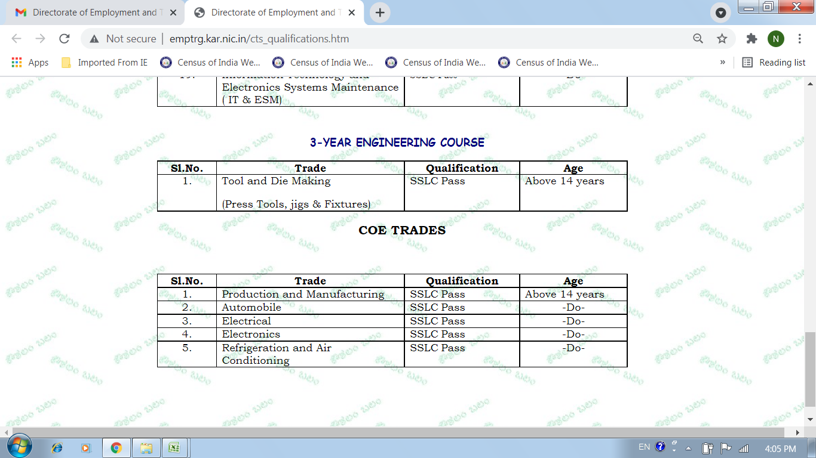
Centre of Excellence Trades

Slide 16
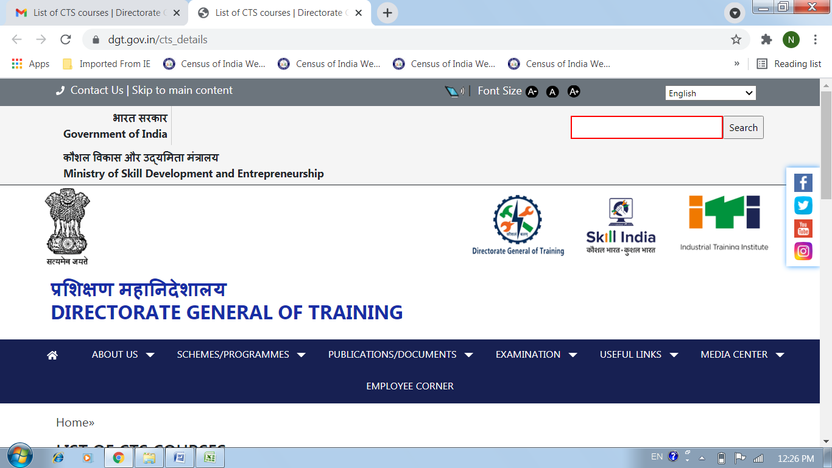
6 Month Courses
S.no | Sector Name | NAME OF THE TRADE | Minimum Qualification Eligibility | Trade Type | Unit/ Batch Size | NSQF level | Duration | Year for NSQF Approval | Year Revision
1 | Aerospace & Aviation | Remotely Piloted Aircraft (RPA)/Drone Pilot | Passed 10th Class Examination with Science and Mathematics or its equivalent | Non Engineering | 24 | 4 | 6 Months(800 Hr.) | 2018 | 2019
2 | Automotive | Driver cum Mechanic | Passed 8th Class Examination | Non Engineering | 20 | 3 | 6 Months(800 Hr.) | 2018 | 2019
3 | Electronics & HW | Smartphone Technician Cum App Tester | Passed 10th Class Examination or its equivalent | Non Engineering | 24 | 3 | 6 Months(800 Hr.) | 2018 | 2019
4 | Private Security | Fireman | Passed class 10th Class Examination or its equivalent. | Non Engineering | 24 | 3 | 6 Months(800 Hr.) | 2018 | 2019
5 | IT &ITeS | Data Entry Operator | Passed 10th class examination | Non Engineering | 24 | 4 | 6 Months(800 Hr.) | 2020 | 2020

Slide 17
1 (One) Year Courses
S.no | Sector Name | NAME OF THE TRADE | Minimum Qualification Eligibility | Trade Type | Unit/ Batch Size | NSQF level | Duration | Year for NSQF Approval | Year Revision
1 | Agriculture | Floriculture & Landscaping | Passed 10th class examination or its equivalent | Non Engineering | 24 | 4 | One year(1600 Hr.) | 2018 | 2019
2 | Agriculture | Horticulture | Passed class 10thexamination or its equivalent | Non Engineering | 24 | 4 | One year(1600 Hr.) | 2018 | 2019
3 | Agriculture | Soil Testing and Crop Technician | Passed 10th class examination with Science and Mathematics or its equivalent | Non Engineering | 24 | 4 | One year(1600 Hr.) | 2018 | 2019
4 | Apparel | Computer Aided Embroidery & Designing | Passed 10th class examination or its equivalent | Non Engineering | 24 | 4 | One year(1600 Hr.) | 2018 | 2019
5 | Apparel | Cutting & Sewing (VI & OD) | Passed 8th class examination (Candidate should be of visually impaired) | Divyang | 12 | 3 | One year(1600 Hr.) | 2018 | 2019
6 | Apparel | Dress Making | Passed 08th class examination | Non Engineering | 20 | 4 | One year(1600 Hr.) | 2015 | 2019

Slide 18
S.no | Sector Name | NAME OF THE TRADE | Minimum Qualification Eligibility | Trade Type | Unit/ Batch Size | NSQF level | Duration | Year for NSQF Approval | Year Revision
6 | Apparel | Dress Making | Passed 08th class examination | Non Engineering | 20 | 4 | One year(1600 Hr.) | 2015 | 2019
7 | Apparel | Fashion Design and Technology | Passed 10th class examination or its equivalent | Non Engineering | 20 | 4 | One year(1600 Hr.) | 2018 | 2019
8 | Apparel | Sewing Technology | Passed 8th class examination | Non Engineering | 20 | 4 | One year(1600 Hr.) | 2015 | 2019
9 | Automotive | Mechanic Auto Body Painting | Passed 10th class examination or its equivalent. | Engineering | 20 | 4 | One year(1600 Hr.) | 2018 | 2019
10 | Automotive | Mechanic Auto Body Repair | Passed 10th class examination with Science and Mathematics or its equivalent. | Engineering | 20 | 4 | One year(1600 Hr.) | 2018 | 2019
11 | Automotive | Mechanic Auto Electrical and Electronics | Passed 10th class examination with Science and Mathematics or its equivalent. | Engineering | 20 | 4 | One year(1600 Hr.) | 2016 | 2019

Slide 19
S.no | Sector Name | NAME OF THE TRADE | Minimum Qualification Eligibility | Trade Type | Unit/ Batch Size | NSQF level | Duration | Year for NSQF Approval | Year Revision
12 | Automotive | Mechanic Diesel | Passed 10th class examination with Science and Mathematics or its equivalent. | Engineering | 24 | 4 | One year(1600 Hr.) | 2016 | 2019
13 | Automotive | Mechanic Tractor | Passed 10th class examination with Science and Mathematics or its equivalent. | Engineering | 20 | 4 | One year(1600 Hr.) | 2016 | 2019
14 | Automotive | Mechanic Two and Three Wheeler | Passed 10th class examination with Science and Mathematics or its equivalent. | Engineering | 20 | 4 | One year(1600 Hr.) | 2018 | 2019
15 | Automotive | Pump Operator Cum Mechanic | Passed 10th class examination with Science and Mathematics or its equivalent. | Engineering | 20 | 4 | One year(1600 Hr.) | 2016 | 2019
16 | Beauty & Wellness | Cosmetology | Passed 10th class examination or its equivalent | Non Engineering | 24 | 4 | One year(1600 Hr.) | 2015 | 2019
17 | Beauty & Wellness | Hair & Skin Care (VI) | Passed 10th class examination (Candidate should be of visually impaired) | Divyang | 12 | 3 | One year(1600 Hr.) | 2018 | 2019

Slide 20
S.no | Sector Name | NAME OF THE TRADE | Minimum Qualification Eligibility | Trade Type | Unit/ Batch Size | NSQF level | Duration | Year for NSQF Approval | Year Revision
18 | Beauty & Wellness | Spa Therapy | Passed 10th class examination or its equivalent | Non Engineering | 24 | 4 | One year(1600 Hr.) | 2018 | 2019
19 | BFSI(Banking, Finance Service & Insurance) | Finance Executive | Passed 10th class examination or its equivalent | Non Engineering | 24 | 4 | One year(1600 Hr.) | 2018 | 2019
20 | Capital Goods & Manufacturing | Additive Manufacturing Technician (3D Printing) | Passed 10th class examination with Science and Mathematics or its equivalent. | Engineering | 20 | 4 | One year(1600 Hr.) | 2018 | 2019
21 | Capital Goods & Manufacturing | Marine Engine Fitter | Passed 10th class examination with Science and Mathematics or its equivalent. | Engineering | 20 | 4 | One year(1600 Hr.) | 2018 | 2019
22 | Capital Goods & Manufacturing | Foundryman | Passed 10th class examination | Engineering | 24 | 4 | One year(1600 Hr.) | 2018 | 2019
23 | Capital Goods & Manufacturing | Sheet Metal Worker | Passed 8th class examination | Engineering | 20 | 3 | One year(1600 Hr.) | 2016 | 2019
24 | Capital Goods & Manufacturing | Welder | Passed 8th class examination | Engineering | 20 | 4 | One year(1600 Hr.) | 2015 | 2019
25 | Capital Goods & Manufacturing | Welder (Fabrication & Fitting) | Passed 8th class examination | Engineering | 20 | 3 | One year(1600 Hr.) | 2016 | 2019
26 | Capital Goods & Manufacturing | Welder(GMAW & GTAW) | Passed 8th class examination | Engineering | 20 | 3 | One year(1600 Hr.) | 2016 | 2019
27 | Capital Goods & Manufacturing | Welder (Pipe) | Passed 8th class examination | Engineering | 20 | 3 | One year(1600 Hr.) | 2016 | 2019

Slide 21
S.no | Sector Name | NAME OF THE TRADE | Minimum Qualification Eligibility | Trade Type | Unit/ Batch Size | NSQF level | Duration | Year for NSQF Approval | Year Revision
28 | Capital Goods & Manufacturing | Welder (Structural) | Passed 8th class examination | Engineering | 20 | 3 | One year(1600 Hr.) | 2016 | 2019
29 | Capital Goods & Manufacturing | Welder (Welding & Inspection) | Passed 8th class examination | Engineering | 20 | 3 | One year(1600 Hr.) | 2016 | 2019
30 | Chemicals & Petrochemicals | Plastic Processing Operator | Passed 10th class examination with Science and Mathematics or its equivalent. | Engineering | 20 | 4 | One year(1600 Hr.) | 2018 | 2019
31 | Construction | Carpenter | Passed 8th class examination | Engineering | 24 | 4 | One year(1600 Hr.) | 2018 | 2019
32 | Construction | Domestic Painter | Passed 10th class examination or its equivalent. | Engineering | 24 | 4 | One year(1600 Hr.) | 2018 | 2019
33 | Construction | Industrial Painter | Passed 10th class examination or its equivalent. | Engineering | 24 | 4 | One year(1600 Hr.) | 2018 | 2019

Slide 22
S.no | Sector Name | NAME OF THE TRADE | Minimum Qualification Eligibility | Trade Type | Unit/ Batch Size | NSQF level | Duration | Year for NSQF Approval | Year Revision
34 | Construction | Interior Design & Decoration | Passed 10th class examination with Science & Mathematics or its equivalent | Engineering | 24 | 4 | One year(1600 Hr.) | 2018 | 2019
35 | Construction | Mason (Building Constructor) | Passed 8th class examination | Engineering | 24 | 4 | One year(1600 Hr.) | 2018 | 2019
36 | Education,Training & Research | Early Childhood Educator | Passed 10th class examination or its equivalent | Non Engineering | 24 | 4 | One year(1600 Hr.) | 2018 | 2019
37 | IT & ITES | IoT Technician (Smart Agriculture) | Passed 10th class examination with Science and Mathematics or its equivalent | Non Engineering | 24 | 4 | One year(1600 Hr.) | 2018 | 2019
38 | IT & ITES | IoT Technician (Smart City) | Passed 10th class examination with Science and Mathematics or its equivalent | Non Engineering | 24 | 4 | One year(1600 Hr.) | 2018 | 2019
39 | IT & ITES | IoT Technician (Smart Health Care) | Passed 10th class examination with Science and Mathematics or its equivalent | Non Engineering | 24 | 4 | One year(1600 Hr.) | 2018 | 2019

Slide 23
S.no | Sector Name | NAME OF THE TRADE | Minimum Qualification Eligibility | Trade Type | Unit/ Batch Size | NSQF level | Duration | Year for NSQF Approval | Year Revision
40 | Environmental Science | Solar Technician (Electrical) | Passed 10th class examination with Science and Mathematics or its equivalent. | Engineering | 20 | 4 | One year(1600 Hr.) | 2018 | 2019
41 | Food Industry | Baker & Confectioner | Passed 10th class examination or its equivalent | Non Engineering | 24 | 4 | One year(1600 Hr.) | 2018 | 2019
42 | Food Industry | Dairying | Passed 10th class examination or its equivalent | Non Engineering | 24 | 4 | One year(1600 Hr.) | 2018 | 2019
43 | Food Industry | Agro Processing | Passed 10th Class examination or its equivalent | Non Engineering | 24 | 4 | One year(1600 Hr.) | 2015 | 2019
44 | Tourism & Hospitality | Food and Beverage Service Assistant | Passed 10th class examination or its equivalent | Non Engineering | 20 | 4 | One year(1600 Hr.) | 2018 | 2019
45 | Food Industry | Food Beverages | Passed 10th Class examination with Science and Mathematics or its equivalent | Non Engineering | 24 | 4 | One year(1600 Hr.) | 2015 | 2019

Slide 24
S.no | Sector Name | NAME OF THE TRADE | Minimum Qualification Eligibility | Trade Type | Unit/ Batch Size | NSQF level | Duration | Year for NSQF Approval | Year Revision
46 | Food Industry | Fruits and Vegetables Processing | Passed 10th Class examination with Science and Mathematics or its equivalent | Non Engineering | 24 | 4 | One year(1600 Hr.) |  | 2019
47 | Food Industry | Milk and Milk Product Technician | Passed 10th class examination or its equivalent | Non Engineering | 24 | 4 | One year(1600 Hr.) | 2018 | 2019
48 | Office Administration & Facility Management | Marketing Executive | Passed 10th class examination or its equivalent | Non Engineering | 24 | 4 | One year(1600 Hr.) | 2017 | 2019
49 | Handicrafts & Carpets | Bamboo Works | Passed 8th Class Examination | Non Engineering | 24 | 3 | One year(1600 Hr.) | 2018 | 2019
50 | Healthcare | Health Sanitary Inspector | Passed 10th class examination or its equivalent | Non Engineering | 24 | 4 | One year(1600 Hr.) | 2018 | 2019
51 | Healthcare | Physiotherapy Technician | Passed 10th class examination or its equivalent | Non Engineering | 24 | 4 | One year(1600 Hr.) | 2018 | 2019

Slide 25
S.no | Sector Name | NAME OF THE TRADE | Minimum Qualification Eligibility | Trade Type | Unit/ Batch Size | NSQF level | Duration | Year for NSQF Approval | Year Revision
52 | Healthcare | Old Age Care | Passed 10th class examination or its equivalent | Non Engineering | 24 | 4 | One year(1600 Hr.) | 2018 | 2019
53 | IT-ITeS | Geo-Informatics Assistant | Passed 12thclass examination with Mathematics in matriculation or its equivalent | Non Engineering | 24 | 5 | One year(1600 Hr.) | 2018 | 2019
54 | IT-ITeS | Computer Hardware & Network Maintenance | Passed 10th Class examination with Science and Mathematics or its equivalent | Non Engineering | 24 | 4 | One year(1600 Hr.) | 2018 | 2019
55 | IT-ITeS | Computer Operator and Programming Assistant (COPA) | Passed 10th class examination | Non Engineering | 24 | 4 | One year(1600 Hr.) | 2017 | 2019
56 | IT-ITeS | Computer Operator and Programming Assistant(VI & OD) | Passed 10th class examination(Candidate should be Visually impaired) | Divyang | 12 | 3 | One year(1600 Hr.) | 2018 | 2019
57 | IT-ITeS | Database System Assistant | Passed 12th class examination with Science & Mathematics or equivalent. | Non Engineering | 24 | 5 | One year(1600 Hr.) | 2018 | 2019

Slide 26
S.no | Sector Name | NAME OF THE TRADE | Minimum Qualification Eligibility | Trade Type | Unit/ Batch Size | NSQF level | Duration | Year for NSQF Approval | Year Revision
58 | IT-ITeS | Desktop Publishing Operator | Passed 10th class examination or its equivalent. | Non Engineering | 24 | 4 | One year(1600 Hr.) | 2018 | 2019
59 | IT-ITeS | Multimedia, Animation & Special Effects | Passed 10th class examination or its equivalent. | Non Engineering | 24 | 4 | One year(1600 Hr.) | 2018 | 2019
60 | IT-ITeS | Software Testing Assitant | Passed 12th class examination with Science & Mathematics or its equivalent. | Non Engineering | 24 | 5 | One year(1600 Hr.) | 2018 | 2019
61 | Leather | Footwear Maker | Passed 8th Class Examination | Non Engineering | 20 | 3 | One year(1600 Hr.) | 2018 | 2019
62 | Leather | Leather Goods Maker | Passed 8th Class Examination | Non Engineering | 20 | 3 | One year(1600 Hr.) | 2018 | 2019
63 | Office Administration & Facility Management | Secretarial Practice (English) | Passed 10th class examination or its equivalent. | Non Engineering | 24 | 4 | One year(1600 Hr.) | 2018 | 2019

Slide 27
S.no | Sector Name | NAME OF THE TRADE | Minimum Qualification Eligibility | Trade Type | Unit/ Batch Size | NSQF level | Duration | Year for NSQF Approval | Year Revision
64 | Office Administration & Facility Management | Stenographer Secretarial Assistant (English) | Passed 10th class examination or its equivalent. | Non Engineering | 24 | 4 | One year(1600 Hr.) | 2018 | 2019
65 | Media & Entertainment | Digital Photographer | Passed 10th class examination or its equivalent. | Non Engineering | 24 | 4 | One year(1600 Hr.) | 2018 | 2019
66 | Media & Entertainment | Photographer | Passed 10th class examination or its equivalent. | Non Engineering | 24 | 4 | One year(1600 Hr.) | 2018 | 2019
67 | Media & Entertainment | Video Cameraman | Passed 10th class examination or its equivalent. | Non Engineering | 24 | 4 | One year(1600 Hr.) | 2018 | 2019
68 | IT-ITeS | Desktop Publishing Operator(VI) | Passed 10th class examination or its equivalent.(Candidate should be of low Vision) | Divyang | 12 | 3 | One year(1600 Hr.) | 2018 | 2019
69 | Mining | Stone Mining Machine Operator | Passed 10th class examination with Science and Mathematics or its equivalent. | Engineering | 24 | 4 | One year(1600 Hr.) | 2018 | 2019

Slide 28
S.no | Sector Name | NAME OF THE TRADE | Minimum Qualification Eligibility | Trade Type | Unit/ Batch Size | NSQF level | Duration | Year for NSQF Approval | Year Revision
70 | Mining | Stone Processing Machine Operator | Passed 10th class examination with Science and Mathematics or its equivalent. | Engineering | 24 | 4 | One year(1600 Hr.) | 2018 | 2018
71 | Office Administration & Facility Management | Human Resource Executive | Passed 10th class examination or its equivalent. | Non Engineering | 24 | 4 | One year(1600 Hr.) | 2018 | 2019
72 | Office Administration & Facility Management | Stenographer Secretarial Assistant (Hindi) | 10th passed under 10+2 System or its equivalent. | Non Engineering | 24 | 4 | One year(1600 Hr.) | 2018 | 2019
73 | Capital Goods & Manufacturing | Mechanic Lens/Prism Grinding | Passed 10th class examination with Science and Mathematics or its equivalent. | Engineering | 16 | 4 | One year(1600 Hr.) | 2018 | 2019
74 | Plumbing | Plumber | Passed 8th class Examination | Engineering | 24 | 4 | One year(1600 Hr.) | 2018 | 2019

Slide 29
S.no | Sector Name | NAME OF THE TRADE | Minimum Qualification Eligibility | Trade Type | Unit/ Batch Size | NSQF level | Duration | Year for NSQF Approval | Year Revision
75 | Safety & Security | Fire Technology and Industrial Safety Management | (a).Passed class 10th class Examination or its equivalent. (b).The minimum physical requirements are Height - 165 cm Weight - 52 kg hest - Normal 81 cm - Expanded 85 cm A registered MBBS doctor must certify that the candidate is medically fit to undertake the course | Non Engineering | 24 | 4 | One year(1600 Hr.) | 2018 | 2019
76 | Health care | Health, Safety and Environment | Passed class 10 Examination or its equivalent. The minimum physical requirements are Height - 165 cm Weight - 52 kg Chest - Normal 81 cm - Expanded 85 cm. A registered MBBS doctor must certify that the candidate is medically fit to undertake the course. | Non Engineering | 24 | 4 | One year(1600 Hr.) | 2018 | 2019

Slide 30
S.no | Sector Name | NAME OF THE TRADE | Minimum Qualification Eligibility | Trade Type | Unit/ Batch Size | NSQF level | Duration | Year for NSQF Approval | Year Revision
77 | Rubber Industry | Rubber Technician | Passed 10th class examination with Science and Mathematics or its equivalent. | Engineering | 24 | 4 | One year(1600 Hr.) | 2018 | 2019
78 | Apparel | Surface Ornamentation Techniques (Embroidary) | Passed 8th Class examination | Non Engineering | 20 | 4 | One year(1600 Hr.) | 2015 | 2019
79 | Textile & Handloom | Weaving Technician for Silk & Woolen Fabrics | Passed 8th class examination | Non Engineering | 20 | 3 | One year(1600 Hr.) | 2018 | 2019
80 | Tourism & Hospitality | Front Office Assistant | Passed 10th class examination or its equivalent. | Non Engineering | 24 | 4 | One year(1600 Hr.) | 2018 | 2019
81 | Tourism & Hospitality | Catering & Hospitality Assistant | Passed 10th class examination or its equivalent. | Non Engineering | 20 | 4 | One year(1600 Hr.) | 2018 | 2019
82 | Food Industry | Food Production (General) | Passed 10th class examination or its equivalent. | Non Engineering | 24 | 4 | One year(1600 Hr.) | 2018 | 2019

Slide 31
S.no | Sector Name | NAME OF THE TRADE | Minimum Qualification Eligibility | Trade Type | Unit/ Batch Size | NSQF level | Duration | Year for NSQF Approval | Year Revision
83 | Tourism & Hospitality | Hospital Housekeeping | Passed 10th class Examination or its equivalent. | Non Engineering | 24 | 4 | One year(1600 Hr.) | 2018 | 2019
84 | Tourism & Hospitality | Housekeeper | Passed 10th class Examination or its equivalent. | Non Engineering | 24 | 4 | One year(1600 Hr.) | 2018 | 2019
85 | Tourism & Hospitality | Tourist Guide | Passed 10th class examination or its equivalent. | Non Engineering | 24 | 4 | One year(1600 Hr.) | 2018 | 2019
86 | Tourism & Hospitality | Travel & Tour Assistant | Passed 10th class examination or its equivalent. | Non Engineering | 24 | 4 | One year(1600 Hr.) | 2018 | 2019
87 | Logistics | In Plant Logistics Assistant | Passed 10th class examination with Science and Mathematics or its equivalent. | Engineering | 20 | 4 | One year(1600 Hr.) | 2020 | 2020
88 | Logistics | Warehouse Technician | Passed 10th class examination. | Engineering | 20 | 4 | One year(1600 Hr.) | 2020 | 2020

Slide 32
Two Years Courses
S.no | Sector Name | NAME OF THE TRADE | Minimum Qualification Eligibility | Trade Type | Unit/ Batch Size | NSQF level | Duration | Year for NSQF Approval | Year Revision
1 | Automotive | Mechanic Agricultural Machinery | Passed 10th class examination with Science and mathematics | Engineering | 24 | 5 | Two Year(3200 Hr.) | 2016 | 2019
2 | Automotive | Mechanic Motor Vehicle (MMV) | Passed 10th Class examination with Science and Mathematics or its equivalent | Engineering | 24 | 5 | Two Year(3200 Hr.) | 2016 | 2019
3 | Capital Goods & Manufacturing | Marine Fitter | Passed 10th class examination with Science and Mathematics or its equivalent. | Engineering | 20 | 5 | Two Year(3200 Hr.) | 2018 | 2019
4 | Capital Goods & Manufacturing | Mechanic Machine Tool Maintenance | Passed 10th Class Examination with Science and Mathematics or its equivalent | Engineering | 24 | 5 | Two Year(3200 Hr.) | 2016 | 2019
5 | Capital Goods & Manufacturing | Operator Advance Machine Tool | Passed 10th Class examination with Science and Mathematics | Engineering | 16 | 5 | Two Year(3200 Hr.) | 2018 | 2019
6 | Construction | Architectural Draughtsman | Passed 10th Class examination under 10+2 system of Education with science and mathematics. | Engineering | 24 | 5 | Two Year(3200 Hr.) | 2018 | 2019

Slide 33
S.no | Sector Name | NAME OF THE TRADE | Minimum Qualification Eligibility | Trade Type | Unit/ Batch Size | NSQF level | Duration | Year for NSQF Approval | Year Revision
7 | Capital Goods & Manufacturing | Central Air Condition Plant Mechanic | Passed 10th class examination with Science and Mathematics or its equivalent. | Engineering | 24 | 5 | Two Year(3200 Hr.) | 2017 | 2019
8 | Capital Goods & Manufacturing | Draughtsman Mechanical | Passed 10th class examination with Science and Mathematics or its equivalent | Engineering | 20 | 5 | Two Year(3200 Hr.) | 2016 | 2019
9 | Capital Goods & Manufacturing | Fitter | Passed 10th class examination with Science and Mathematics or its equivalent. | Engineering | 20 | 5 | Two Year(3200 Hr.) | 2015 | 2019
10 | Capital Goods & Manufacturing | Metal Cutting Attendant(VI) | Passed 10th class examination with Science and Mathematics or its equivalent (Candidate should be visually impaired). | Divyang | 12 | 3 | Two Year(3200 Hr.) | 2018 | 2019
11 | Capital Goods & Manufacturing | Machinist | Passed 10th class examination with Science and Mathematics or its equivalent. | Engineering | 20 | 5 | Two Year(3200 Hr.) | 2016 | 2019
12 | Capital Goods & Manufacturing | Machinist Grinder | Passed 10th class examination with Science and Mathematics or its equivalent. | Engineering | 20 | 5 | Two Year(3200 Hr.) | 2016 | 2019

Slide 34
S.no | Sector Name | NAME OF THE TRADE | Minimum Qualification Eligibility | Trade Type | Unit/ Batch Size | NSQF level | Duration | Year for NSQF Approval | Year Revision
13 | Capital Goods & Manufacturing | Tool & Die Maker(Dies & Moulds) | Passed 10th Class examination with Science and Mathematics or its equivalent | Engineering | 24 | 5 | Two Year(3200 Hr.) | 2016 | 2019
14 | Capital Goods & Manufacturing | Tool & Die Maker(Press Tools,Jigs & Fixtures) | Passed 10th Class with Science and Mathematics under 10+2 system of education or its equivalent | Engineering | 24 | 5 | Two Year(3200 Hr.) | 2016 | 2019
15 | Capital Goods & Manufacturing | Turner | Passed 10th class examination with Science and Mathematics or its equivalent. | Engineering | 20 | 5 | Two Year(3200 Hr.) | 2015 | 2019
16 | Chemicals & Petrochemicals | Attendant Operator (Chemical Plant) | Passed 10th class examination with Science and Mathematics or its equivalent. | Engineering | 24 | 5 | Two Year(3200 Hr.) | 2018 | 2019
17 | Chemicals & Petrochemicals | Instrument Mechanic (Chemical Plant) | Passed 10th class examination with Science and Mathematics or its equivalent. | Engineering | 20 | 5 | Two Year(3200 Hr.) | 2018 | 2019
18 | Chemicals & Petrochemicals | Laboratory Assistant (Chemical Plant) | Passed 10th class examination with Science and Mathematics or its equivalent. | Engineering | 20 | 5 | Two Year(3200 Hr.) | 2018 | 2019

Slide 35
S.no | Sector Name | NAME OF THE TRADE | Minimum Qualification Eligibility | Trade Type | Unit/ Batch Size | NSQF level | Duration | Year for NSQF Approval | Year Revision
19 | Chemicals & Petrochemicals | Maintenance Mechanic (Chemical Plant) | Passed 10th class examination with Science and Mathematics or its equivalent. | Engineering | 20 | 5 | Two Year(3200 Hr.) | 2018 | 2019
20 | Construction | Civil Engineering Assistant | Passed 10thclass examination with Science and Mathematics or its equivalent. | Engineering | 24 | 5 | Two Year(3200 Hr.) | 2018 | 2019
21 | Construction | Draughtsman (Civil) | Passed 10th Class examination with Science and Mathematics or its equivalent | Engineering | 24 | 5 | Two Year(3200 Hr.) | 2017 | 2019
22 | Construction | Painter (General) | Passed 10th class examination. | Engineering | 20 | 5 | Two Year(3200 Hr.) | 2018 | 2019
23 | Construction | Surveyor | Passed 10th class examination with Science and Mathematics or its equivalent. | Engineering | 24 | 5 | Two Year(3200 Hr.) | 2018 | 2019
24 | Power | Electrician Power Distribution | Passed 10th class examination with Science and Mathematics or its equivalent. | Engineering | 20 | 5 | Two Year(3200 Hr.) | 2018 | 2019

Slide 36
S.no | Sector Name | NAME OF THE TRADE | Minimum Qualification Eligibility | Trade Type | Unit/ Batch Size | NSQF level | Duration | Year for NSQF Approval | Year Revision
25 | Electronics & HW | Electronics Mechanic | Passed 10th class examination with Science and Mathematics or its equivalent. | Engineering | 24 | 5 | Two Year(3200 Hr.) | 2015 | 2019
26 | Chemicals & Petrochemicals | Electroplater | Passed 10th class examination with Science and Mathematics or its equivalent. | Engineering | 20 | 5 | Two Year(3200 Hr.) | 2018 | 2019
27 | Electronics & HW | Instrument Mechanic | Passed 10th class examination with Science and Mathematics or its equivalent. | Engineering | 24 | 5 | Two Year(3200 Hr.) | 2018 | 2019
28 | Electronics & HW | Mechanic Consumer Electronic Appliances | Passed 10th class examination with Science and Mathematics or its equivalent. | Engineering | 24 | 5 | Two Year(3200 Hr.) | 2018 | 2019
29 | Capital Goods & Manufacturing | Refrigeration and Air Conditioner Technician | Passed 10th class examination with Science and Mathematics or its equivalent. | Engineering | 24 | 5 | Two Year(3200 Hr.) | 2018 | 2019
30 | Electronics & HW | Technician Power Electronics Systems | Passed 10th class examination with Science and Mathematics or its equivalent. | Engineering | 24 | 5 | Two Year(3200 Hr.) | 2018 | 2019

Slide 37
S.no | Sector Name | NAME OF THE TRADE | Minimum Qualification Eligibility | Trade Type | Unit/ Batch Size | NSQF level | Duration | Year for NSQF Approval | Year Revision
31 | Healthcare | Radiology Technician | Passed 10th Class examination with Science and Mathematics or its Equivalent. | Non Engineering | 20 | 5 | Two Year(3200 Hr.) | 2018 | 2019
32 | Healthcare | Dental Laboratory Equipment Technician | Passed 10th class examination or its equivalent | Non Engineering | 24 | 5 | Two Year(3200 Hr.) | 2018 | 2019
33 | Electronics & HW | Technician Medical Electronics | Passed 10th class examination with Science and Mathematics or its equivalent. | Engineering | 24 | 5 | Two Year(3200 Hr.) | 2018 | 2019
34 | Capital Goods & Manufacturing | Refractory Technician | Passed 10th class examination with Science and Mathematics or its equivalent. | Engineering | 24 | 5 | Two Year(3200 Hr.) | 2018 | 2019
35 | IT-ITeS | Information & Communication Technology System Maintenance | Passed 10th Class examination with Science and Mathematics or its equivalent. | Engineering | 24 | 5 | Two Year(3200 Hr.) | 2018 | 2019
36 | IT-ITeS | Information Technology | Passed 10th class examination with Science and Mathematics or its equivalent. | Engineering | 24 | 5 | Two Year(3200 Hr.) | 2018 | 2019

Slide 38
S.no | Sector Name | NAME OF THE TRADE | Minimum Qualification Eligibility | Trade Type | Unit/ Batch Size | NSQF level | Duration | Year for NSQF Approval | Year Revision
37 | Capital Goods & Manufacturing | Mechanic Mining Machinery | Passed 10th Class examination with Science and Mathematics or its equivalent. | Engineering | 24 | 5 | Two Year(3200 Hr.) | 2018 | 2019
38 | Power | Electrician | 10th passed under 10+2 System with science & maths or its equivalent | Engineering | 20 | 5 | Two Year(3200 Hr.) | 2015 | 2019
39 | Power | Wireman | Passed 8th class examination | Engineering | 20 | 4 | Two Year(3200 Hr.) | 2016 | 2019
40 | Capital Goods & Manufacturing | Vessel Navigator | Passed 10th Class with Science and Mathematics or its equivalent | Engineering | 20 | 5 | Two Year(3200 Hr.) | 2018 | 2019
41 | Textile & Handloom | Spinning Technician | Passed 10th class examination with Science and Mathematics or its equivalent. | Engineering | 20 | 5 | Two Year(3200 Hr.) | 2018 | 2019
42 | Capital Goods & Manufacturing | Textile Mechatronics | Passed 10th class examination with Science and Mathematics or its equivalent. | Engineering | 24 | 5 | Two Year(3200 Hr.) | 2018 | 2019

Slide 39
S.no | Sector Name | NAME OF THE TRADE | Minimum Qualification Eligibility | Trade Type | Unit/ Batch Size | NSQF level | Duration | Year for NSQF Approval | Year Revision
43 | Textile & Handloom | Textile Wet Processing Technician | Passed 10th class examination with Science and Mathematics | Engineering | 20 | 5 | Two Year(3200 Hr.) | 2018 | 2019
44 | Textile & Handloom | Weaving Technician | Passed 10th class examination with Science and Mathematics or its equivalent. | Engineering | 24 | 5 | Two Year(3200 Hr.) | 2018 | 2019
45 | Power | Lift and Escalator Mechanic | Passed 10th class examination with Science and Mathematics or its equivalent. | Engineering | 24 | 5 | Two Year(3200 Hr.) | 2018 | 2019
46 | Capital Goods & Manufacturing | Aeronautical Structure and Equipment Fitter | Passed 10th Class Examination with Science and Mathematics | Engineering | 20 | 5 | Two Year(3200 Hr.) | 2018 | 2019
47 | Capital Goods & Manufacturing | Technician Mechatronics | Passed 10th class examination with Science and Mathematics or its equivalent. | Engineering | 24 | 5 | Two Year(3200 Hr.) | 2018 | 2019

Slide 40
GOVERNMENT JOBS
AFTER 10th

Slide 41
Benefit of Government Jobs
Good Salary
Job Security Till 60 Years
Free Accommodation / housing
Free Medical Treatment for the entire family
Children’s Education in Kendriya Vidyalaya and other Central Institutions
After Retirement Life Long Pension and other Benefits
Job for the family member in case of death of the employee while in service
And Many More.

Slide 42
GOVERNMENT OF KARNATAKA
POLICE DEPARTMENT - Police Armed Constable
Police Constable (KSRP)
Police Constable (KSISP)
Followers
Fire Fighters (Fire Service Department)
TRANSPORT DEPARTMENT
(KSRTC) - Conductor
Driver
KEB - LDC,
Meter Reader,
Line Man
STATE GOVT - Forest Guard
Excise Guard
Peon
Attender
Dalayath
Security Guard
Anganwadi Worker
Helper
Driver

Slide 43
AIRPORT - Ground staff
RAILWAYS - Train Clerk
Junior Clerk
RPF Constable
Track Man
Helper
Assistant Points Man
Safaiwala
Peon
Fitter
Cabin man
Key Man
Lever man
Porter
Shunter
Switch Man
Welder

Slide 44
STAFF SELECTION COMMISSION
BSF, CISF, SSB, ITBP, CRPF - Constable GD
Rifle Man GD
INDIAN AIR FORCE - Carpenter
Painter
Cook
Copper Smith & Sheet Metal
Worker
AC Mechanic
Fitter
House Keeping Staff
Laundry Man
Tailor
Mess Staff
Multi Tasking Staff
INDIAN NAVY - Fire Engine Drivers
Telephone Operators
Fireman
Cook
Pest Control Worker
Groom
Saddler

Slide 45
Soldier GD
ARMY - Soldier Technical Exam
Soldier Nursing Assistant
Soldier General Duty
Soldier Clerk
INDIAN COAST GUARD - Multi Tasking Staff
PUBLIC UNDERTAKINGS - All Group ‘D’ Posts
BANKS - Attender
Watchman
Gardener
POSTAL DEPARTMENT - Postal Assistant
Sorting Assistant
Gramin Dak Sevaks
Driver

Slide 46
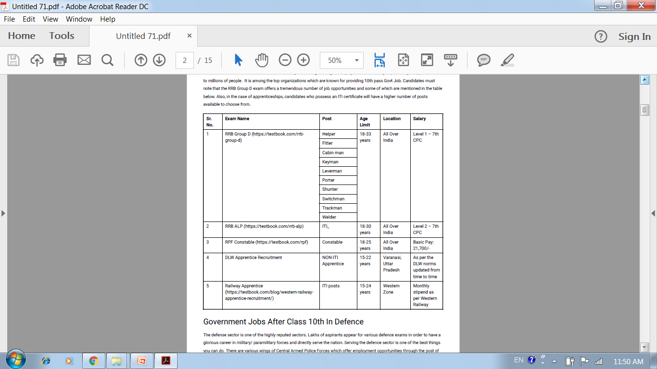
RAILWAYS

Slide 47
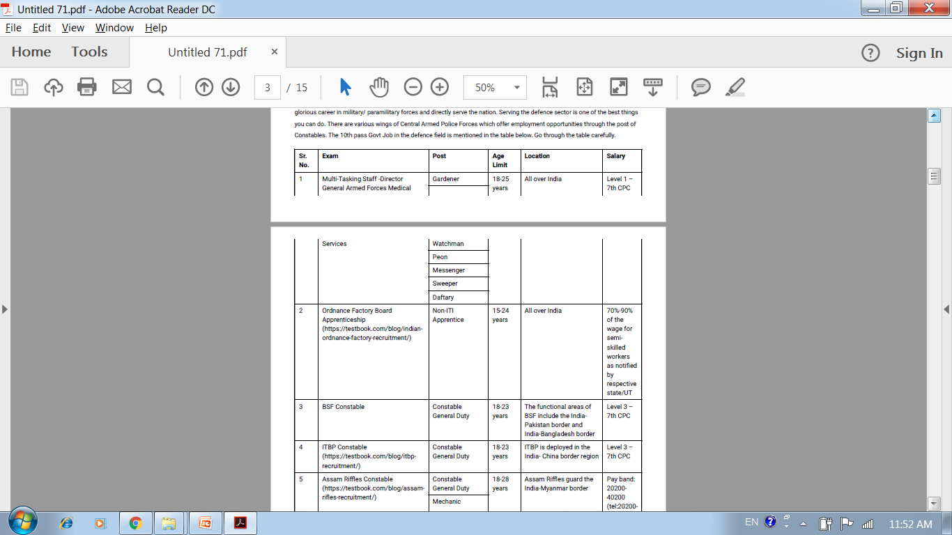
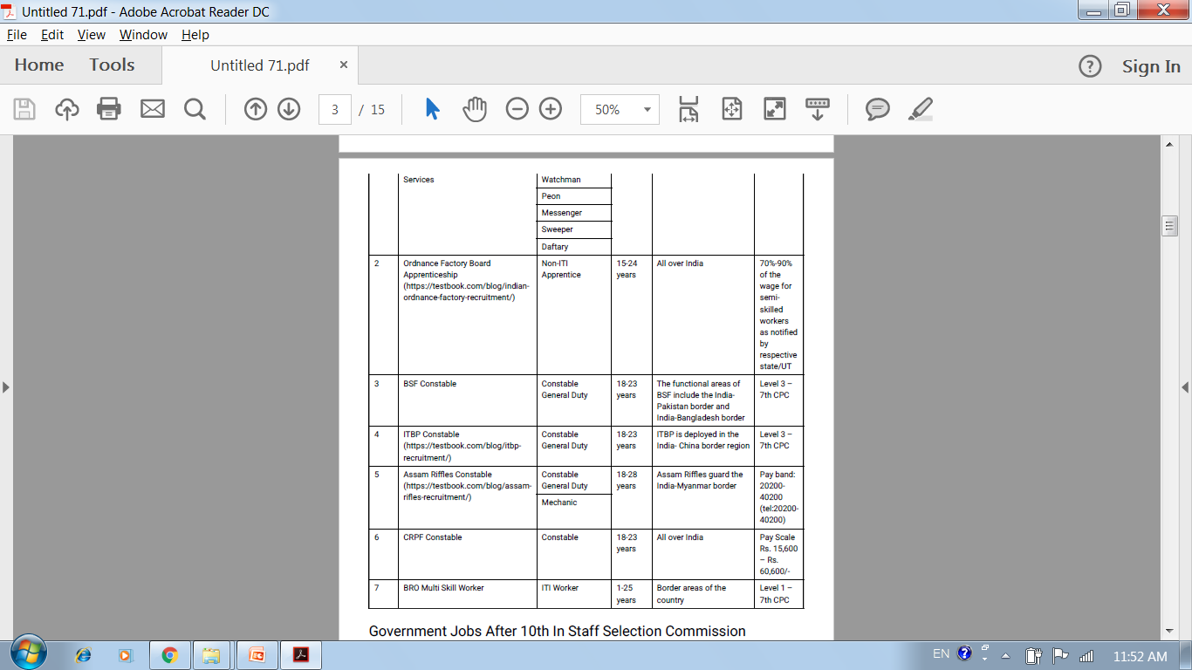
DEFENCE

Slide 48
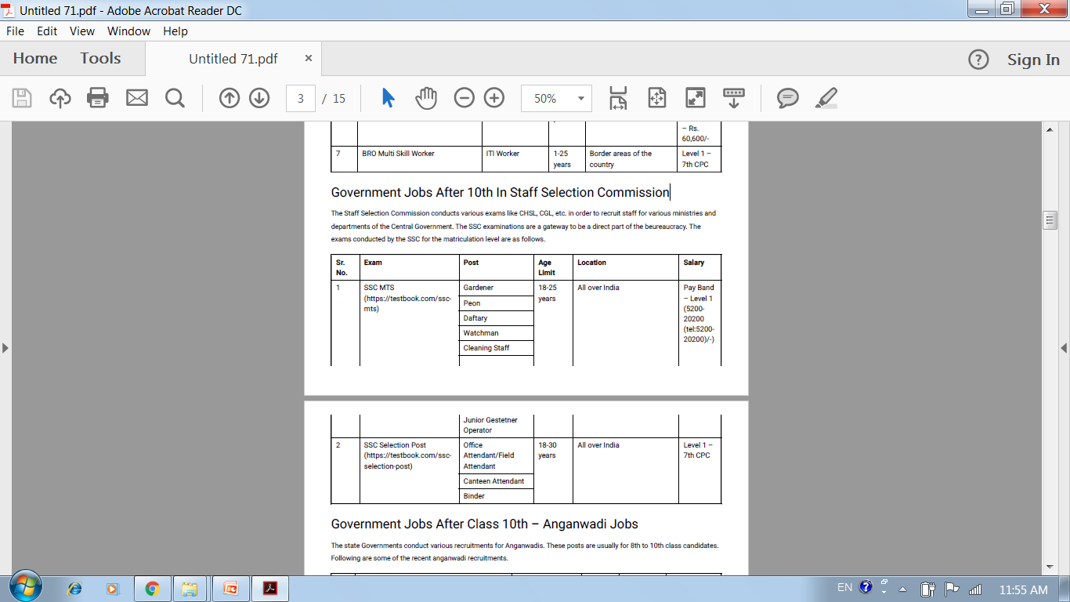
STAFF SELECTION COMMISSION

Slide 49
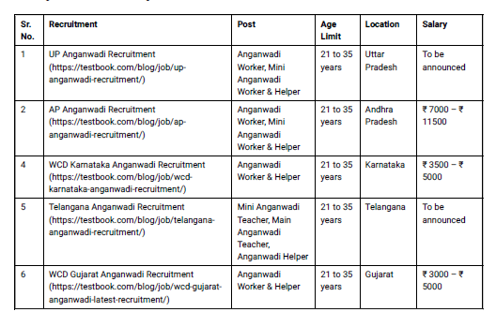
ANGANWADI JOBS

Slide 50
POSTAL DEPT.
Gram Dak Sevak (GDS) After Class 10th
Sr. No. | Post | Age Limit
1 | GDS | 18-40 Years
2 | Multi Tasking Staff (MTS) | 18-25 Years
3 | Postman/MailGuard | 18-27 Years
4 | Dak Sevak | 18-40 Years
5 | Branch Postmaster | 18-40 Years
6 | Assistant Branch Postmaster | 18-40 Years

Slide 51
COURSES AFTER
12th (PUC)

Slide 52
NATIONAL DEFENCE ACADEMY
(NDA)
Degrees | Type of Entry | Age | Eligibility
BA | Indian Army | 16 ½ -19 Yrs | 12th Class pass/appearing of the 10+2 (Any stream)

Slide 53
NATIONAL DEFENCE ACADEMY
(NDA)
Degrees | Type of Entry | Age | Eligibility
B.Sc. | Indian Navy & Naval Academy | 16 ½ -19 Yrs | 12th Class pass/appearing of the 10+2 Physics and Mathematics

Slide 54
NATIONAL DEFENCE ACADEMY
(NDA)
Degrees | Type of Entry | Age | Eligibility
B.E. | Indian Air Force | 16 ½ -19 Yrs | 12th Class pass/appearing of the 10+2 Physics and Mathematics

Slide 55
NATIONAL DEFENCE ACADEMY
(NDA)
Selection Process & Test pattern
Paper 1 Mathematics Paper 2 General ability test, English, G.K. NDA www.upsconline.nic.in | Forms Out : Jan/Feb & Jun/July Last Date : Feb & July Test Date : March/April & Sep/Oct Marks : 900 Forms Available : Online

Slide 56

LAW

Slide 57
IV | L A W
 | Degrees | Duration | Entrance Exams for these Courses
1 | B.Sc. LLB | 5 Years | CLAT
2 | BA LLB | 5 Years | AILET (DELHI)
3 | B.Com. LLB | 5 Years | LSAT (Private College Multilocation)
4 | BBA LLB | 5 Years | SET (Symbiosis Univ Pune)
5 | BLS LLB | 5 Years | MH CET All 5 years Law Schools in Maharashtra
6 | BSW LLB | 5 Years | CUET (Christ Univ Bangalore)
7 | B.Tech. LLB | 6 Years | MSU (MS Univ. Baroda)
 |  |  | UL-SAT (UPES Deharadun)
 |  |  | CET-IP (Guru Govind Singh Indraprastha University Delhi)

Slide 58
IV | L A W
Branchers
 | Constitutional Law Environmental Law International Law Administrative Law Human Rights and Humanitarian Law Business Laws Intellctual Property Laws Labour Law Criminal Law Corporate and Commercial Laws Jurisprudence Cyber Law and Cyber Security

Slide 59
JOURNALISM
Types of Journalism
Journalism is a broad field and includes various sub-fields under it. There are different areas of work involved in Journalism like PHOTO JOURNALIST, VIDEOGRAPHY, EDITING, WRITING, CABLE CASTING ETC. All these programs under Journalism can broadly be divided under three medium heads:
1) Print Media Journalism
Course Program | Duration
B.A. (Journalism) | 3 years
B.A. (Hindi Journalism)
B.A. Hons (Journalism)
B.A. (Journalism & Mass Communication)
B.A. (Journalism & Communication Studies)
B.A. (Mass Media)
B.A. (Script Writing)
BJMC (Advertising & Public Relations)
BJMC (Production & Direction)
B.Sc. (Mass Communication & Journalism)
B.Sc. (Mass Communication, Journalism & Advertising)
Bachelors in Media Science

Slide 60
JOURNALISM
2) Broadcast Media Journalism
Course Program | Duration
M.A. (Journalism) | 2 years
M.A. (Photo Journalism)
M.A. (Convergent Journalism)
M.A. (Journalism & Mass Communication)
M.A. (Mass Communication, Advertising & Journalism)
M.A. (Broadcast Journalism)
M.Sc. (Mass Communication, Journalism & Advertising)
MBA (Media &Communications)
MBA (Mass Media Management)

Slide 61
JOURNALISM
3) Multimedia Journalism
Course Program | Duration
Certificate course (Journalism & Creative Writing) | 6 months-1 year
Certificate course (Science & Sports Journalism)
PG Diploma (Journalism and Mass Communication) | 1 year
PG Diploma (Broadcast journalism)
PG Diploma (Defence Journalism)
PG Diploma (Print Journalism)
PG Diploma (Science & Technology Journalism)
PG Diploma (Print/ Multimedia Journalism)
PG Diploma (Business Journalism)
PG Diploma (New Media Journalism)
PhD (Journalism & Mass Communication) | 3 years

Slide 62
JOURNALISM INSTITUTIONS
Harkisan Mehta Institute of Media, Research and Analysis | https://hmmra.ac.in/
Asian Academy of Film & Television (AAFT) | https://aaft.com/
A.P. College of Journalism | https://apcj.in/
Delhi School of Journalism, Delhi University | http://dsj.du.ac.in/
Indian Institute of Journalism & New Media | https://www.iijnm.org/
St. Xavier’s College | https://www.sxccal.edu/journalism-department/
National School of Journalism | https://www.nationalschoolofjournalism.com/
Asian College of Journalism | https://www.asianmedia.org/
Indian Institute of Mass Communication | http://iimc.nic.in/
Banaras Hindu University | https://www.bhu.ac.in/arts/journalism_mass_comm/

Slide 63

AERONAUTICAL ENGINEERING

Slide 64
AERONAUTICAL COURSES
Aeronautical Engineering Courses List and Course Duration
S.no. | Course | Course Duration
1 | Polytechnic Diploma Course | 3 years (After 10+2)
2 | Under Graduate Degree Courses (B.Tech.) and (B.E) | 4 years (After 10+2)
3 | Post Graduation Degree Courses (M.Tech.) | 2 years (After Completion of UG Degree)
4 | Doctoral Degree courses (PhD) | 1-2 years after completion of PG courses

Slide 65
ELIGIBILITY CRITERIA FOR AERONAUTICAL ENGINEERING COURSES
Senior Secondary School (10+2) or equivalent AICTE approved 3 years of Engineering Diploma in any stream.
2. With Math, Physics and Chemistry as Compulsory subjects from a recognized board.
3. An Aggregate of 70 – 75% marks in Math, Physics and Chemistry in Qualifying examination.
4. The applicant age should be between 16 – 28 at the time of the admission Aeronautical Engineering Courses List and Course Duration

Slide 66
Admission Process for Aeronautical Engineering courses
1. To get admission in Aeronautical Engineering courses, the aspirant must appear in the JEE Main and JEE Advanced score.
2. To enroll for Post Graduate degree courses, the aspirant must qualify for the GATE Exam.
3. Candidates holding a Diploma in Aircraft Maintenance are eligible to acquire degree in Aeronautical Engineering by qualifying for the Examination conducted by the Aeronautical Society of India.
Fee Structure for Aeronautical Engineering Courses
The fee can be INR 60 K to INR 2 Lakhs per year. The fee submission either be annual or Semester wise for some institutes.
Top Colleges/Institutes for Aeronautical Engineering
S.No. | Name of the college
1 | Manipal Institute of Technology, Manipal
2 | Indian Institute of Space, Science and Technology, Thiruvananthapuram
3 | Amity University, Mumbai
4 | Lovely Professional University, Punjab
5 | Indian Institute of Technology, IIT Madras
6 | Indian Institute of Technology, IIT Kanpur
7 | Hindustan Institute of Technology, Chennai
8 | Visveshwaraya Technological University, Belgaum
9 | Andhra University, Visakhapatnam
10 | PES College of Engineering, Karnataka
11 | Malla Reddy College of Engineering, Hyderabad
12 | NITTE Meenakshi Institute of Technology, Bangalore
13 | Indian Institute of Technology, IIT Kharagpur
14 | Indian Institute of Technology, IIT Bombay

Slide 67
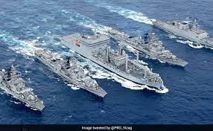
MARINE

Slide 68
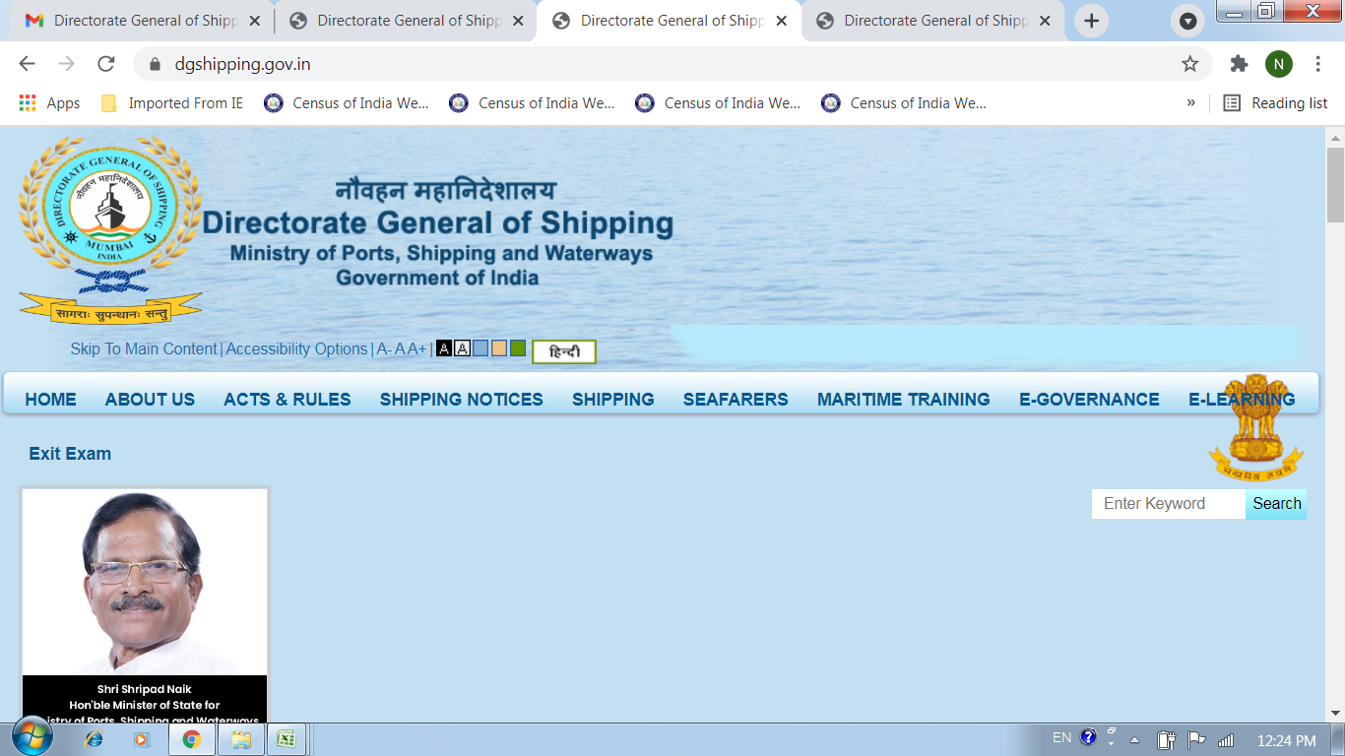
MARITIME COURSES
Approved Course List
Sr.No. | Name of Course | Duration
1 | BE / B-Tech Marine Engineering | 4 Years
2 | B.Sc (Maritime Science) - Polyvalent Course | 3 Years
3 | B.Sc Nautical Science | 3 Years
4 | Higher National Diploma Course (Marine Engineering) | 2 Years
5 | Higher National Diploma Course (Nautical Science) | 2 Years
6 | Pre-sea Training for Diploma Holders | 2 Years
7 | Diploma In Nautical Science | 1 Year
8 | Extra Chief Engineer | 1 Year
9 | Graduate Marine Engineering | 1 Year
10 | Certificate Course In Maritime Caterring | 6 Months
11 | Mate of Home Trade ship - NCV | 6 Months
12 | Training for General Purpose Ratings | 6 Months
13 | MEO Class - II | 4 Months
14 | MEO Class - III (CEO - NCV) | 4 Months
15 | MEO Class - III (SEO - NCV) - Part B | 4 Months
16 | MEO Class - IV (NCV) | 4 Months
17 | Navigational Watchkeeping Officer- NCV | 4 Months
18 | Second Mate (FG) Competency Course | 4 Months
19 | Chief Mate (FG) - Phase I | 3 Months
20 | Chief Mate (FG) - Phase II | 3 Months

Slide 69
Sr.No. | Name of Course | Duration
21 | Competency Course for Chief Mate NCV Phase 2 exam | 3 Months
22 | Electro Technical Officers | 85 Days
23 | Bridging Course for ATS candidates | 2 Months
24 | Chief Mate (NCV) Course for Indian Naval Officers | 2 Months
25 | MEO Class - I | 2 Months
26 | MEO Class - III (SEO - NCV) - Part A | 2 Months
27 | Second Mate (FG) Foundation Course | 2 Months
28 | Special ETO Bridging Course for not qualifying eligibility | 5 Weeks
29 | Master (NCV) Advanced Shipboard Management | 1 Month
30 | Master FG Advanced Shipboard Management | 1 Month
31 | Induction Course - Mech 3 / ERA 3 to MEO Class - IV (NCV) | 2 Weeks
32 | Ship`s Cook | 2 Weeks
33 | Bridging Course for Existing Electrical Officers to ETO | 16 Days
34 | Restricted Operator Certificate Course for GMDSS | 14 Days
35 | General Operator`s Certificate for GMDSS | 12 Days
36 | Orientation Course for Catering Personal | 12 Days
37 | Basic Safety Training | 11 Days
38 | Refresher &Updating Training Course for Engineers-Management | 11 Days
39 | Refresher &Updating Training Course for Master &Deck Officer | 11 Days
40 | Advanced Training for Chemical Tanker Cargo Operations | 10 Days
41 | Advanced Training for Liquified Gas Tanker Cargo Operations | 10 Days
42 | Advanced Training for Oil Tanker Cargo Operations | 10 Days
43 | Assessment, Examination and Certification of Seafarers | 10 Days
44 | Medical Care | 10 Days
45 | Radar Observer Simulator | 10 Days
46 | Vertical Integration Course for Trainers - VICT | 10 Days
47 | Marine Bioler & Steam Engineering. Course - Management level | 9 Days
48 | Crisis Management and Human Behaviour | 1 Week
49 | Simulator- Liquid Cargo Handling - Gas - Management level | 1 Week

Slide 70
Sr.No. | Name of Course | Duration
50 | Basic Offshore Safety Course | 6 Days
51 | Basic Training for Oil and Chemical Tanker Cargo Operations | 6 Days
52 | Marine Bioler & Steam Engineering Course - Operational level | 6 Days
53 | Radar and Navigation Simulator | 6 Days
54 | Refresher & Updating Course for Engineers -Operational level | 6 Days
55 | Advanced Training course for Ships Operating in Polar waters | 5 Days
56 | Advanced Trg. for Ships using Fuels covered within IGF code | 5 Days
57 | Automatic Radar Plotting Aids | 5 Days
58 | Basic Training for Liquified Gas Tanker Cargo Operations | 5 Days
59 | Basic Training for Ships Operating in Polar water Course | 5 Days
60 | Chemical Tanker Cargo and Ballast handling Simulator | 5 Days
61 | Electronic Chart Display and Information Systems | 5 Days
62 | Engine Room Simulator - Management level | 5 Days
63 | Familiarization Training Programme For LNG Tanker Operation | 5 Days
64 | High Voltage Safety and Switch Gear at Management level | 5 Days
65 | LNG Tanker Cargo and Ballast handling Simulator | 5 Days
66 | LPG Tanker Cargo and Ballast handling Simulator | 5 Days
67 | Proficiency In Survival Craft and Rescue Boats | 5 Days
68 | Refresher and Updating Training Course for Nautical Officers | 5 Days
69 | Ship Manoeuvering Simulator | 5 Days
70 | Simulator- Liquid Cargo Handling - Oil - Management level | 5 Days
71 | Train the Simulator Trainer and Assessor Course | 5 Days
72 | Advanced Training in Fire Fighting | 4 Days
73 | Basic Trainig for Ships using Fuels covered within IGF code | 4 Days
74 | Medical First Aid | 4 Days
75 | Company Security Officer | 3 Days
76 | Crowd Management, Passenger Safety and Safety Training | 3 Days
77 | Diesel Engine Combustion Gas Simulator | 3 Days
78 | Engine Room Simulator - Operational level | 3 Days

Slide 71
Sr.No. | Name of Course | Duration
79 | Fast Rescue Boats | 3 Days
80 | Port Facility Security Officer | 3 Days
81 | Refresher and Updating Training Course for all Engineers | 3 Days
82 | Security Trng. for Seafarer with Designated Security Duties | 2 Days
83 | Ship Security Officer | 2 Days
84 | Augmentation of FPFF (Practical Tanker Fire Fighting) | 1 Day
85 | Familiarization Course for Medical Examiner of Seafarers | 1 Day
86 | High Voltage Safety and Switch Gear at Operational level | 1 Day
87 | Refresher Course for Medical Examiner of Seafarers | 1 Day
88 | Refresher in Proficiency in Fast Rescue Boat | 1 Day
89 | Engineering Management Course for CEO (NC Class III) | Day
90 | Indian Maritime Legislation Course | 18 Hours
91 | Refresher Training for Medical Care | 6 Hours
92 | Refresher Training For Proficiency In PSCRB | 4.5 Hours
93 | Refresher Training for Advanced Training in Fire Fighting | 4 Hours
94 | Refresher Training for Medical First Aid | 3 Hours
95 | Refresher Training for Proficiency in FPFF | 3 Hours
96 | Refresher Training for Proficiency in PST | 2 Hours

Slide 72
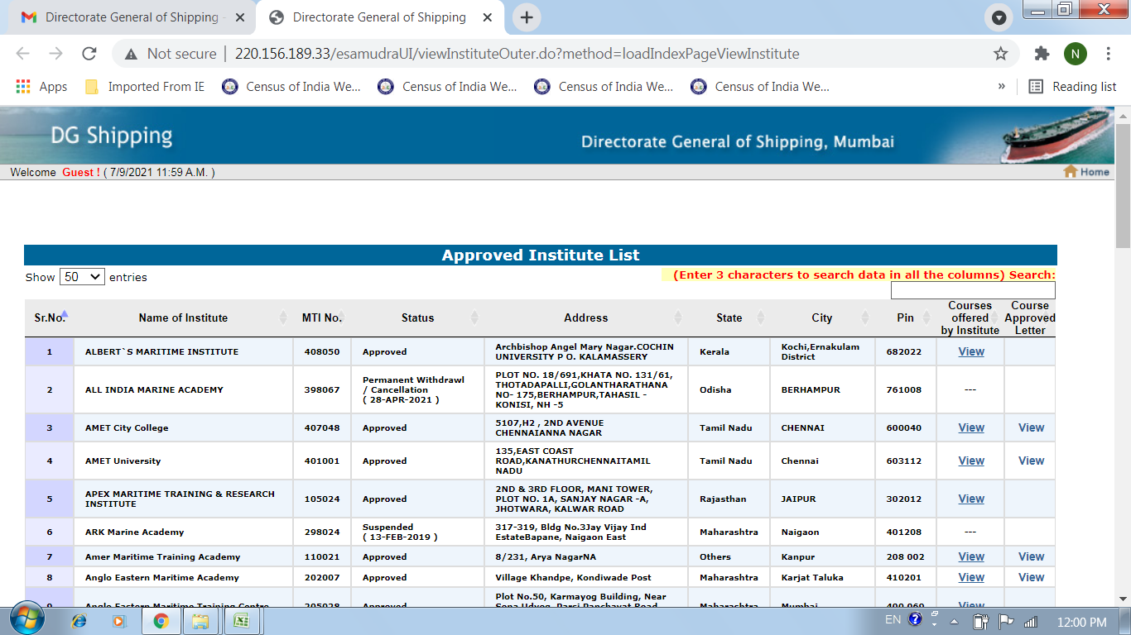
Sr.No. | Name of Institute | State | City
1 | ALBERT`S MARITIME INSTITUTE | Kerala | Kochi,Ernakulam District
2 | ALL INDIA MARINE ACADEMY | Odisha | BERHAMPUR
3 | AMET City College | Tamil Nadu | CHENNAI
4 | AMET University | Tamil Nadu | Chennai
5 | APEX MARITIME TRAINING & RESEARCH INSTITUTE | Rajasthan | JAIPUR
6 | ARK Marine Academy | Maharashtra | Naigaon
7 | Amer Maritime Training Academy | Others | Kanpur
8 | Anglo Eastern Maritime Academy | Maharashtra | Karjat Taluka
9 | Anglo Eastern Maritime Training Centre | Maharashtra | Mumbai
10 | Anglo Eastern Maritime Training Centre | Delhi | NEW DELHI
11 | Anvay Maritime Institute | Maharashtra | NAVI MUMBAI
12 | Applied Research International | Delhi | New Delhi
13 | Applied Research International - School of Higher Academic & Professional Education - I | Delhi | New Delhi
14 | Aquasis Maritime Institute | Jharkhand | RANCHI
15 | Aquatech Institute of Maritime Studies | Delhi | New Delhi
16 | Arya Marine Academy | Maharashtra | Mumbai
17 | Asha International Institute of Marine Technology | Uttar Pradesh | Varanasi
18 | Asha International Institute of Marine Technology | Maharashtra | NAVI MUMBAI
19 | BP Marine Academy | Maharashtra | Navi Mumbai
20 | BP Marine Academy - Panvel | Maharashtra | NAVI MUMBAI
21 | Baba Marine Institute | Maharashtra | Navi Mumbai
22 | Balaji Seamen Training Institute | Tamil Nadu | Chennai
23 | Behara Institute of Maritime Training | Andhra Pradesh | VIZIANAGARAM
24 | CMC Maritime Academy, Chennai (Campus) | Tamil Nadu | CHENNAI
25 | CV Raman College of Engineering | Odisha | Bhubaneshwar

Slide 73
Sr.No. | Name of Institute | State | City
26 | Centre For Maritime Training Noida | Uttar Pradesh | NOIDA
27 | Centre for Maritime Education And Training | Uttar Pradesh | Lucknow
28 | Chennai School of Ship Management | Tamilnadu | Chennai
29 | Chidambaram Institute of Maritime Technology | Tamilnadu | Chennai
30 | Chitkara University School of Maritime Studies | Punjab | Rajpura
31 | Cochin Shipyard Limited | Kerala | KOCHI
32 | Coimbatore Marine College | Tamil Nadu | Coimbatore
33 | College of Maritime Studies And Research | West Bengal | Kolkata
34 | Columbus Maritime Training Institutes | Maharashtra | SHAHAPUR
35 | Commander Ali`s Acadmy of Merchant Navy | Telangana | Hyderabad
36 | Coral Maritime Institute of Learning And Development | Maharashtra | NAVI MUMBAI
37 | Cosmopolitan Technology of Maritime | Tamil Nadu | SRIPERUMBADUR
38 | DR. B.R. Ambedkar Institute of Technology | A&N | Port Blair
39 | Don Bosco Normar Maritime Academy | Maharashtra | Mumbai
40 | Euro Tech Maritime Academy | Kerala | COCHIN
41 | Fleet Management Training Institute | Maharashtra | Navi Mumbai
42 | Fosma Maritime Institute & Research Organisation | Uttar Pradesh | NOIDA
43 | Fosma Maritime Institute & Research Organisation (Kol) | West Bengal | KOLKATA
44 | Francon's Marine Academy | Goa | Goa
45 | GKM College of Engineering And Technology | Tamil Nadu | Chennai
46 | GKM Institute of Marine Sciences And Technology | Tamil Nadu | CHENNAI
47 | Garden Reach Ship Builders & Engineers Ltd | West Bengal | Kolkata
48 | Girik Maritime Academy | Maharashtra | NAVI MUMBAI
49 | Good Result Maritime Academy | DELHI | NEW DELHI
50 | Gurship Education Trust Maritime Training Institute | Maharashtra | MUMBAI

Slide 74
Sr.No. | Name of Institute | State | City
51 | HIMT College | Tamil Nadu | Kalpakkam
52 | HIMT Tidal Park | Tamil Nadu | Chennai
53 | HSNA Maritime Education & Research -Mumbai | Maharashtra | NAVI MUMBAI
54 | HSNA Maritime Education And Research | Uttar Pradesh | LUCKNOW
55 | Haldia Institute of Maritime Studies & Research | West Bengal | Haldia
56 | Hindustan Institute of Maritime Training | Tamil Nadu | Chennai
57 | Hoon Maritime Institute | West Bengal | KOLKATA
58 | IMU , Kolkata Campus | West Bengal | Kolkata
59 | IMU, Mumbai Campus | Maharashtra | Mumbai
60 | IMU, Navi Mumbai Campus | Maharashtra | Navi Mumbai
61 | Immanuel Arasar College of Marine Engineering | Tamil Nadu | MARTHANDAM
62 | Indian Institute of Port Management (IMU Kolkata) | West Bengal | Kolkata
63 | Indian Maritime College | Tamil Nadu | Chennai
64 | Indian Maritime University(Kochi) | Kerala | KOCHI
65 | Indian Maritime University,Chennai (NIPM /NMA) | Tamil Nadu | Chennai
66 | Indian Register of Shipping | Maharashtra | Mumbai
67 | Indus Seafarers Training Academy | Tamil Nadu | CHENNAI
68 | Institute of Marine Education And Research | Bihar | Patna
69 | Institute of Marine Education And Research Lucknow | Uttar Pradesh | LUCKNOW
70 | Institute of Marine Engineers(India) Cochin | Kerala | Kochi
71 | Institute of Maritime Studies | Goa | Vasco da Gama
72 | Institute of Petrolium Safety And Enviornment Management(ONGC) | Goa | Betul
73 | International Marine Academy | Maharashtra | Mumbai
74 | International Maritime Academy | Tamil Nadu | Chennai
75 | International Maritime Foundation of Marine Education | Maharashtra | Navi Mumbai

Slide 75
Sr.No. | Name of Institute | State | City
76 | International Maritime Institute | Uttar Pradesh | Greater Noida
77 | International Maritime Training Centre | Maharashtra | Mumbai
78 | J.Sons Merchant Navy Institute | Uttar Pradesh | Meerut
79 | Jeyanthinather Academy of Marine Studies | Tamil Nadu | THOOTHUKUDI
80 | K.A.Maritime Academy | GOA | CORTALIM
81 | KCM College of Education | Uttar Pradesh | LUCKNOW
82 | Kanak Education Foundation | HARYANA | SONEPAT
83 | Kunjali Marakkar School of Marine Engineering | Kerala | KOCHI
84 | Loyalty Marine Education Trust | Maharashtra | NAVI MUMBAI
85 | Loyalty Marine Education Trust - PRE SEA | Maharashtra | SUDHAGAD
86 | M/S Asha Marine College Owned By The RMU Charitable Trust | Sikkim | EAST SIKKIM
87 | M/S. Blue Water Marine Academy | HARYANA | JIND
88 | M/S. Bravo Maritime Academy | Maharashtra | Nerul (E)
89 | M/S. Pragati Marine College | Maharashtra | NAVI MUMBAI
90 | MARINE ENGINEERING AND RESEARCH INSTITUTE, MUMBAI | Maharashtra | Mumbai
91 | MASSA Maritime Academy | Maharashtra | Navi Mumbai
92 | MERCANTILE MARINE ACADEMY | West Bengal | KOLKATA
93 | MMTI'S Education & Research Trust,Khopoli | Maharashtra | KHOPOLI
94 | MTI | Maharashtra | MUMBAI
95 | MVVS Maritime Academy | Maharashtra | MIRA ROAD-EAST
96 | Maharashtra Academy of Naval Education & Training | Maharashtra | Pune
97 | Mainstay Training Institute | TAMIL NADU | CHENNAI
98 | Mangalore Marine College And Technology | Karnataka | MANGALORE
99 | Mangalore Marine College Mumbai Campus | MAHARASTRA | MUMBAI
100 | Marina Academy of Maritime Research Centre and Charitable Trust | Gujarat | AHMEDABAD

Slide 76
Sr.No. | Name of Institute | State | City
101 | Marine Education Charitable Trust (Extended Campus) | West Bengal | KOLKATA
102 | Marine Educational Charitable Trust | West Bengal | Kolkata
103 | Marine Medical Clinic | Maharashtra | Mumbai
104 | Marine Officer Training Academy | Puducherry | Pondicherry
105 | Marine Training Academy | Maharashtra | Mumbai
106 | Marine Training Academy | Gujarat | UDVADA
107 | Maritime Academy of India | West Bengal | Kolkata
108 | Maritime Education Training And Research Institute | West Bengal | 24Pargans(S)
109 | Maritime Foundation | Tamil Nadu | Chennai
110 | Maritime Training Institute [SCI] (Tuticorin Campus) | TAMIL NADU | TUTICORIN
111 | Massa Maritime Academy | Tamil Nadu | CHENNAI
112 | Mohammad Sathak Engineering College | Tamil Nadu | Kilakarai
113 | Mumbai Maritime Training Institute | Maharashtra | Mumbai
114 | NUSI Maritime Academy | Goa | GOA
115 | Natcom Education & Research Foundation | Haryana | GURUGRAM
116 | National Inland Navigation Institute | Bihar | PATNA
117 | National Ship Design And Research Centre | AP | Visakhapatnam
118 | Naval Maritime Academy East | AP | Visakhapatnam
119 | Naval Maritime Academy West | Maharashtra | Mumbai
120 | Navigator Maritime Academy | Uttar Pradesh | AGRA
121 | Navyug Vidyapeeth Trust | MAHARASTRA | MAHAD
122 | Noorul Islam College of Engineering | Tamil Nadu | Kanyakumari
123 | Northern Maritime Training College | Uttar Pradesh | AGRA
124 | OERC Academy | Maharashtra | NAVI MUMBAI
125 | Ocean Dream Marine Training Institute | Maharashtra | NAVI MUMBAI

Slide 77
Sr.No. | Name of Institute | State | City
126 | Oceana Maritime Training Institute | Maharashtra | NAVI MUMBAI
127 | Oceanic Maritime Academy | Uttarakhand | Dehradun
128 | Oceans XV Educational Trust | Delhi | NEW DELHI
129 | Orissa Maritime Academy | Odisha | Paradeep
130 | PENTAGON MARITIME TRAINING & RESEARCH INSTITUTE | Maharashtra | Navi Mumbai
131 | PSN College of Engineering And Technology | Tamil Nadu | Tirunelvelli
132 | Park Maritime Academy | Tamil Nadu | COIMBATORE
133 | Pentagon Marine Services Pvt. Ltd. | Maharashtra | NAVI MUMBAI
134 | Perunthalaivar Kamarajar Institute of Maritime Science And Enginerring | Tamil Nadu | CHIDAMBARAM
135 | Pondicherry Maritime Academy | Tamil Nadu | PUDUCHERRY
136 | Praveenya Institute of Marine Engineering & Maritime Studies (PRIME) | Andhra Pradesh | VISAKHAPATNAM
137 | R.L. Institute of Nautical Sciences | Tamil Nadu | Madurai
138 | R.M Maritime Academy | Maharashtra | NAVI MUMBAI
139 | Ramana Academy of Maritime Studies | Maharashtra | NAVI MUMBAI
140 | S.P. Marine Academy | Gujarat | JUNAGADH
141 | SCMS Maritime Training Institute | Maharashtra | Mumbai
142 | SCMS NADHAL MTI | Maharashtra | PANVEL
143 | SEA SCAN MARITIME FOUNDATION | Goa | VERNA
144 | SEASCAN MARINE FOUNDATION | Goa | VASCO
145 | SEI Educational Trust | West Bengal | KOLKATA
146 | SEI Educational Trust Faridabad | Haryana | FARIDABAD
147 | SNS Maritime Training Institute | Maharashtra | Navi Mumbai
148 | Sagar Ocean Maritime Academy | Maharashtra | PANVEL
149 | Sailors Maritime Academy | Andhra Pradesh | Vizianagaram
150 | Sakshi Institute of Maritime Foundation | Maharashtra | MUMBAI

Slide 78
Sr.No. | Name of Institute | State | City
151 | Samundra Institute of Maritime Studies | Maharashtra | Lonavala
152 | Samundra Institute of Maritime Studies | Maharashtra | MUMBAI
153 | School of Higher Academic And Professional Education (SHAPE) | Haryana | PANCHKULA
154 | School of Seamanship & Nautical Technology | Tamil Nadu | MADURANTHAKAM
155 | School of Synergic Studies | Maharashtra | Mumbai
156 | Seacom Marine College | West Bengal | Kolkata
157 | Seacom Marine College, Howrah | West Bengal | HOWRAH
158 | Seacom Skills University | WEST BENGAL | BOLPUR
159 | Seagulll Marine Academy | Maharashtra | NAVI MUMBAI
160 | Seaskills Maritime Academy | Tamil Nadu | COIMBATORE
161 | Sensea Maritime Academy | West Bengal | Kolkata
162 | Sensea Maritime Academy | West Bengal | KOLKATA
163 | Setrac College of Offshore Training | Maharashtra | NAVI MUMBAI
164 | Shri Mahavir Marine Educational Trust | UTTAR PRADESH | GREATER NOIDA
165 | Southern Academy of Maritime Studies | Tamil Nadu | CHENNAI
166 | Springdale Academy of Maritime Education and Training(SAMET) | Odisha | Bhubaneswar
167 | Sri Chakra Maritime College | Tamil Nadu | Auroville
168 | Sri Nandhanam College of Engineering And Technology | Tamil Nadu | Tirupattur
169 | Sriram Institute of Marine Studies | Delhi | Delhi
170 | Srivenkateshwara College of Engineering | Tamil Nadu | Sriperumbadur
171 | Sun Marine Academy | Maharashtra | NAVI MUMBAI
172 | Suraksha Marine | Maharashtra | Vasai
173 | TS Rahaman | Maharashtra | Mumbai
174 | Tamil Nadu Maritime Academy | Tamil Nadu | Tuticorin
175 | The Great Eastern Institute of Maritime Studies | Maharashtra | Lonavala

Slide 79
Sr.No. | Name of Institute | State | City
176 | The Great Eastern Shipping Company Ltd. | MAHARASHTRA | MUMBAI
177 | The Institute of Marine Engineers(India) | Maharashtra | NAVI MUMBAI
178 | The Neotia University | West Bengal | Kolkata
179 | Tolani Maritime Institute | Maharashtra | Pune
180 | Tolani Maritime Institute | MAHARASTRA | MUMBAI
181 | Trident College of Marine Technology | West Bengal | 24 Pargnas(S)
182 | Trident Institute of Maritime Studies | Maharashtra | NAVI MUMBAI
183 | U.V. Patel College of Engineering | Gujarat | MEHSANA
184 | United Marine Academy | Maharashtra | Navi Mumbai
185 | Univan Maritime Training Academy | Kerala | Kochi
186 | Urmila Institutes of Maritime Studies | Bihar | PATNA
187 | VIJAYATILAK MARITIME ACADEMY | Maharashtra | VASAI VIRAR
188 | VIZAG HIMT | Andhra Pradesh | Visakhapatnam
189 | Varuna Institute of Maritime Studies | Tamil Nadu | Chennai
190 | Vels Academy of Maritime Education And Training | Tamil Nadu | Chennai
191 | Vishwakarma Maritime Institute | Maharashtra | PUNE
192 | Yak Educational Trust | Maharashtra | Raigad
193 | Yak Management And Marine Education Centre | Maharashtra | Navi Mumbai
194 | Zasha Institute of Maritime Studies | Uttarakhand | DEHRADUN

Slide 80

MEDICAL

Slide 81
I | SCIENCE -A GROUP (Physics, Chemistry & Biology)
 | MEDICAL | Duration | Entrance Exams for these Courses
1 | MBBS (Bachelor of Medicine & Bachelor of Surgery) | 5½ Years | NEET AIIMS JIPMER CET KSET
2 | BDS (Bachelor of Dental Surgery) | 5 Years
3 | BAMS (Bachelor of Ayurvedic Medicine & Surgery) | 5½ Years
4 | BSMS (Bachelor of Siddha Medicine & Surgery) | 5½ Years
5 | BNYS (Bachelor of Naturopathy & Yogic Sciences) | 5 Years
6 | BHMS (Bachelor of Homeopathic Medicine & Surgery) | 5½ Years
7 | BUMS (Bachelor of Unani Medicine & Surgery) | 5½ Years
8 | B. Sc. (Nursing) (Bachelor of Science (Nursing)) | 4 Years
9 | B. Optom. (Bachelor of Optometry) | 4 Years
10 | BOT (Bachelor of Occupational Therapy) | 4 Years
11 | BPT (Bachelor of Physiotherapy) | 4½ Years
12 | B.Sc. (Trauma Care Management) | 4 Years
13 | B.Sc. Hospital Management | 3 Years
14 | B.Sc. Anesthesia Tech | 3 Years
15 | B.Sc. Cath Lab Tech | 3 Years
16 | B.Sc. Nuclear Medicine | 3 Years
17 | B.Sc. OT | 3 Years
18 | B.Sc. Radio Therapy | 3 Years
19 | B.Sc. Renal Dialysis | 3 Years
20 | B.Sc. Respiratory Care | 3 Years
21 | B. Pharma (Bachelor of Pharmacy) | 4 Years
22 | B. Pharm (Ayu) (Bachelor of Pharmacy(Ayurveda)) | 4 Years
23 | B.P.O (Bachelor in Prosthetics & Orthotics) | 4 Years
24 | B. ASLP (Bachelor in Audiology & Speech Language pathology) | 4 Years
25 | B. R. Sc. (Bachelor in Rehabilitation Science) | 3 Years
26 | B.Sc. (Agriculture) ((Bachelor of Science (Agriculture)) | 4 Years
27 | B. Sc. (Sericulture) ((Bachelor in Science (Sericulture)) | 4 Years
28 | B. V. Sc. (Bachelor of Veterinary Sciences) | 4 Years
29 | B. F. Sc. (Bachelor of Fisheries Sciences) | 4 Years

Slide 82
Auxiliary Nursing Midwifery (ANM) & General Nursing Midwifery (GNM)
Comparative Overview of ANM & GNM
 | ANM | GNM
 | Diploma | Diploma
Duration of Course | 2 years | 3.5 years
Minimum qualifying marks | 50% in 10th or 12th | 40% in 12th
Subjects required | Science/ Arts | PCB
Eligibility | 10th or 10+2 | 10+2

Slide 83
Colleges Providing Admission in ANM & GNM
Armed Forces Medical College | Pune
Baba Farid University of Health Sciences | Punjab
Indira Gandhi Institute of Medical Sciences | Patna
Jawaharlal Nehru Institute of Postgraduate Medical Education & Research | Puducherry
King George’s Medical University | Uttar Pradesh
Lady Hardinge Medical College | Delhi
Madras Medical College | Chennai
NIMS University | Rajasthan
Rajiv Gandhi University of Health Sciences | Bengaluru

Slide 84
MEDICAL LAB TECHNOLOGY COURSE
Sl. No. | Name of the College | Place
1 | A.J. Institute of Medical Sciences {MLT Course} | Mangalore
2 | Alva’s College of Medical Laboratory Technology. Alva’s Health Center | Moodbidri
3 | Acharya Institute of Health Sciences College of MLT | Bangalore
4 | Dr.B.R.Ambedkar Medical College, {Dept of MLT}, {Dr. B.R.AMC Campus} | Bangalore
5 | City College of MLT City Enclave | Mangalore
6 | St. John’s Medical College {B Sc MLT Course} | Bangalore
7 | Bangalore Medical College & Research Institute, {MLT Course} | Bangalore
8 | Fr.Muller’s Medical College {B Sc MLT} | Mangalore
9 | Padmashree College of MLT | Bangalore
10 | Navodaya Medical College {B Sc MLT} | Raichur
11 | Sri Jayadeva Institute of Cardiology {MLT Course} | Bangalore
12 | Kempegowda Institute of Medical Sciences {B Sc MLT} | Bangalore
13 | Kidwai Memorial Institute of Oncology, {MLT Course} | Bangalore
14 | M.V. Shetty Institute of Health Sciences, {B Sc MLT Courses} | Mangalore
15 | Sri Sathya Sai Institute of Higher Medical Sciences, {B Sc MLT} | Bangalore
16 | Fortis Institute of Medical Sciences {B Sc MLT} | Bangalore
17 | Indira Gandhi Institute of Child Health, {B SC MLT} | Bangalore
18 | Nitte Institute of Medical Laboratory Sciences, K.S.Hegede Medical Sciences | Mangalore
19 | Acharya Institute of Health Sciences College of B Sc Imaging Technology, | Bangalore
20 | Dr.B.R.Ambedkar Medical College, {B Sc Imaging Technology Course} | Bangalore
21 | A.J. Institute of Medical Sciences {B Sc Imaging Technology Course} | Mangalore
22 | Fr.Muller’s Medical College {B Sc Imaging Technology Course} | Mangalore

Slide 85
COURSES UNDER PARA MEDICAL BOARD
Courses coming under the jurisdiction of the Para Medical Board are:
1 | Diploma in Medical Laboratory Technology.
2 | Diploma in X-Ray Technology.
3 | Diploma in Health Inspector.
4 | Diploma in Medical Records Technology.
5 | Diploma in Operation Theater & Anaesthesia Technology.
6 | Diploma in Dialysis Technology.
7 | Diploma in Ophthalmic Technology.
8 | Diploma in Dental Mechanics.
9 | Diploma in Dental Hygiene.
DURATION OF THE COURSES
The duration of the above courses will be of two years for PUC candidates.

Slide 86
Paramedical Courses List After 12th Science
S.No. | Course
1 | BSc (Hons) Nursing
2 | BSc (Hons) Paramedical Science
3 | BSc in Operation Theatre Technology
4 | BSc in Cardiac Technology
5 | BSc in Physician Assistant
6 | BSc in Medical Imaging Technology
7 | BSc in Medical Lab Technology
8 | BSc in Anesthesia
9 | BSc in Medical Record Technology
10 | BSc in Cardiovascular Technology
11 | BSc in Nuclear Medicine Technology
12 | BSc in Neurophysiology Technology
13 | BSc in Dialysis Technology
14 | BSc in Ophthalmic Technology
15 | BSc in Audiology and Speech Therapy
16 | BSc in Occupational Therapy
17 | BSc in Radiology
18 | BSc in Radiography
19 | BSC Optometry
20 | Bachelor of Paramedicine
21 | Bachelor of Paramedical Technology
22 | Bachelor of Physiotherapy
23 | Bachelor of Health in Paramedicine (Hons)

Slide 87
PHYSIOTHERAPY COURSES
Courses Available
Diploma | Diploma in Physiotherapy | DPT - 2 Years
UG | Bachelors in Physiotherapy | BPT - 4 Years
PG | Masters in Physiotherapy | MPT - 2 Years
TOP COLLEGES FOR PHYSIOTHERAPY COURSES
Christian Medical College, Vellore
Sanskriti University, Mathura
Kasturba Medical College, Mangalore
Chandigarh University, Chandigarh
Madras Medical College, Chennai
GGS Indraprastha University, New Delhi
St. Johns Medical College, Bangalore

Slide 88
PHARMACEUTICAL MANAGEMENT
Pharmaceutical Management Courses & Eligibility
Diploma in Pharmaceutical Management
Advanced Diploma in Pharmaceutical Business Management
BBA plus Diploma in Business Administration (Pharmaceutical)
Master of Business Administration in Pharmaceutical Management Executive
Master of Business Administration in Pharmaceutical Management
Post Graduate Diploma in Pharmaceutical Management
MBA in Pharmaceutical Industry Management
PG Course in Pharmaceutical Management
Post Graduate Diploma in Pharmaceutical Management
Eligibilities Required
For UG courses: 12th standard from a recognized board. at least 50% aggregate in the qualifying examination.

Slide 89

ENGINEERING

Slide 90
COURSES IN ENGINEERING
II | SCIENCE -B GROUP (Physics, Chemistry & Mathematics)
S.No. | ENGINEERING | Duration | Entrance Exams for these Courses
1 | B. E. / B. Tech. Artificial Intelligence (AI) | 4 Years | JEE CET KSET BITSAT VIT Symbiosis SRM NATA
2 | B. E. / B. Tech. Cyber Security
3 | B. E. / B. Tech. Computer Science | 4 Years
4 | B. E. / B. Tech. Aeronautical | 4 Years
5 | B. E. / B. Tech. Aerospace | 4 Years
6 | B. E. / B. Tech. Marine | 4 Years
7 | B. E. / B. Tech. Naval Architecture | 4 Years
8 | B. E. / B. Tech. Ocean Engineering | 4 Years
9 | B. E. / B. Tech. Petroleum | 4 Years
10 | B. E. / B. Tech. Electronics & Communication | 4 Years
11 | B. E. / B. Tech. Electronics & Electricals | 4 Years
12 | B. E. / B. Tech. Electronics & Instrumentation | 4 Years
13 | B. E. / B. Tech. Mechanical | 4 Years
14 | B. E. / B. Tech. Civil | 4 Years
15 | B. E. / B. Tech. Chemical | 4 Years
16 | B. E. / B. Tech. Architecture | 4 Years
17 | B. E. / B. Tech. Automobile | 4 Years
18 | B. E. / B. Tech. Metallurgical | 4 Years
19 | B. E. / B. Tech. Mineral | 4 Years
20 | B. E. / B. Tech. Mining | 4 Years

Slide 91
S.No. | ENGINEERING | Duration | Entrance Exams for these Courses
21 | B. E. / B. Tech. Industrial Instrumentation | 4 Years | JEE CET KSET BITSAT VIT Symbiosis SRM NATA
22 | B. E. / B. Tech. Ceramic | 4 Years
23 | B. E. / B. Tech. Polymer | 4 Years
24 | B. E. / B. Tech. Plastic | 4 Years
25 | B. E. / B. Tech. Bio-Technology | 4 Years
26 | B. E. / B. Tech. Bio-Medical
27 | B. E. / B. Environment
28 | B. E. / B. Tech. Textile Engineering | 4 Years
29 | B. E. / B. Tech. Agriculture & Food | 4 Years
30 | B. Arch. (Bachelor of Architecture) | 5 Years
31 | B.S. (Bachelore of Science) | 4 Years
32 | B F. Tech. (Bachelor of Fashion Technology) | 4 Years
33 | B. Plan (Bachelor of Planning) | 4 Years
34 | B.I.D (Bachelor of Interior Design) | 4 Years
35 | B. Des. (Bachelor of Design) | 4 Years

Slide 92
WEB DESIGNING COURSES
Certificate Courses | WEB DESIGNING INTERNET WEB DESIGNING WEB DESIGNING &APPLICATION SOFTWARE WEB DESIGNING & OFFICE AUTOMATION MULTIMEDIA WEB DESIGNING
DIPLOMA COURSES (1-2 YEARS) | WEB DESIGNING INTERNET WEB DESIGNING WEB DESIGNING &APPLICATION SOFTWARE WEB DESIGNING & OFFICE AUTOMATION MULTIMEDIA WEB DESIGNING
UNDERGRADUATE COURSE | B.Sc. IN WEB DESIGNING & MULTIMEDIA B.TECH/ B.E IN IT or COMPUTER SCIENCE
POSTGRADUATION COURSE | PGD IN WEB DESIGNING M.Sc. IN WEB DESIGNING AND E-COMMERCE

Slide 93
GRAPHIC DESIGNING COURSES
Degree/ Diploma | Programme
Bachelor’s degree course (3-4 year program) | B.Des (Graphic Design)
 | B.Sc. (Graphic Design)
 | B.Sc. (Multimedia, Animation & Graphics)
 | B.A. (Graphic Design)
 | Bachelors of Graphic Design
Master’s degree course (2-year program) | M.Des (Graphic Design)
 | M.A. (Graphic Design)
PhD | Graphic Design
Diploma & Certificate Courses (6 months-1 year) | Certificate in Graphic Design
 | Advance Diploma in Graphic Design
 | Graduate Diploma in Graphic Design
 | Post Graduate Diploma in Graphic Design
Admission in Graphic Designing Courses
1) MIT 2) AIEED 3) CEED 4) UCEED 5) NIFT 6) SEED
INSTITUTIONS
MIT Institue of Design | Pune
National Institute of Design | Bangalore, Ahmedabad
Footwear Design & Development Institute | Noida
IIT | Mumbai
Wigan & Leigh College (WLCI) | New Delhi
Symbiosis Institute of Design | Pune
Koshys ANimation & Media School | Bangalore
Ellen School of Art & Design | Jaipur
Kanya Maha Vidhyalaya | Jalandhar
NIFT | Delhi, Mumbai

Slide 94
FORENSIC SCIENCE
Forensic Science Courses & Course Duration
Bachelors in Forensic Science | 3 years
Post-graduation in Forensic Science | 2 years
Post-graduation Diploma in Forensic Science | 1 years
M.PHil in Forensic Science | 3 years
P.hD in Forensic Science | 3 years
Top 10 Colleges that offered Forensic Science Courses
IFS Education Department, Pune
Department of Forensic science, Agra
AIIMS, Delhi
Centre for Cyber Forensics and Information Security, Chennai
Institute of Forensic Science, Gujarat
Institute of Forensic Science & Criminology, Chandigarh
Lady Hardinge Medical Science, New Delhi
Lok Nayak Jayaprakash Narayan Institute of Criminology and Forensic Science, New Delhi
Government Institute of Forensic Science, Aurangabad
Institute of Forensic Science, Mumbai

Slide 95
 | HOTEL MANAGEMENT & CATERING COURSES
 | Certificate | Certificate course in Hotel Management & Catering Technology
 |  | Certificate course in Culinary Arts
 |  | Certificate course in Food and Beverage Service
 | Diploma | Diploma in Catering Management
 |  | Diploma in Catering Technology
 |  | Diploma in Hotel & Catering Management
 |  | PGD in Hotel Management, Catering Technology & Tourism
 |  | Advanced Diploma in Hotel & Catering Management
 | UG | B.Sc. in Catering Science & Hospitality Management
 |  | B.Sc. in Catering & Hotel Administration
 |  | B.Sc. in Hotel Management & Catering Technology (BHMCT)
 |  | Bachelor of Catering Technology & Culinary Arts
 |  | BBA in Hotel & Catering Management
 |  | Bachelors of Hotel Management (BHM)
 | PG | MBA in Hotel Management
 |  | MBA in Hotel & Catering Management
 |  | M.Sc. in Hotel & Catering Management
 |  | M.Sc. in Hotel Management, Catering Technology & Tourism
Hotel Management & Catering Eligibility & Admission
Course Level | Duration | Key Eligibility
Certificate | 6 -12 months | Passed 12th
Diploma | 1 – 3 years | Passed 10th
 |  | Minimum marks – 40%
 |  | English must be a compulsory subject
UG degree | 3 – 4 years | Passed 12th
 |  | Minimum marks – 50%
 |  | English must be a compulsory subject
PG degree | 2 – 3 years | Bachelors degree from any recognised university
 |  | Secured at least 45% of marks in UG degree course

Slide 96
LOGISTICS MANAGEMENT
Courses Available
Diploma Courses
Diploma in Logistic Management
Diploma in Supply Chain Management
Diploma in Logistics and Shipping
PG Diploma in Logistics and SCM
PG Diploma in Materials and Logistic Management
Undergraduate (UG) Courses
Bachelor of Commerce in SCM
Bachelor of SCM
Post-Graduate (PG) Courses
MBA in Logistics and SCM
MBA in Material and Logistic Management

Slide 97
ELIGIBILITY
UG | 12th or 3-year diploma course from any recognized board/institution with qualifying marks.
PG | Bachelors degree from any recognized university with qualifying marks
Top Institutes for Logistics and Supply Chain Management Courses in India
1. Indian Institute of Management, Mumbai
2. UPES, Dehradun
3. Institute of Management Technology, Nagpur
4. Sinhgad Institute of Management, Pune
5. LCBF, Ernakulum, Kerala
6. ITM University or NorthCap University, Gwalior
7. SCM Hub International Business School, Kochi, Kerala
8. IILM, Udaipur, Rajasthan
9. Vels University, Chennai
10. Chitkara University, Chandigarh
11. Global Institute of Integral Management Studies (GIIMS), Kochi, Kerala
12. Vidya Bharathi Group of Institutions

Slide 98
RETAIL MANAGEMENT
COURSE NAME
Certificate Course in Retail Management
Diploma in Retail Management
PG Diploma in Retail Management
PG Diploma in Fashion Merchandising and Retail Management
B.Sc. in Retail Management
BBA in Retail Management
B.Sc. in Fashion Merchandising and Retail Management
MBA in Retail Management
M.Sc. in Retail Management
M.Sc. in Fashion Merchandising and Retail Management
Ph.D. in Retail Management

Slide 99
Retail Management Admission & Eligibility
Course level | Duration | Key Eligibility
Certificate | 6 – 12 months | – Intermediate pass out
Diploma | 1 – 2 years | – Intermediate pass out
 |  | – For PG Diploma: must been graduated in related discipline
Undergraduate | 3 years | – Intermediate pass out
 |  | – secured at least 50% of marks in previous qualifying exam
 |  | – qualify entrance exam, if applicable.
Postgraduate | 2 years | – Bachelors in related discipline
 |  | – secured at least 50% of marks in the graduation
 |  | – qualify entrance exam, if applicable.
Ph.D. | 2-4 years | – PG degree in related discipline

Slide 100
ENTRANCE EXAMINATIONS
CAT CMAT
MAT MICAT
GMAT SNAP
XAT IPU CET
Top Institutes for Retail Management Courses
Symbiosis Skills and Open University (SSOU), Pune
Symbiosis University of Applied Sciences (SUAS), Indore
Lovely Professional University, Jalandhar
Amity University, Noida
Department of Management Studies, IIT Delhi
Chitkara University, Patiala
School of Communication and Management Studies, Cochin
Prin. LN Welingkar Institute of Management Development and Research, Mumbai
Tezpur University, Assam
K J Somaiya Institute of Management Studies and Research, Mumbai
Birla Institute of Management Technology, Noida

Slide 101
PHOTOGRAPHY COURSES
Diploma Courses
General Photography course
Lighting courses for photography
Wedding photography
Commercial photography
Photojournalism
Basic of photography
Wildlife photography
Photography Certificate Courses
The course duration of certified courses is 3 months, 6 months, 11months or 1 year
Certificate in Photography
Professional Photography
Certificate in Camera and Photography
Certificate in Digital Photography
Certificate in Advanced Photography
Certificate in Photo Journalism

Slide 102
UNDERGRADUATE COURSES
The course duration is either three years or four years in Bachelors in Fine Art courses (BFA) BFA has various specialization in
Arts,
Animation,
Photography,
Painting,
Visuals,
Digital arts,
Drama & Theatre
Graphic Designing
Creativity in Photography
Printmaking
Cartooning
Sculpture
Calligraphy
Pottery & Ceramics
UV Photography
Theory of Basic Photography
Photography in Communication Design

Slide 103
POST GRADUATION COURSES
Students either do MFA or PG diploma in Photography, some of the colleges also provide M.Des in photography.
Photography of nature
Public related photography
Interior Photography
Cartooning
Sculpture
Calligraphy
Pottery & Ceramics
Fashion photography
Food photography
Photography related to travel
Architecture Photography

Slide 104
INDIA TOP 10 BEST COLLEGES OF PHOTOGRAPHY
Colleges | Courses offered
Asian Academy of Film and Television | Sound and video editing
 | Diploma in Camera techniques
 | Diploma in Lighting techniques
 | Production, director and Journalism
National Institute of Design, Ahmedabad | M.Des and B.Des program in Photography designing
National Institute of Photography | Diploma in Fashion Photography
 | Digital Photo-Editing Techniques
 | Diploma in Tabletop photography
 | Diploma in Wedding and Events Photography
Osmania University, Hyderabad | BFA 3 years duration course
Jawaharlal Nehru Architecture and Fine Arts University, Hyderabad | Graduation and post graduation in Fine Art
 | PTPG
 | Bridge course
The Indian Institute of Digital Art and Animation | BSc Film
 | PG Diploma Photography
 | BSc in photography
 | Diploma in Photography & Videography
AJ Kidwai Mass Communication Research Center | PG diploma in Aerial photography, industry, food photography i.e Still photography
Light and Life Academy | PG diploma course in Professional photography,
 | Diploma in Travel photography
 | Diploma in nature photography
Delhi College of Photography | Course in Basic, advanced, wildlife, wedding and fashion photography

Slide 105
III | PURE SCIENCE / COMPUTER APPLICATIONS
 | Degrees | Duration | Entrance Exams for these Courses
1 | BCA (Bachelor in Computer Applications) | 3 Years | PDPU
2 | BCA+MCA (Bachelor + Master in Computer Applications) | 5 Years | CUET (CHRIST UNIVERSITY)
3 | B Sc./B Sc.(Hons.) (Bachelor of Sci./Bachelor of Sci.(Hons.) | 3 Years | IISc Bangalore
4 | B. Math. (Bachelor of Mathematics) | 4 Years | IISER (Multilocation)
5 | B. Stat. (Bachelor of Statistics) | 4 Years | University of Mumbai- Department of Atomic Energy
6 | BS-MS Integrated (Bachelor of Sci.-Master of Sci. Integrated) | 5 Years | IITs
7 | BCA (Bachelor of Computer Applications) | 3 Years | Birla Institute of Technology & Science
8 | BBA-IT (Bachelor of Business Administration (Info. Tech.)) | 3 Years | Chennai Mathematical Institute
 | SUBJECTS
 | Anthropology Applied Physical Science Biochemistry Biomedical Science Botany Chemistry Computer Science Electronics Food Technology Geology Home Science Instrumentation Life Sciences Mathematics Mathematics and Chemistry Mathematics and Computer Science Mathematics and Electronics Microbiology Physical Sciences & Computer Science Physical Sciences & Chemistry Physical Sciences & Physics Physical Sciences with Electronics Physical Sciences Physics Statistics Zoology

Slide 106
V | COMMERCE
 | Degrees | Duration | Entrance Exams for these Courses
1 | B.Com. | 3 Years | NPAT
2 | B.Com.(Hons.) | 3 Years | PDPU
3 | B.Sc.(Finance) | 3 Years | PUBDET (PRESIDENCY UNIVERSITY)
4 | BBA(Finance) | 3 Years | CUET (CHRIST UNIVERSITY)
5 | BFA(Financial Accounting) | 3 Years | AHMEDABAD UNIVERSITY
6 | B.Com. (Professional) | 3 Years
VI | PURE COMMERCE
 | Degrees | Duration
1 | CA (Chartered Accountant) |  | www.icai.org
2 | CS (Company Secretary) |  | www.icsi.edu
3 | CWA (Cost and Works Accountant) |  | www.icwai.org
4 | CFA (Certified Finance Analyst) |  | www.cfainstitue.org
5 | CFP (Certified Financial Planner) |  | www.cfp.net
6 | CIB (Certified Investment Banker) |  | Various Private Institutions
7 | CSB (Certified Stock Broker) |  | www.nism.ac.in
8 | CIA (Certified Investment Analyst) |  | www.nism.ac.in
9 | Certified Actuary |  | www.actuariesindia.org
10 | NSE Certifications |  | www.nseindia.com
11 | BSE Certifications |  | www.bsebti.com

Slide 107
VII | BUSINESS MANAGEMENT
 | Degrees | Duration | Entrance Exams for these Courses
1 | BBA (Bachelor in Business Administration) | 3 Years | IPM - AT ( IIM Indore)
2 | BMS (Bachelor in Management Studies) | 3 Years | UGAT (Private Colleges Multilocation)
3 | BBS (Bachelor in Business Studies) | 3 Years | Ahmedabad University Ahmedabad
4 | BBM (Bachelor in Business Management) | 3 Years | JSAT (Jindal Global Business School)
5 | BBA+MBA Integrated Programme in Management | 5 Years | JAT (Shaheed Sukadev College of Business Studie's, Delhi)
 |  |  | NPAT (Narsee Monjee Mumbai
 | SUBJECTS |  | CUET (Christ Univ Bangalore)
 | Finance & Accounting Marketing and Advertising |  | MU-OET (Manipal Uni.)
 | International Business Systems & Operations |  | SET (Symbiosis Univ Pune)
 | Information Technology Human Resource |  | St. Xavier's, Mumbai
 |  |  | MSU, Baroda
X | ECONOMICS
 | Degrees | Duration | Entrance Exams for these Courses
1 | BA (Hons.) Economics | 3 Years | NPAT (Narsee Monjee Uni. Mumbai)
2 | B.Sc. (Hons.) Economics | 3 Years | SET (Symbiosis Univ. Pune)
 |  |  | JSAT (Jindal School of Journalism & Communication)
 | SUBJECTS |  | CUET Christ Univ. Bangalore)
 | Economic Development International Economics Monetary Theory and Policy Finance |  | CET-IP (Code-197) GGS-IP University-Delhi
 |  |  | NET (Azim Premji Univ. Bangalore)

Slide 108
XI | SOCIAL WORK
 | Degrees | Duration | Entrance Exams for these Courses
1 | BSW (Bachelor in Social Work) | 3 Years | TISS - BAT (Tata Institute of Social Sciences)
2 | BA (Social Work) | 3 Years | MSU-Baroda
3 | BSW+MSW (Bachelor + Master in Social Work) | 5 Years | Aligarh Muslim University
4 | BRS (Bachelor in Rural studies) | 3 Years
 | SUBJECTS
 | Family & Child Welfare Industrial Relations and Personal Management Medical and Psychiartric Social Work Community Development
XII | ARTS/ HUMANITIES
 | Degrees | Duration
1 | BA (Bachelor in Arts) | 3 Years
Branchers
 | 1. Applied Psychology 2. Economics 3. Geography 4. Journalism 5. Philosophy 6. Political Science 7. Social Work 8. Sociology 9. Archaeology 10. Museology 11. Public Administration 12. Indian/Foreign Language 13. History 14. Psychology 15. Anthropology
XIII | LIBERAL ARTS
 | Degrees | Duration
1 | BA (Hons.) with Diploma in Liberal Arts | 3/4 Years | SLS (PDPU)
2 | BBA (Hons.) with Diploma in Liberal Arts | 3/4 Years | JSAT (Jindal School of Liberal Arts)
3 | B Com. (Hons.) with Diploma in Liberal Arts | 3/4 Years | Ashoka
4 | B Sc. (Hons.) with Diploma in Liberal Arts | 3/4 Years | SET (Symbiosis Univ. Pune)
 |  |  | FEAT (FLAME Uni. Pune)
 | SUBJECTS
 | Literary & Cultural Stdies Marketing & Advertrising Public Administration Finance Journalism & New Media International Studies Foreign Language Marketing Business Administration Environmental Studies International Business Economics Human Resources Mass Media Entrepreneurship Mathematics Event Management Psychology Social Studies Film & TV

Slide 109
XIV | DESIGN / FINE ARTS / VISUAL ARTS
 | B.I.D (Bachelor of Inerior Design) | 4 Years
1 | B.Des.(Bachelor in Design) | 4 Years | DAT (National Institute of Design)
2 | BFA (Bachelor in Fine Arts) | 4 Years | DAT (Mains) National Institute of Design
3 | BVA (Bachelor in Visual Arts) | 4 Years | UCEED
4 | B.Cr.A(Bachelor in Creative Arts) | 4 Years | GAT
 |  |  | MIT
 |  |  | SET
 |  |  | NIRMA-ET
 | SUBJECTS
 | • Apparel • Automobile • Ceramic • Exhibition • Fashion • Furniture • Game • Graphic • Industrial • Interior • Jewellery & Metalsmithing • Knitwear • Life Style Accessory • Leather • Photography • Product • Textile • Toy
XV | PERFORMING ARTS
 | Degrees | Duration | Entrance Exams for these Courses
1 | BPA (Bachelor in Performing Arts) | 4 Years | CUET(CHRIST UNIVERSITY)
2 | BA (Performing Arts)
 | SUBJECTS
 | Music Dance Theatre
XVI | SPORTS
 | Degrees | Duration | Entrance Exams for these Courses
1 | BBA(Sports Management) | 3 Years | National Academy of Sports Management- Mumbai
 | BSM (Bachelore of Sports Management) | 3 Years
2 | BA(Sports Management) | 3 Years | International Institute of Sports Management, Mumbai
3 | BPE (Bachelor in Physical Education) | 3 Years | Salesian College-Darjeeling, West Bengal

Slide 110

Short Term Courses After 12th For Job: List of Professional Courses
Short Term Courses After 12th Class: Everyone dreams to earn money, maybe because of your financial crisis or because you want to have something on your own, be it personal or social. So, we have thought about this question and answered it with all the job oriented short-term courses after class 12th. But in this competitive world, you either need to stand yourself by a degree or by sources.
Digital Marketing Diploma | 3 to 12 months.
Web Designing Diploma | 2 to 6 Months
Course of Hotel Management | 6 Months to 1 Year
The Photography Diploma | 1 to 6 Months
The Event Management Diploma | 6 Months to 1 Year
The Multimedia Diploma | 6 Months to 2 Years
Diploma in Fashion Designing | 1 Year to 18 Months
Diploma in Graphic Design and Computer Application | 6 Months to 1 Year
The Music Club | 4 to 6 Months
The Knitting Session | 6 Months

Slide 111
List Of Exams In Karnataka: Competitive Entrance Exams
S.NO | Exam Name | Abbreviated as | Conducting Body | Applicable for
1 | Undergraduate Common Entrance Test | UG CET or KCET | Karnataka Examinations Authority (KEA) | UG level engineering, agricultural, and pharmacy courses
2 | Post-graduate Common Entrance Test | PG CET | Karnataka Examinations Authority (KEA) | MBA/ MCA/ M.Arch/ M.Tech/ M.E
3 | Karnataka Post-graduate Common Entrance Test MBA | PG CET MBA 2020 | Karnataka Examinations Authority | MBA
Entrance Examinations
Medical | Engineering
NEET (National Eligibility cum Entrance Test) | JEE Main (Joint Entrance Examination)
BCECE (Bihar Combined Entrance Competitive Examination) | UPESEAT (University of Petroleum & Energy Studies)
KEAM (Kerala Engineering Architecture Medical Entrance Exam) | TS EAMCET (Engineering Agricultural and Medical)
NEET PG (National Eligibility cum Entrance Trust Post Graduate) | JEE Advanced (Joint Entrance Examination Advanced)
INI CET (Institute of National Importance Combined Entrance Test) | AP EAMCET (Engineering Agricultural and Pharmacy)

Slide 112
Science | Pharmacy
 | GPAT (Graduate Pharmacy Aptitude Test)
SET Exam (State Eligibility Test) | TS EAMCET (Telangana State Engineering Agriculture & Medical Common Entrance Test)
IIT JAM (Joint Admission Test for Masters) | AP EAMCET (Andhra Pradesh Engineering Agriculture & Medical Common Entrance Test)
JCECE (JharkhandCombined Entrance Competitive Examination) | BITSAT (Birla Institute of Technology and Science Aptitude Test)
IMU CET (Indian Maritime University Common Entrance Test) | WBJEE (West Bengal Joint Entrance Examination)
Law | Design
CLAT (Common Law Admission Test) | NIFT (National Institute of Fashion Technology)
TS LAWCET (Telangana State Law Common Entrance Test) | UPES DAT (University of Petroleum and Energy Studies (UPES) Design Aptitude Test)
ULSAT (University of Petroleum and Energy Studies (UPES) Law School Aptitude Test) | NID (National Institute of Design)
AILET All India Law Entrance Test) | UCEED (Undergraduate Common Entrance Examination for Design)
AP LAWCET (Andhra Pradesh Law Common Entrance Test) | CEED (Common Entrance Examination for Design)

Slide 113
Commerce | Management
IPU CET (Indraprastha University Common Entrance Test) | CAT (for MBA) (Common Admission Test)
NPAT (National Test for Programme After Twelfth) | MAT (for MBA) (Management Aptitude Test)
BHU UET (Banaras Hindu University Entrance Exam) | UPESMET (University of Petroleum and Energy Studies Management Entrance Test)
DSAT (Dayananda Sagar Admission Test) | SNAP (Symbiosis National Aptitude Test)
OUCET (Osmania University Common Post Graduate Entrance Test) | TS ICET (Telangana State Integrated Common Entrance Through Based Test)

Slide 114
Dental | Architecture
NEET (National Eligibility cum Entrance Test) | JEE Main (Joint Entrance Examination)
PGIMER (Post Graduate Institute of Medical Education and Research) | JEE Advanced (Joint Entrance Examination Advanced)
NEET MDS (National Eligibility cum Entrance Test for Master of Dental Surgery) | NATA (National Aptitude Test in Architecture)
RUET (Rama University Entrance Test) | COMEDK UGET (Consortium of Medical, Engineering and Dental College of Karnataka Under Graduate Entrance Test)
MP DMAT (Madhya Pradesh Dental / Mdical Association Test) | KIITEE (Kalinga Institute of Industrial Technology Entrance Examination)
Arts | Agriculture
CUCET (Central University Common Entrance Test) | MHT CET (Maharashtra State Common Entrance Test)
KIITEE (Kalinga Institute of Industrial Technology Entrance Examination) | BCECE (Bihar Combined Entrance Competitive Examination)
TISSNET (Tata Institute of Social Science National Entrance Test) | KEAM (Kerala Engineering Architecture Medical Entrance Exam)
NPAT (National Test for Programme After Twelfth) | ICAR AIEEA (Indian Council of Agiculture Research All India Entrance Examination for Admission
DAVV CET (Devi Ahilya Vishwavidyalaya Common Entrance Test) | AGRICET

Slide 115
Paramedical | Education
CPNET (Combined Paramedical Pharmacy and Nursing Entrance Test) | TS EDCET (Telangana State Education Common Entrance Test)
JENPAUH (West Bengal Joint Entrance Exam Board) | IGNOU Bed (Indira Gandhi National Open University BEd)
SMFWBEE (State Medical Faculty of West Bengal Entrance Exam) | AP EDCET (Andhra Pradesh Education Common Entrance Test)
AIIMS Nursing (All India Institute of Medical Science) Nursing | Bihar CET Bed (Bihar Bachelor of Education Combined Entrance Test)
BHU BSc Nursing (Banaras Hindu University) BSc Nursing | MAH BEd CET (Maharashtra Bachelor of Education Combined Entrance Test)
Computer Application
TS ICET (Telangana State Integrated Common Entrance Through Computer Based Test)
AP ICET (Telangana State Integrated Common Entrance Through Computer Based Test)
PGCET (Karnataka Post Graduate Common Entrance Test)
TANCET (Tamil Nadu Common Entrance Test)
MAH MCA CET (Maharashtra MCA Common Entrance Test)

Slide 116
JOBS AFTER 12th

Slide 117
List of Government Jobs After 12th Govt of Karnataka Police
KARNATAKA STATE POLICE 1. Police Constable (Civil) 2. Police Constable (Armed) 3. Police Constable (KSRP) 4. Police Constable (KSISP) 5. Police Constable (CID) 6. Police Constable (FINGER PRINTS) 7. Police Constable (FORENSIC SCIENCE) 8. Jailor & Warder (Men & Women) In Karnataka Prisons Department 9. Instructor & Assistant Instructor (Men & Women) In Home Gaurds & Civil Defence Services, Bengaluru 10. Sainik (Men & Women) In Home Gaurds & Civil Defence Services, Bengaluru 11. Driver (Men) In Home Gaurds & Civil Defence Services, Bengaluru 12. Firemen

Slide 118
KARNATAKA GOVERNMENT Second Division Assistant (SDA)
KEB Meter Readers, Line Man, etc.
Electricity Board Jobs
KPTCL Recruitment 2021
BESCOM Recruitment
HESCOM Recruitment
MESCOM Recruitment
GESCOM Recruitment 2021
TRANSPORT JOBS
KSRTC Recruitment 2021
NEKRTC Recruitment
NWKRTC Recruitment
BMTC Recruitment
BMRCL Recruitment 2021
EDUCATION DEPARTMENT Teachers

Slide 119
CENTRAL GOVERNMENT
STAFF SELECTION COMMISSION
(Website of the Commission: https://ssc.nic.in)
SSC Combined Higher Secondary Level (SSC CHSL)
Upper Division Clerk (UDC)
Lower Division Clerk (LDC)
Postal Assistant (PA)
Data Entry Operator (DEO)
Sorting Assistant (SA)
SSC Multi Tasking Staff (SSC MTS)
SSC General Duty Constable (SSC GD Exam)
SSC Grade C and Grade D Stenographer (SSC Stenographer)
SSC Combined Higher Secondary Level (CHSL)
SSC Multi Tasking Staff (MTS)
SSC Stenographer (Grade C and Grade D)
Age limit :18-27 years
Essential Educational Qualifications
12th Standard or equivalent examination from a recognized Board or University.

Slide 120
GOVERNMENT OF INDIA MINISTRYOF RAIWAYS
 | Assistant Loco Pilot (RRB ALP)
 | Railway Group D (RRB/RRC Group D) Helper/Assistant Pointsman Track Maintainer Grade-IV
 | Railway Clerks
 | Railway Constables
Sl. No. | NON TECHNICAL POPULAR CATEGORIES (NTPC) |  | Total Post
1 | Junior Clerk cum Typist |  | 30,000
2 | Account Clerk cum Typist
3 | Trains Clerk
4 | Commercial cum Ticket Clerk
5 | Trafic Assistant
6 | Goods Guard
7 | Senior Commercial cum Ticket Clerk
8 | Senior Commercial cum Typist
9 | Junior Accounts Assistant cum Typist
10 | Commercial Apprentice
11 | Station Master
Sl. No. | PARA-MEDICAL STAFF
1 | Staff Nurse
2 | Health & Maleria Inspector
3 | Pharmacist
4 | ECG Technician
5 | Lab Assistaant
6 | Lab Superintendent
Sl. No. | MINISTERIAL AND ISOLATED CATEGORIES
1 | Stenographer
2 | Chief Law Assistant
3 | Junior Translator (Hindi)

Slide 121
Sl. No. | LEVEL-1 POST | Total Post
1 | Track Maintainer Grade - IV | 1,00,000
2 | Helper/Assistant in various Technical Departments (Electrical, Engineering, Mechanical and S&T Departments)
3 | Assistant Pointsman
4 | Level -1 Post in other Departments

Slide 122
Sl. No. | Exam Name | Post | Age Limit
1 | RRB NTPC | Train Clerk | 18-30
 |  | Ticket Clerk
 |  | Account Clerk cum Typist
 |  | Junior Clerk
 |  | Junior Time Keeper
2 | ALP | Assistant Loco Pilot | 18-30
 |  | Technicians
3 | SER Recruitment | Commercial cum Ticket Clerk | 18-42
 |  | Typist

Slide 123
NATIONAL DEFENCE ACADEMY (NDA)
INDIAN ARMY Technical Entry Scheme, Mahila Constables, Soldiers, Junior Commissioned Officers for Catering
INDIAN NAVY Sailor, Artificer Apprentice Senior Secondary Recruits (SSR)
INDIAN COAST GUARD Sailors, Technicians, Assistant Commandants and Airmen

Slide 124
Sl. No. | Exam Name | Post | Age Limit
1 | India Navy 10+2 Cadet Entry Scheme (PC) | Cadet | As per Rules of Indian Navy
2 | India Navy Sailor (AA & SSR) Recruitment | AA & SSR | As per Rules of Indian Navy
3 | CISF Head Constable (General Duty) Recruitment | Head Constable | 18-23 Years
4 | UPSC (NDC & NA) Exam | NDC & NA | As per Rules of the Academy
All India Entrance Exam NDA for Armed Forces (National Defence Academy)
Indian Coast Guard Exam for the post of Sailors, Technicians, Assistant Commandants and Airmen

Slide 125
CENTRAL POLICE FORCES POLICE CONSTABLES
BORDER SECURITY FORCE (BSF)
CENTRAL RESERVE POLICE FORCE (CRPF)
SASHASTRA SEEMA BAL (SSB)
INDO-TIBETAN BORDER POLICE FORCE (ITBP)
CENTRAL INDUSTRIAL SECURITY FORCE (CISF)
Multiple Task Jobs in 100's of Public and Private Under Takings, IT, Commercial Businesses, Hospitality, Travel and Tourism, Health, etc.

Slide 126
Jobs | Vacancies
Other Roles | 56708
Anganwadi Worker | 50485
Software | 29763
Trainee | 25894
Programmer | 24501
Trained Graduate Teacher | 14912
Assistant | 11777
Designer | 10585
Sub Inspector | 10301
Application Engineer | 10053
Constable | 9628
Gramin Dak Sevak | 9213
Pre Primary Teacher | 8393
Assistant Teacher | 7886
Customer Service Executive | 7617
Auxiliary Nurse Midwifery | 5000
Medical Officer | 4883
Development Officer | 4396
Specialist | 3772
Apprentice | 3607
 | 1 lakh + vacancies

Slide 127
BANKING AND INSURANCE
Sl. No. | Exam Name | Post | Age Limit
1 | South Indian Bank Clerk Recruitment | Probationary Officer | 18-25
 |  | Probationary Clerk | 18-26
2 | ESIC | MTS Stenographer | 18 Years
3 | State Cooperative Bank (UP Cooperative Bank, West Bangal Cooperative Banks, etc) | MTS | 18 Years
PUBLIC UNDERTAKINGS
Sl. No. | Exam Name | Post | Age Limit
1 | Oil India Limited | Junior Assistant | Minimum 18
2 | Coal India | Technicla Post / Woker | Minimum 18
3 | IOCL Trade Apprentice Recruitment | Data Entry Operator | 18-24
4 | DRDO ITR Apprentice | Machinist | Below 28
 |  | Fitter
 |  | Computer Operator Programming
 |  | Draughtsman
 |  | Painter
 |  | Plumber
 |  | Welder

Slide 128
PART – 4

Slide 129
COURSES AFTER GRADUATION

Slide 130
PRAMEDICAL COURSES AFTER GRADUATION
Sl. No. | Courses
1 | PG Diploma in Cardiac Pulmonary Perfusion
2 | PG Diploma in Anesthesiology
3 | PG Diploma in Child Health
4 | PG Diploma in Medical Radio-Diagnosis
5 | Master of Paramedic Science
6 | Master of Paramedic Practitioner
7 | Master in Physiotherapy
8 | MS/MSc in Community Health Nursing
9 | MS/MSc in Medical Lab Technology
10 | MS/MSc in Obstetrics and Gynecology Nursing
11 | MS/MSc in Pediatric Nursing
12 | MS/MSc in Child Health Nursing
13 | MS/MSc in Psychiatric Nursing
14 | MD in Pathology
15 | MD in Anaesthesia
16 | MD in Radiodiagnosis
17 | PhD in Paramedical Science
18 | PhD (Integrated) in Paramedical Science

Slide 131
INDIRA GANDHI NATIONAL OPEN UNIVERSITY
ONLINE PROGRAMMES
MASTERS
M.A. in Translation Studies (MATS)
Master of Arts (Hindi) (MHD)
M.A. in Gandhi and Peace Studies (MAGPS)
DIPLOMA
Post Graduate Diploma in Sustainability Science (PGDSS)
Post Graduate Diploma in Gandhi and Peace Studies (PGDGPS)
Diploma in Tourism Studies (DTS)

Slide 132
CERTIFICATE
Post Graduate Certificate in Agriculture Policy (PGCAP)
Certificate in Tribal Studies (CTRBS)
Post Graduate Certificate in Gandhi and Peace Studies (PGCGPS)
Certificate Programme In Peace Studies and Conflict Management (CPSCM)

Slide 133
DISTANCE LEARNING
DOTORAL DEGREE
Ph.D in Dairy Science and Technology
Doctor of Philosophy in Anthropology
Doctor of Philosophy in Biochemistry
Doctor of Philosophy in Chemistry
Doctor of Philosophy in Commerce
Doctor of Philosophy Computer Science
Doctor of Philosophy in Economics
Doctor of Philosophy in English
Doctor of Philosophy in Development Studies
Doctor of Philosophy in Food & Nutrition
PhD in Gender and Development Studies
PhD in Women’s Studies
Doctor of Philosophy in Geography
Doctor of Philosophy in Hindi
Doctor of Philosophy in History
Doctor of Philosophy in Environmental Science
Doctor of Philosophy in Inter-disciplinary and Trans-disciplinary Studies
Doctor of Philosophy in Journalism & Mass Communication
Doctor of Philosophy in Library & Information Science
Doctor of Philosophy in Management

Slide 134
Doctor of Philosophy in Mathematics
Doctor of Philosophy in Nursing
Doctor of Philosophy in Performing and Visual Arts with specialization in Fine Arts, Theatre Arts and Music
Doctor of Philosophy in Law
Doctor of Philosophy in Life Sciences
Doctor of Philosophy in Physics
Doctor of Philosophy in Political Science
Doctor of Philosophy in Education
Doctor of Philosophy in Psychology
Doctor of Philosophy in Public Administration
Doctor of Philosophy in Rural Development
Ph D in Arabic
Ph.D in French
Doctor of Philosophy in Geology
Doctor of Philosophy in Social Work
Doctor of Philosophy in Sociology
Ph.D in Distance Education
Doctor of Philosophy in Statistics
Doctor of Philosophy in Tourism and Hospitality
Ph.D. in Translation Studies
Doctor of Philosophy in Vocational Education

Slide 135
M.Phil PROGRAMME
MPHIL in Chemistry
Master of Philosophy in Commerce
M.Phil in Economics
M.Phil. in Geography
Master of Philosophy in Journalism and Mass Communication
Master of Philosophy in Theatre Arts
Master of Philosophy in Political Science
Master of Philosophy in Sociology
Master of Philosophy in Social Work
M.Phil in Distance Education
Master of Philosophy in Translation Studies

Slide 136
MASTER'S DEGREE
Master of Business Administration (Banking & Finance)
Master of Business Administration
Master of Commerce
Master of Commerce in Business Policy and Corporate Governance
Master of Computer Applications (Jan 2005 to July 2020 admission cycle)
Master of Computer Applications (January 2021 admission cycle and Onward)
Master of Science (Food and Nutrition)
Master of Arts (Economics)
MA in Distance Education
Master of Education
Master of Arts(Education)
Master of Arts in Adult Education
Master of Arts (English)
Master of Arts in Extension & Development Studies
Master of Arts in Development Studies
Master of Commerce in Finance & Taxation
Master of Arts (MA in Folklore and Culture Studies)
Master of Arts in Gandhi and Peace Studies
MA in Gender and Development Studies
Master of Arts in Women’s and Gender Studies
Master of Arts (Hindi)
Master of Arts (History)

Slide 137
Master of Science (Hospitality Administration)
Master of Arts (Sanskrit)
Master of Arts (Urdu)
Master of Arts (Hindi) Online
Master of Science (Environmental Science)
Master of Arts (Philosophy)
Master of Arts in Journalism & Mass Communication
Master of Library and Information Science
Master of Commerce in Management Accounting & Financial Strategies
MSc (Mathematics with Applications in Computer Science)
Master of Arts (Political Science)
MA in Psychology
Master of Arts (Public Administration)
Master of Arts (Rural Development)
Master of Science (Counselling and Family Therapy)
Masters in Anthropology
Master of Social Work
Master of Social Work (Counselling)
Master of Arts (Sociology)
MA in Distance Education
Master of Tourism & Travel Management
MA in Translation Studies

Slide 138
PG DIPLOMA
Post-Graduate Diploma in Audio Programme Production
Post Graduate Diploma in Computer Applications (Last Admission Cycle July 2020)
Post Graduate Diploma in Computer Application (January 2021 Admission Cycle and Onwards)
Post-Graduate Diploma in Folklore and Culture Studies
Post Graduate Diploma in Sustainability Science
Post Graduate Diploma in Environmental and Occupational Health
Post Graduate Diploma in Hotel Operation
Post Graduate Diploma in Journalism and Mass Communication
Post Graduate Diploma in Development Communication
Post Graduate Diploma in Digital Media
Post Graduate Diploma in Social Work Counseling

Slide 139
PG IN ADVANCE DIPLOMA
Post Graduate Diploma in Urban Planning and Development
Post-Graduate Diploma in Analytical Chemistry
PG Diploma in Animal Welfare
Post-Graduate Diploma in Book Publishing
Post Graduate Diploma in Criminal Justice
Post Graduate Diploma in Disaster Management
Post-Graduate Diploma in Adult Education
Post-Graduate Diploma in Education Technology
Post-Graduate Diploma in Environment and Sustainable Development
Post-Graduate Diploma in Extension and Development Studies
Post Graduate Diploma in Development Studies
PG Diploma in Corporate Social Responsibility
Post-Graduate Diploma in Food Safety and Quality Management
Post Graduate Diploma in Gandhi and Peace Studies
Post Graduate Diploma in Women’s & Gender Studies
Post-Graduate Diploma in Geriatric Medicine
Post-Graduate Diploma in HIV Medicine
Post-Graduate Diploma in Hospital and Health Management
Post Graduate Diploma in Higher Education
Post-Graduate Diploma in Intellectual Property Rights

Slide 140
Post-Graduate Diploma in Library Automation and Networking
Post-Graduate Diploma in Financial Management
Post-Graduate Diploma in Marketing Management
Post-Graduate Diploma in Operations Management
Post Graduate Diploma in International Business Operations
Post Graduate Diploma in Financial Markets Practice
Post Graduate Diploma in Human Resource Management
Post-Graduate Diploma in Maternal and Child Health
Post-Graduate Diploma in Pharmaceutical Sales Management
Post Graduate Diploma in Pre-Primary Education
Post Graduate Diploma in Educational Management and Administration
PG Diploma in Mental Health
Post-Graduate Diploma in Rural Development
Post Graduate Diploma in Counseling and Family Therapy
Post-Graduate Diploma in School Leadership and Management
Post Graduate Diploma in Applied Statistics
PG Diploma in Translation
Post Graduate Diploma in Information Security

Slide 141
PG ADVANCE CERTIFICATE
Post-Graduate Certificate in Agriculture Policy
Post-Graduate Certificate in Bangla-Hindi Translation
Post Graduate Certificate in Cyber Law
Post-Graduate Certificate in Adult Education
Post-Graduate Certificate in Extension and Development Studies
Post Graduate Certificate in Climate Change
Post Graduate Certificate in Gandhi and Peace Studies
Post-Graduate Certificate in Malayalam-Hindi Translation
Post-Graduate Certificate in Patent Practice
Post Graduate Certificate in Information and Assistive Technologies for the Instructors of Visually Impaired
Advanced Certificate in Power Distribution Management
Post Graduate Certificate in Geoinformatics
Advanced Certificate in Information Security

Slide 142
NALSAR UNIVERSITY OF LAW, HYDERABAD
DIRECTORATE OF DISTANCE EDUCATION (DDE) CENTRE FOR DISTANCE AND ONLINE EDUCATION (CDOE)
The Centre for Distance and Online Education (CDOE) at NALSAR invites applications for admission to the following courses for the academic year 2021-2022 which are offered through Open and Distance Learning Mode:
S.No. | Programme
1 | 2-Year M.A. (Aviation Law & Air Transport Management)
2 | 2-Year M.A. (Security & Defence Laws)
3 | 2-Year M.A. (Space & Telecommunication Laws)
4 | 2-Year M.A. (Maritime Laws)
5 | 2-Year M.A. (Criminal Law & Forensic Science)
6 | 2-Year M.A. (International Taxation)
7 | 2-Year M.A. (Animal Protection Laws)
8 | One-Year Advanced Diploma in Patents Law
9 | One-Year Advanced Diploma in Cyber Laws
10 | One-Year Advanced Diploma in Media Laws

Slide 143
11 | One-Year Advanced Diploma in International Humanitarian Law
12 | One-Year Advanced Diploma in Alternative Dispute Resolution
13 | One-Year Advanced Diploma in Family Dispute Resolution
14 | One-Year Advanced Diploma in Drafting, Negotiation & Enforcement of Contracts
15 | One-Year Advanced Diploma in Aviation Law & Air Transport Management
16 | One-Year Advanced Diploma in GIS & Remote Sensing Laws
17 | One-Year Advanced Diploma in Maritime Laws
18 | One-Year Advanced Diploma in Criminal Law & Forensic Science
19 | One-Year Advanced Diploma in Financial Services & Legislations
20 | One-Year Advanced Diploma in Corporate Taxation
21 | One-Year Advanced Diploma in Animal Protection Laws
22 | One-Year Advanced Diploma in Cyber Security & Data Protection Laws

Slide 144
PG PARA MEDICAL COURSES AFTER GRADUATION
Sl. No. | Courses
1 | M.Sc. Radiation Technology
2 | M.Sc. Medical Lab Technology
3 | M.Sc. Optometry & Opthalmic Technology
4 | M.Sc. Occupation Therapy
5 | M.Sc. Physiotherapy
6 | M.Sc. Nursing
7 | M.Sc. Pathology Technology
8 | M.Sc. Hospital Administration
9 | M.Sc. Vaterinary Public Health
10 | M.Sc. Pharmacy
Sl. No. | COUSES
1 | PG Diploma in Maternal and Child Health
2 | PG Diploma in Geriatric Medicine
3 | PG Diploma in Hospital and Health Management

Slide 145
JOBS AFTER GRADUATION

Slide 146
JOBS AFTER GRADUATION
TENTATIVE VACANCIES IN VARIOUS GOVERNMENT
AND PUBLIC UNDERTAKINGS
UPSC - 5,000
SSC - 70,000
CENTRAL ARMED POLICE (CPMF) - 68,000
RAIWAY RECRUITMENT BOARD (RRB) - 1,32,000
IBPS / SBI - 32,000
NATIONAL INSURANCE COMPANIES - 1,000
TEACHERS - 50,000
INDIAN POSTS - 10,000
KENDRIYA VIDYALAYA - 8,500
NAVODAYA VIDYALAYA - 2,500
FCI - 4,000
ARMY, NAVY, DEFENCE - 50,000
PUBLIC UNDERTAKINGS - 50,000
OTHER DEPARTMENTS - 20,000
TOTAL - 5,03,000

Slide 147
KARNATAKA GOVERNMENT
Sub-Inspector of Police (Civil)
Sub-Inspector of Police (Armed)
Sub-Inspector of Police (KSRP)
Sub-Inspector of Police (KSISP)
Sub-Inspector of Police (CID)
Sub-Inspector of Police (FINGER PRINTS)
Sub-Inspector of Police (FORENSIC SCIENCE)
Assistant Executive Engineers (KEB)
Assistant Engineers (KEB)
Meter Readers (KEB)
Line Man (KEB)
Assistant Executive Engineers (KPC)
Assistant Engineers (KPC)

Slide 148
KARNATAKA PUBLIC SERVICE COMMISSION, BANGALORE
Backward Classes Welfare Officer
Assistant Labour Commissioner
Chief Officers Municipal Administration
Assistant Director Food and Civil Supplies
Employment and Training Officers
PDO
FDA / SDA
Grampanchayath Secretary
Assistant Secretary, Panchayath and Rural Development
Head Masters (Block Education Officers)
Assistant Commissioner (AC)
Deputy Superintendent Of Police (DSP)
Joint Commissioner of Commercial Taxes (JCCT)
Treasury Officers
Assistant Conservation of Forest
Tahsildar
Deputy Superintendent of Excise
Excise Guard
Regional Transport Officers
Motor Vehicle Inspectors

Slide 149
UNION PUBLIC SERVICE COMMISSION
1. INDIAN CIVIL SERVICES. COMMON SINGLE EXAMINATION FOR ALL THE
BELOW SERVICES.
(i) Indian Administrative Service (IAS).
(ii) Indian Foreign Service (IFS).
(iii) Indian Police Service(IPS).
(iv) Indian P & T Accounts & Finance
Service.
(v) Indian Audit and Accounts Service.
(vi) Indian Revenue Service (Customs and Central Excise).
(vii) Indian Defence Accounts Service.
(viii) Indian Revenue Service (Income Tax).
(ix) Indian Ordnance Factories Service.
(x) Indian Postal Service.
(xi) Indian Civil Accounts Service.
(xii) Indian Railway Traffic Service.
(xiii) Indian Railway Accounts Service.
(xiv) Indian Railway Personnel Service.
(xv) Post of Assistant Security Commissioner in Railway Protection Force.
(xvi) Indian Defence Estates Service.
(xvii) Indian Information Service.
(xviii) Indian Trade Service.
(xix) Indian Corporate Law Service.
(xx) Armed Forces Headquarters Civil Service.
(xxi) Delhi, Andaman & Nicobar Islands, Lakshadweep, Daman & Diu and Dadra & Nagar Haveli Civil Service.
(xxii) Pondicherry Civil Service.
(xxiii) Pondicherry Police Service.

Slide 150
Geo-Scientist and Geologist Service
Indian Economic Service
Indian Forest Service
Indian Defence Service
National Defence Academy and Naval Academy Examination
CISF Assistant Commandant.
Indian Engineering Service
Indian Statistical Service
Indian Medical Service
Central Armed Police Forces (Assistant Commandant)
Section Officer-Steno (Grade ‘B’-Grade-I) LDCE

Slide 151
STAFF SELECTION COMMISSION (SSC)
CENTRAL GOVERNMENT
Inspector Of Income Tax
Inspector, (Central Excise)
Inspector (Preventive Officer)
Inspector (Examiner)
Asst. Enforcement Officer
Sub-Inspector of Police
Inspector of Police
Divisional Accountant
Sub-Inspector(Narcotics)
Junior Statistical Officer
Auditor
Accountant/Junior Accountant
Upper Division Clerk
Tax Assistant
Assistant
Assistant Audit Officer
Assistant Section Officer
Assistant

Slide 152
RAILWAYS
Station Master
Goods Guard
Traffic Assistant
Senior Commercial Ticket Clerk
Senior Time Keeper
Trains Clerk

Slide 153
BANKING SERVICES
Probationary Officers
Clerks

Slide 154
PUBLIC UNDERTAKINGS
National thermal Power Corporation
Oil & Natural Gas Corporation Limited
Steel Authority of India Limited
Bharat Heavy Electricals Limited
Indian Oil Corporation Limited
Coal India Limited 4. GAIL (India) Limited
Gas Authority of India Limited
Bharat Petroleum Corporation Limited
Hindustan Petroleum Corporation Limited
Power Grid Corporation of India Limited
Bharat Electronics Limited
Container Corporation of India Limited
Engineers India Limited
Hindustan Aeronautics Limited
Hindustan Petroleum Corporation Limited
Mahanagar Telephone Nigam Limited
National Aluminium Company Limited
National Building Construction Corporation (India) Limited
National Mineral Development Corporation Limited
Neyveli Lignite Corporation Limited

Slide 155
Oil India Limited
Power Finance Corporation Limited
Rashtriya Ispat Nigam Limited
Rural Electrification Corporation Limited
Shipping Corporation of India Limited
Airports Authority of India
Antrix Corporation Limited
Balmer Lawrie & Co. Limited
Bharat Coking Coal Limited
Bharat Dynamics Limited
Bharat Earth Movers Limited
Bharat Sanchar Nigam Limited
Bridge & Roof Company (India) Limited
Central Warehousing Corporation
Central Coalfields Limited
Central Mine Planning & Design Institute Limited
Chennai Petroleum Corporation Limited
Cochin Shipyard Limited
Cotton Corporation of India Limited
Dredging Corporation of India
15. Educational Consultants (India) Limited
Kamarajar Port Limited
Garden Reach Shipbuilders & Engineers Limited
Goa Shipyard Limited
Hindustan Copper Limited
HLL Lifecare Limited
Hindustan Newsprint Limited
Hindustan Paper Corporation Limited
Housing & Urban Development Corporation Limited
HSCC (India) Limited

Slide 156
India Tourism Development Corporation Limited
India Trade Promotion Organization
Indian Rare Earths Limited
Indian Railway Catering & Tourism Corporation Limited
Indian Railway Finance Corporation Limited
Indian Renewable Energy Development Agency Limited
IRCON International Limited
Kudramukh Iron Ore Company Limited
Mazagaon Dock Shipbuilders Limited
Mahanadi Coalfields Limited
MOIL Limited
Mangalore Refinery & Petrochemical Limited
Mineral Exploration Corporation Limited
Mishra Dhatu Nigam Limited
MMTC Limited
MSTC Limited
National Fertilizers Limited
National Projects Construction Corporation Limited
National Small Industries Corporation Limited
National Seeds Corporation
NHPC Limited
Northern Coalfields Limited
North Eastern Electric Power Corporation Limited
Numaligarh Refinery Limited
ONGC Videsh Limited
Pawan Hans Helicopters Limited
Projects & Development India Limited
Railtel Corporation of India Limited
Rail Vikas Nigam Limited
Rashtriya Chemicals & Fertilizers Limited

Slide 157
RITES Limited
SJVN Limited
Security Printing and Minting Corporation of India Limited
South Eastern Coalfields Limited
State Trading Corporation of India
Telecommunications Consultants India Limited
THDC India Limited
Western Coalfields Limited
Water and Power Consultancy Service Limited
Artificial Limbs Manufacturing Corporation of India
Bharat Pumps & Compressors Limited
Broadcast Engineering Consultants India Limited
Central Railside Warehouse Company Limited
Engineering Projects (India) Limited
FCI Aravali Gypsum & Minerals India Limited
Ferro Scrap Nigam Limited
HMT (International) Limited
Indian Medicines & Pharmaceuticals Corporation Limited
MECON Limited
100. National Film Development Corporation Limited
101. Rajasthan Electronics & Instruments Limited

Slide 158
GOVERNMENT EXAMINATIONS FOR JOBS
Union Public Service Commission Central Armed Police Forces (UPSC CAPF)
Karnataka Public Service Commission Karnataka Administrative Service (KPSC KAS)
Staff Selection Commission Exams (SSC)
Staff Selection Commission Junior Engineer (SSC JE)
Staff Selection Commission General Duty post of Constable (SSC GD)
Staff Selection Commission Central Police Organization (SSC CPO)
Staff Selection Commission Combined Higher Secondary Level (SSC CHSL)
Staff Selection Commission Combined Graduate Level (SSC CGL)
Railway Recruitment Board Exam (RRB)
Railway Recruitment Board Junior Engineer (RRB JE)

Slide 159
Railway Recruitment Board Non Technical Popular Categories (RRB NTPC)
Railway Recruitment Board Assistant Loco Pilot (RRB ALP)
National Defence Academy Exam (NDA)
Air Force Common Admission Test (AFCAT)
Defence Exams
Combined Defence Services Exams (CDS)
Reserve Bank of India Exams (RBI)
Reserve Bank of India Assistant (RBI Assistant)
Reserve Bank of India Grade - B (RBI Grade -B)
State Bank of India Exams (SBI)
State Bank of India Probationary Officers (SBI PO)
State Bank of India Specialist Officers (SBI SO)
State Bank of India Clerk (SBI Clerk)
Institute of Banking Personal Selection Exams (IBPS)
Institute of Banking Personal Selection Specialist Officers (IBPS SO)

Slide 160
Institute of Banking Personal Selection Regional Rural Banks (IBPS RRB)
Institute of Banking Personal Selection Probationary Officers (IBPS PO)
Institute of Banking Personal Selection Clerk (IBPS Clerk)
New India Assurance Company Ltd. Exams (NIACL)
New India Assurance Company Ltd. Assistant (NIACL Assistant)
New India Assurance Company Ltd. Administrative Officers (NIACL AO)
Life Insurance Corporation Exams (LIC)
Life Insurance Corporation Housing Finance Ltd. (LIC HFL)
Life Insurance Corporation Apprentice Development Officer (LIC ADO)
Life Insurance Corporation Assistant Administrative Officer (LIC AAO)
Indian Institute of Banking and Finance Exams (IIBF)
Junior Assistant of Indian Institute of Banking and Finance Exam (JAIIBF)
Certified Associate of Indian Institute of Banking and Finance Exam (CAIIBF)
Food Corporation of India Manager (FCI)
National Insurance Company Ltd. (NICL)

Slide 161
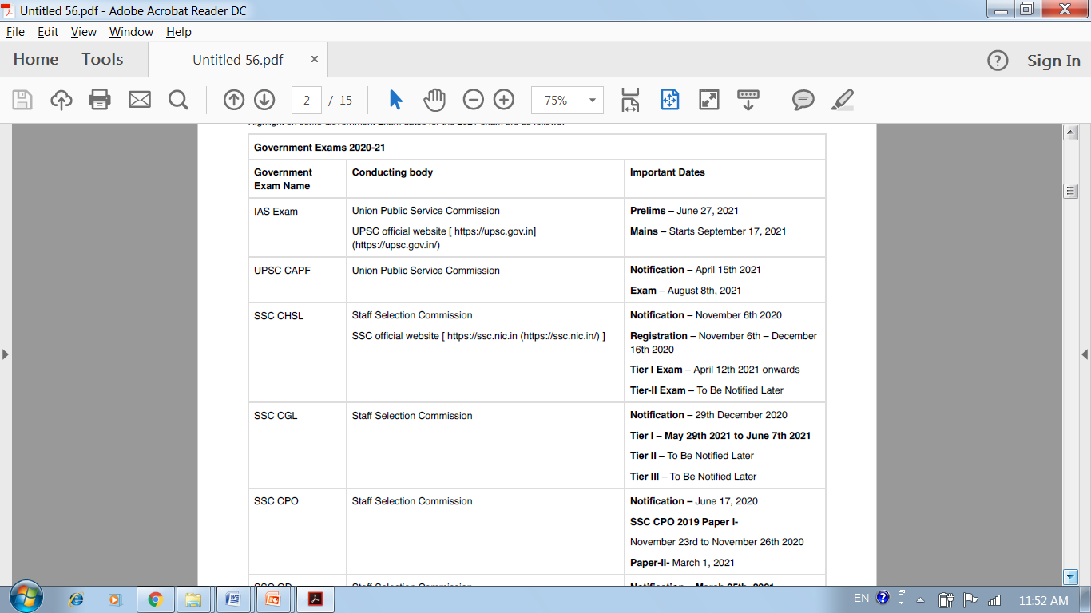
UPCOMING GOVERNMENT EXAMS 2020-21

Slide 162
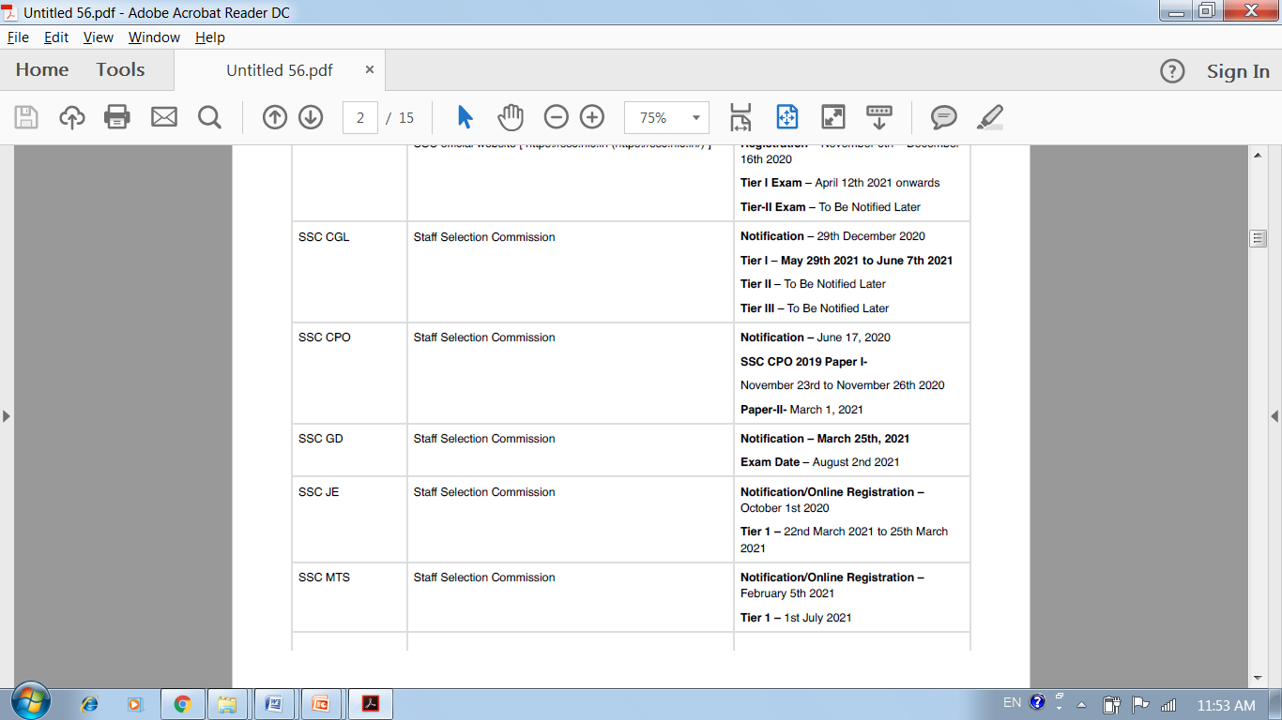

Slide 163
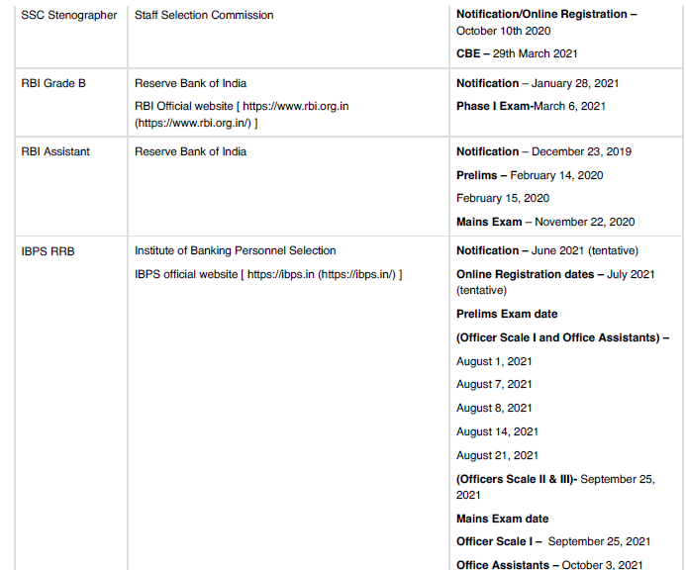

Slide 164
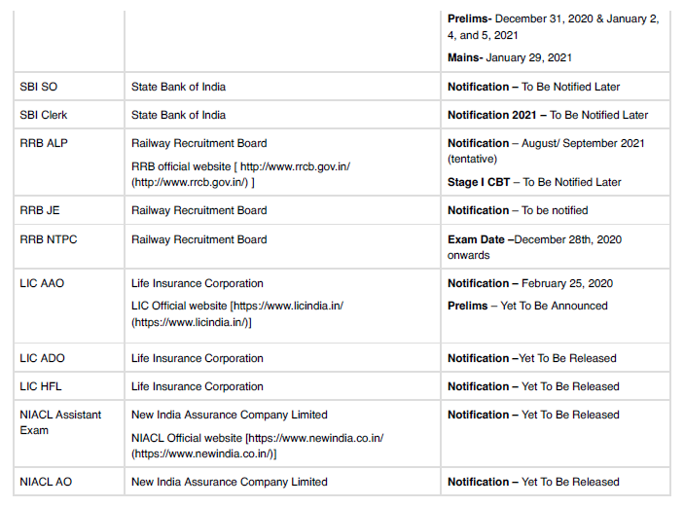

Slide 165
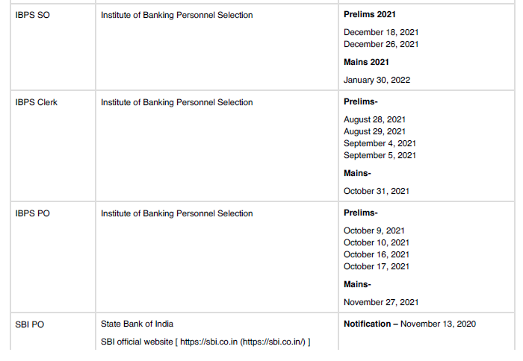

Slide 166
POST GRADUATE GOVERNMENT JOBS
PG Govt Jobs Through UPSC
Combined Geo-Scientist
UPSC IES Services
PG Govt Jobs through State Service Commissions
PG Govt Bank jobs
SBI- PO (Probationary Officer)
IBPS PO
NABARD Grade A
NABARD Grade B
NABARD Development Assistant
Specialist Officers (SO) in various govt banks
Grade B officer in RBI
PG Govt job options in PSU
Junior Research Follow (JRF)
Scientists
Engineers
Managers in various departments
Research Analysts
Senior Resident
Senior Executive
Research Officer
Other PG Govt Job Options
Managers in various Government firms
IB (Intelligence Bureau) jobs
Lecturers/ Professors in a public Universities
Senior Software Engineer/ Developer
Statistician etc.

Slide 167
KPSC RECRUITMENT
Eligibility Criteria
Candidates must have a bachelor’s degree or equivalent to it from any university which is recognized from UGC. But candidates who possess a degree in Hindi, Vishara, Pandita, etc. are not notified under the recruitment scripts so candidates with this qualification are not eligible for the post.
KPSC Assistant/ FDA (RPC & HK) Age Limit
All candidates need to fulfill the age criteria as on the last date of application for the post.
Minimum age: 21 years 2) Maximum Age: 35 years

Slide 168
INTELLIGENCE BUREAU
IB Recruitment 2021
Name of recruitment | Intelligence Bureau ( IB )
Article category | Recruitment information
Conducting Authority | Ministry of Home Affairs (MHA)
Type of Exam | National level recruitment exam
Recruitment year | 2020-21
Mode of application | Online
Official website | www.mha.gov.in
Latest Vacancy | 2000 post
Post Name | Intelligence Officer, Accountant & Research Officer & other Posts
AGE LIMIT | (As of 9/01/2021) Maximum- 27 years
 | Pay Scale– Rs. 44,900/- to Rs.1,42,400/- (Level 7)
Eligibility:
Candidates must have a graduate degree/ equivalent from a recognized university. Candidates must be of age group 18-27 years.
Applicants must have basic knowledge of computers.
Age relaxation of 5 years and 3 years in upper age limit is applicable for SC/ST candidates and OBC candidates respectively.

Slide 169
IB ACIO RECRUITMENT
Group C post, General Central Service, Non-Gazettes, Non-Ministerial
Number of Vacancies- 2000
ACIO 2021 RECRUITMENT OVERVIEW
Category | No. of Post as per category
OBC | 417
ST | 121
SC | 360
EWS | 113
UR | 989
EXAM NAME | IB ACIO
CONDUCTING BODY | MHA (MINISTRY OF HOME AFFAIRS
EXAM LEVEL | NATIONAL LEVEL EXAM
MODE OF EXAMINATION | ONLINE
QUESTION TYPE | MCQ (MULTIPLE TYPE OF QUESTIONS)
YEAR | 2020-21
NUMBER OF VACCANCIES | 2000
ESSENTIAL QUALIFICATION | GRADUATION
DESIRED QUALIFICATION | COMPUTER KNOWLEDGE
EXAMINATION FEES | 100/-
 | APPLICATION FEES is only for unreserved male aspirants, its free for reserved class ST/SC and all females
RECRUITMENT FEES | 500/-
Official Web Site | www.mha.gov.in or www.ncs.gov.in

Slide 170
ELIGIBILTY CERITERIA
Minimum Qualification Required:- The candidate must be graduated from any field, are eligible for this post.
Candidate must have basic computer knowledge.
AGE LIMIT
The age is in between 18-27 years
The age relaxation for General candidates is 35year whereas in case of SC/ST, Widow, divorced women, and judicially separated woman and not remarried the age relaxation is 40 years.
candidates who already served 3years continuous services can fill the application form up to the age of Forty.
Age relaxation for 5 years more for ST/SC and by 3 years for OBC aspirants
5 years age relaxation for meritorious Sport person
the age relaxation for Serviceman and the candidate who has Jammu and Kashmir

Slide 171
STAFF SELECTION COMMISSION
SSC JUNIOR ENGINEER RECRUITMENT
Eligibility
Age Criteria
Up to 32 Years
SECURITY EXCHANGE BOARD OF INDIA (SEBI)
Age
Age will be calculated as on 29th Feb 2020.
Candidate applying for the post should not exceed the age of 30
Candidates must have been born on or after 1st March 1990.
Relaxation in age:
SC/ST candidates: 5 years in upper age limit
OBC: 3 years
PWBD: 10 years
Ex-servicemen: 5 years
Name of the body conducting the examination | Security Exchange Board of India
Name of the examination | Grade ‘A’ officer recruitment
Name of the post | Assistant Manager (under various categories)
Number of posts | 147

Slide 172
Qualification:
PG Diploma in any discipline for general stream and…
PG diploma in statistics/Economics/commerce/business administration (finance)/econometrics will be required for the research stream.
Note: you are eligible to apply for a maximum of two streams in which you are eligible for and for that you have to submit the separate application.
If you have appeared in your final examination and awaiting your result then you are eligible to apply.
Selection criteria
The post you are going to apply for will go through three selection procedure stages which are:
Phase I: online screening (100 x 2 marks)
Phase II: online examination (100 x 2 marks)
Phase III: Interview

Slide 173
SSC CGL RECRUITMENT 2021
Recruitment | SSC CGL 2020 Recruitment
Article category | Recruitment Application
Conducting Authority | Staff Selection Commission (SSC)
Recruitment Exam | Combined Graduate Level Examination
Recruitment Year | 2020
Job Type | Group ‘B’ and Group ‘C’ (Central Government)
Total Vacancies | 6506 (tentative)
Official portal | https://ssc.nic.in
Eligibility
Citizenship Criteria-
A citizen of India or a subject of Nepal or Bhutan is eligible to apply. Or
Tibetan refugee who have come India before 1st January, 1962 with an
intention of settling in India permanently. Or
Candidate of Indian origin whose ancestors has migrated to India from
countries listed in Indian Constitution.

Slide 174
Age Criteria (as on 1st Jan 2021)
Osts | Age Limit | Remark
Auditors (Diff Ministries), Accountant, Accountant/ Junior Accountant, Senior Secretariat Assistant/ Upper Division Clerks, Tax Assistant, Sub-Inspector | 18-27 years | Applicants must have born not before 2nd January 1994 and not after 1st January 2003
Various Posts | 20-27 years | Applicants must have born not before 2nd Jan 1994 and not after 1st Jan 2001
Assistant Section Officer, Assistant Section Officer, Assistant Section Officer, Assistant Section Officer, Assistant, Sub Inspector, | 20-30 years | Applicants must have born not before 2nd January 1991 and not after 1st January 2001

Slide 175
Osts | Age Limit | Remark
Sub Inspector (group B), Divisional Accountant, Assistant/ Superintendent, Assistant, Inspector, Inspector Posts, Assistant Enforcement Officer, Inspector (Examiner), Inspector (Preventive Officer), Inspector, (Central Excise), Inspector of Income Tax, Assistant Section Officer, Assistant Section Officer, Assistant Accounts Officer, Assistant Audit Officer | up to 30 years | Applicants must have born not before 2nd Jan 1991 and not after 1st Jan 2003
Junior Statistical Officer | Up to 32years | Applicants must have born not before 2nd Jan 1989 and not after 1st Jan 2003

Slide 176
Age relaxation is also permissible as per the reservation criteria
Educational Qualification Criteria (as on 1st Jan 2021)
Candidates must have a bachelor’s degree from a recognized university/institution.
Candidate’s in final year of their graduation program are also eligible.
For more information on eligibility criteria, candidates can read official recruitment notice pdf shared at the end of the article.
SSC CGL Selection Process
There are four stages of ssc cgl recruitment process and these stages include following examinations-
Tier I: Computer Based Examination (CBE)
Tier II: Computer Based Examination (CBE)
Tier III: Pen & Paper Mode Exam (Descriptive Paper)
Tier-IV: Computer Proficiency Test/ Data Entry Skill Test (as
applicable)
Candidates who will clear all the exams will be called for document verification. They have to carry original as well as photocopies of all the required documents along with them at the time of document verification.

Slide 177
Tentative vacancy Combined Graduate Level Examination-2020
(Updated as on dated 08.02.2021)
Sno | Post code | Name of Department | Name of Post | Total
1 | A01 | Indian Audit & Accounts Department under C&AG | Assistant Audit Officer Group ‘B’ Gazetted (Non Ministerial) | 250
2 | B03 | Central Secretariat Service (DOPT) | Assistant Section Officer | 151
3 | B04 | Intelligence Bureau | Assistant/Assistant Section Officer | 23
4 | B06 | Ministry of External Affairs | Assistant/Assistant Section Officer | 89
5 | B07 | AFHQ (Ministry of Defence) | Assistant/Assistant Section Officer | 88
6 | B08 | Election Commission | Assistant Section Officer | 4
7 | B10 | Ministry of Electronics & Information Technology | Assistant/Assistant Section Officer | 5
8 | B11 | Central Administrative Tribunal | Assistant Section Officer | 5
9 | B12 | Central Vigilance Commission | Assistant Section Officer | 2
10 | B13 | National Technical Research Organisation | Assistant/Assistant Section Officer | 6

Slide 178
11 | B14 to B18 | 1. Bureau of Police Research & Development 2. Coast Guard Headquarters 3. D/o Commerce, M/o Commerce & Industry 4. Narcotics Control Bureau 5. Ministry of External Affairs (Passport Division) | Assistant /Assistant Supdt. | 14
12 | B20 | Ministry of Mines | Assistant | 18
13 | B21 | Ministry of Corporate Affairs | Assistant | 2
14 | B22 | Central Board of Direct Taxes (CBDT) | Inspector Of Income Tax | 202
15 | B23 | Central Board of Indirect Taxes & Customs(CBIC) | Inspector, (Central Excise) | 1216
16 | B24 | Central Board of Indirect Taxes & Customs(CBIC) | Inspector (Preventive Officer) | 878
17 | B25 | Central Board of Indirect Taxes & Customs(CBIC) | Inspector (Examiner) | 33
18 | B26 | Enforcement Directorate (Deptt. of Revenue) | Asstt. Enforcement Officer | 114
19 | B27 | Central Bureau of Investigation | Sub Inspectors | 11
20 | B28 | Ministry of Communications (Department of Posts-SPN) | Inspector Post | 43

Slide 179
21 | B29 | Comptroller & Auditor General of India | Divisional Accountant | 400
22 | B31 | National Investigation Agency | Sub-Inspector(NIA) | 11
23 | C32 | M/o Statistics & Programme Implementation | Junior Statistical Officer | 401
24 | D33 | Comptroller & Auditor General of India | Auditor | 500
25 | D34 | Offices under Controller General of Defence Accounts | Auditor | 260
26 | D35 | National Technical Research Organisation | Auditor | 1
27 | D37 to D39 | 1. Controller General of Accounts 2. M/o Communication (D/o Telecommunication O/o CGCA) 3. Ministry of Communication (D/o Post-Admn.) | Accountant/Junior Accountant | 661
28 | D40 to D48 | 1. Ministry of Textiles 2. Directorate General of Defence Estates (Ministry of Defence) 3. Ministry of Electronics & Information Technology 4. D/o Science & Technology 5. Ministry of Water Resources, River Development & Ganga Rejuvenation (Ministry of Jal Shakti) 6. Office of Development Commissioner (Micro, Small & Medium Enterprises) 7. D/o Agriculture Cooperation and Farmers Welfare 8. Central Bureau of Narcotics 9. D/o Animal Husbandry, Dairying & Fisheries | Senior Secretariat Assistant/Upper Division Clerk | 203

Slide 180
29 | D51 | Central Board of Direct Taxes (CBDT) | Tax Assistant | 1085
30 | D52 | Central Board of Indirect Taxes & Customs(CBIC) | Tax Assistant | 354
31 | D53 | Central Bureau of Narcotics | Sub-Inspector (Narcotics) - 2400 | 5
 |  | Total |  | 7035
1 | B14 | Bureau of Police Research & Development | Assistant | 1
2 | B15 | D/o Commerce, M/o Commerce & Industry | Assistant | 2
3 | B16 | Coast Guard Headquarters | Assistant | 5
4 | B17 | Narcotics Control Bureau | Assistant | 2
5 | B18 | Ministry of External Affairs (Central Passport Offices ) | Assistant Supdt. | 4
 |  | Total |  | 14

Slide 181
1 | D37 | Controller General of Accounts | Accountant/Junior Accountant | 153
2 | D38 | Ministry of Communication, (D/o Telecommunication O/o CGCA) | Accountant/Junior Accountant | 50
3 | D39 | Ministry of Communication (D/o Post-ADMN.) | Accountant/Junior Accountant | 458
 |  | Total |  | 661
1 | D40 | Ministry of Textiles | Senior Secretariat Assistant/ UpperDivision Clerk | 3
2 | D41 | Directorate General of Defence Estates (Ministry of Defence) | Senior Secretariat Assistant/ Upper Division Clerk | 20
3 | D42 | Ministry of Electronics & Information Technology | Senior Secretariat Assistant/ Upper Division Clerk | 14
4 | D43 | D/o Science & Technology | Senior Secretariat Assistant/ Upper Division Clerk | 122
5 | D44 | Ministry of Water Resources, River Development & Ganga Rejuvenation (Ministry of Jal Shakti) | Senior Secretariat Assistant/ UpperDivision Clerk | 2
6 | D45 | Office of the Development Commissioner (Micro, Small & Medium Enterprises) [MSME] | Senior Secretariat Assistant/ Upper Division Clerk | 26
7 | D46 | D/o Agriculture, Co-operation and Farmers Welfare | Senior Secretariat Assistant/ Upper Division Clerk | 5
8 | D47 | Central Bureau of Narcotics | Senior Secretariat Assistant/ Upper Division Clerk | 6
9 | D48 | D/o Animal Husbandry, Dairying & Fisheries | Senior Secretariat Assistant/ Upper Division Clerk | 5
 |  | Total |  | 203

Slide 182
Tentative vacancies for the Combined Higher Secondary (10+2) Level Examination, 2020 (FOR LDC/JSA/PA/SA & DEO )
SNO | Department Name | Post | Total
1 | Bureau of Police Research & Development | LDC/JSA | 6
2 | Canteen Stores Department (Ministry of Defence) | LDC/JSA | 70
3 | Central Administrative Tribunal | LDC/JSA | 22
4 | Central Bureau of Investigation | LDC/JSA | 47
5 | Central Passport Office (Ministry of External Affairs) | LDC/JSA | 17
6 | Controller General of Accounts | LDC/JSA | 107
7 | Controller General of Defence Accounts | LDC/JSA | 58
8 | Customs, Excise & Service Tax Appellate Tribunal | LDC/JSA | 11
9 | Department of Fisheries (Ministry of Fisheries, Animal Husbandry and Dairying ) | LDC/JSA | 6
10 | Department of Agriculture Cooperation and Farmers Welfare (M/O Agriculture and Farmers Welfare) | LDC/JSA | 21
11 | Department of Commerce (Ministry of Commerce & Industry) | LDC/JSA | 6
12 | Department of Electronics and Information Technology | LDC/JSA | 7
13 | Department of Forensic Science Services (M/o Home Affairs) | LDC/JSA | 7
14 | Department of Science & Technology | LDC/JSA | 10
15 | Farrakka Barrage Project (Department of Water Resources, River Development & Ganga Rejuvenation (Minstry of Jal Shakti) | LDC/JSA | 2

Slide 183
SNO | Department Name | Post | Total
16 | Directorate General of Aeronoutical Quality Assurance (M/O Defence) | LDC/JSA | 14
17 | Directorate Geneal of Health Servies (M/O Health and Family Welfare) | LDC/JSA | 23
18 | Election Commission of India | LDC/JSA | 8
19 | Enforcement Directorate (Department of Revenue) | LDC/JSA | 2
20 | IHQ MOD (Navy)/DTE of Civilian Manpower Planning and Recruitment Integrated Headquarters (DCMPR) | LDC/JSA | 231
21 | Intelligence Bureau | LDC/JSA | 79
22 | Lal Bahadur Shastri National Academy of Administration (LBSNAA), Department of Personnel & Training | LDC/JSA | 5
23 | Ministry of Civil Aviation | LDC/JSA | 11
24 | Ministry of Communications (Department of Communication) Office of CGCA | LDC/JSA | 182
25 | Ministry of Communications (Department of Posts)-(PA-Admn) | LDC/JSA | 268
26 | Ministry of Culture | LDC/JSA | 3
27 | Ministry of Defence (Office of The JS & CAO) AFHQ | LDC/JSA | 89
28 | Ministry of External Affairs | LDC/JSA | 17
29 | Ministry of Housing and Urban Affairs | LDC/JSA | 37
30 | Ministry of Information & Broadcasting | LDC/JSA | 15

Slide 184
SNO | Department Name | Post | Total
31 | Ministry of Jal Shakti (Department of Water Resources, River Development & Ganga Rejuvenation) | LDC/JSA | 3
32 | Ministry of Labour & Employment | LDC/JSA | 44
33 | Ministry of Power | LDC/JSA | 3
34 | Ministry of Textiles | LDC/JSA | 5
35 | National Informatics Centre | LDC/JSA | 14
36 | National Investigation Agency | LDC/JSA | 7
37 | National Technical Research Organisation | LDC/JSA | 38
38 | Office of Development Commissioner, Ministry of Micro, Small & Medium Enterprise(MSME) | LDC/JSA | 12
39 | Registrar General of India | LDC/JSA | 21
40 | Tatrakshak Mukhyalaya[Indian Coast Guard) | LDC/JSA | 10
 | Total |  | 1538
Tentative vacancies for the Combined Higher Secondary (10+2) Level Examination, 2020 (FOR PA/SA)
Tentative vacancies for the Combined Higher Secondary (10+2) Level
Examination, 2020 (FOR PA/SA)
SNO | Department Name | Post | Total
41 | Ministry of Communications & IT(Department of Posts)-SPN | PA/SA | 3181

Slide 185
RAILWAY SWR APPRENTICE RECRUITMENT
South Western Railway Apprentice Recruitment
Authority | South Western Railway (SWR)
Official Portal | rrchubli.in
Category | Recruitment
Advt No. | SWR/RRC/Act Appr/01/2020
Recruitment For | Apprentice Recruitment 2020
Vacncies | 1004

Slide 186
SWR Recruitment 2020 – Vacancy Overview
Carriage Repair Workshop, Hubballi
Trade | UR | SC | ST | OBC | Total
Fitter | 49 | 15 | 7 | 26 | 97
Welder | 16 | 5 | 2 | 9 | 32
Machinist | 4 | 1 | 1 | 2 | 8
Turner | 5 | 1 | 1 | 2 | 9
Electrician | 15 | 4 | 2 | 8 | 29
Carpenter | 6 | 1 | 1 | 3 | 11
Painter | 8 | 2 | 1 | 4 | 15
PASSA | 9 | 2 | 1 | 4 | 16
Total | 112 | 31 | 16 | 58 | 217
Hubballi Division
Trade | UR | SC | ST | OBC | Total
Fitter | 83 | 23 | 11 | 34 | 151
Welder | 3 | 1 | 0 | 1 | 5
Electrician | 42 | 11 | 6 | 17 | 76
Refrigeration and Air Conditioner Mechanic | 9 | 2 | 1 | 4 | 16
Programming and System Administration Assistant (PASSA) | 21 | 5 | 3 | 9 | 39
Total | 158 | 43 | 21 | 65 | 287

Slide 187
Mysuru Divison
Trade | UR | SC | ST | OBC | Total
Fitter | 30 | 09 | 05 | 16 | 60
Welder | 02 | 00 | 00 | 00 | 02
Electrician | 22 | 06 | 03 | 12 | 43
PASSA | 35 | 11 | 05 | 19 | 70
Stenographer | 02 | 00 | 00 | 00 | 02
Total | 91 | 26 | 13 | 47 | 177
Central Workshop, Mysuru
Trade | UR | SC | ST | OBC | Total
Fitter | 09 | 03 | 01 | 05 | 18
Turner | 02 | 01 | 00 | 01 | 04
Machinist | 03 | 01 | 00 | 01 | 05
Welder | 03 | 01 | 00 | 02 | 06
Electrician | 02 | 01 | 00 | 01 | 04
Painter | 02 | 00 | 00 | 01 | 03
PASSA | 02 | 00 | 00 | 01 | 03
Total | 23 | 07 | 01 | 12 | 43

Slide 188
Eligibility
Age Limits | Minimum of 15 years can enroll Maximum of 24 years for Unreserved and EWS. Age relaxation as per government rules.
Educational Qualifications | Applicant must have score with minimum marks of 50% in High School or in its equivalent examinations. Should possess a National Trade Certificate in relevant trade by NCVT.
RAILWAY RECRUITMENT BOARD (RRB)
Article Category | RRB Recruitment and application form 2021
Available Vacancies | 1663
The Last date to apply for vacancies available with RRB | 22 April 2019 (Extended)
Mode to apply for RRB MI | Online
Application Fee | Rs. 500 for general category candidate, Rs. 250 for Reserved Category Candidates
Mode of Selection | Through CBT

Slide 189
RRB MI RECRUITMENT VACANCY DETAILS 2021
Eligibility Criteria
Post | Age Limit | Qualification
Junior Stenographer (Hindi) | 18- 30 | 10+2 or equivalent with 80 WPM shorthand speed
Junior Stenographer (English) | 18- 30 | 10+2 or equivalent with 80 WPM shorthand speed
Junior Translator (Hindi) | 18 – 33 | Masters Degree in Hindi or English
Staff and Welfare Inspector | 18 – 33 | Graduate + Dilploma, or LLB or MBA
Chief Law Assistant | 18 – 40 | LLB or LLM
Lab Asst. Grade III (Chemist & Metallurgist) | 18 – 30 | !0+2 with a diploma in Lab Technology
Finger Print Examiner | 20 – 35 | 10+2 with pass certificate of Fingerprint expert exam conducted by GOI
Head Cook and Cook | 18 -30 | 10+ 2 or equivalent
Senior Publicity Inspector and Publicity Inspector | 18 -33 | Degree and diploma in advertisement and relevant fields with 2 years of experience
For PGT Teachers | 18 – 45 | B. Ed and Master Degree in relevant subjects
PTI Teachers | 18 – 45 | Degree and Diploma in physical training
Asst. Mistress (Junior School) | 18 – 45 | 10+ 2 or equivalent with D. Ed and TET
Music Mistress | 18 – 45 | BA Music10+ 2 or equivalent with
Dance Mistress | 18 – 45 | Diploma or degree in Dance
Laboratory Asst/ School | 18 – 45 | 10+ 2 or equivalent in PCM

Slide 190
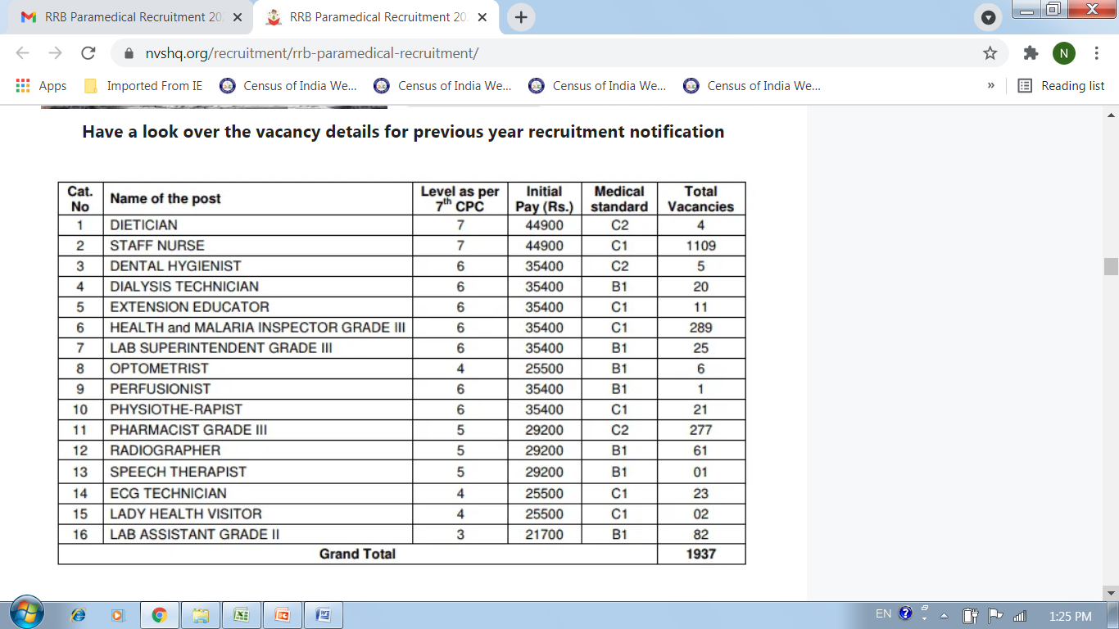
RRB PARAMEDICAL RECRUITMENT
Notification | RRB Paramedical
Article category | Notification & Application info
CEN no. | –
Recruiting Organization | RRB
Job category | Government job
Post | Paramedical Staff
No. of vacancies | Around 1800 posts (Expected)

Slide 191
Post | Age | Vacanices
Dietician | 18-33 | 4
Staff Nurse | 20-40 | 1109
Dental Hygienist | 18-33 | 5
Dialysis Technician | 20-33 | 20
Extension Educator | 22-35 | 11
Health and Malaria Inspector III | 18-33 | 289
Lab Superintendent Grade III | 18-33 | 25
Optometrist | 18-33 | 6
Perfusionist | 21-40 | 1
Physiotherapist | 18-33 | 21
Pharmaciast Grade III | 20-35 | 277
Radiographer | 19-33 | 61
Speech Therapist | 18-33 | 1
ECG Technician | 18-33 | 23
Lady Health Visitor | 18-30 | 2
Lab Assistant Grade II | 18-33 | 82

Slide 192
Eligibility
A candidate must be either:
a citizen of India
Nepal
Bhutan
Tibetan refugee before the 1st January, 1962
Indian origin who has migrated from Pakistan, Burma, Sri Lanka, East African Countries of Kenya, Uganda, the United Republic of Tanzania, Zambia, Malawi, Zaire, Ethiopia and Vietnam with the intention of permanently settling in India.
(b), (c), (d) and (e) above have certificate of eligibility has been issued by the Government of India.
Age Criteria
The lower and upper age limit below.

Slide 193
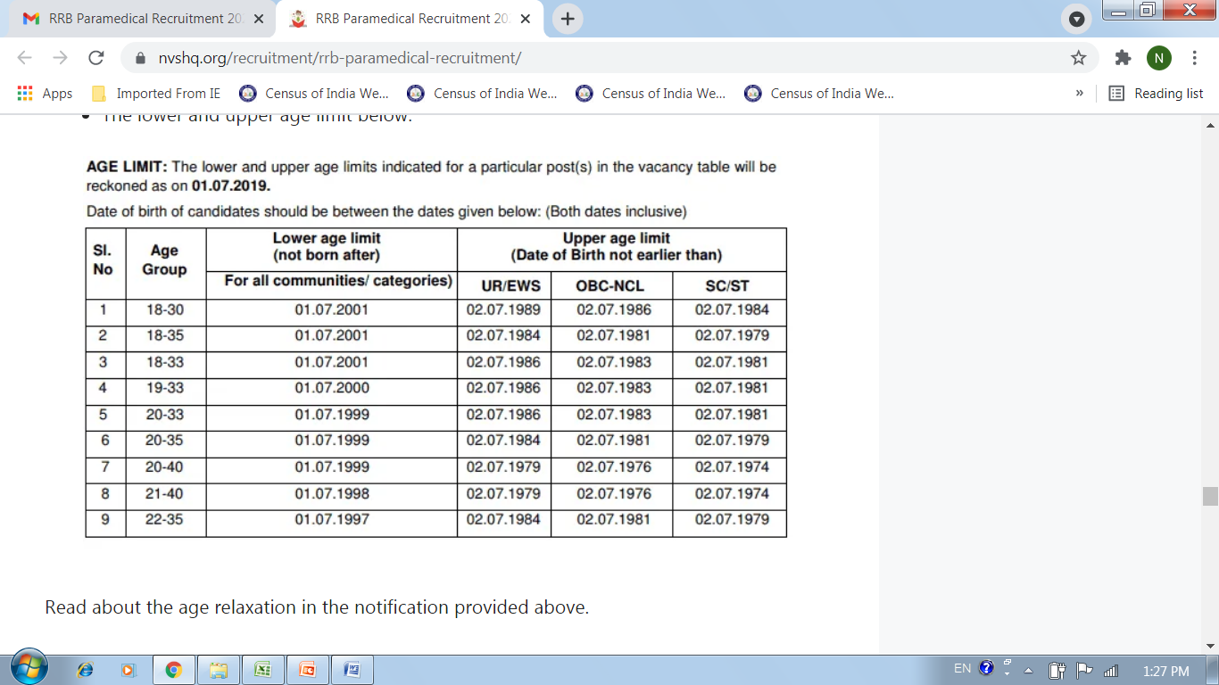
Educational Criteria
Candidates who are appearing and waiting for the declaration of result of the qualifying exams should not apply.
Requisite minimum Educational/Technical/Professional qualifications indicated for the posts in Annexure-A of this CEN
Medical Standards
Candidates must be mentally and physically sound and should meet the medical standards for respective post.

Slide 194
INDIAN NAVY SSC OFFICER RECRUITMENT 2021
Article about | Indian Navy SSC Officer Recruitment 2021
Conducting authority | Indian Navy
Course Month | Jun-21
Total Post | 17
Official Website | https://www.joinindiannavy.gov.in/
Indian Navy SSC Officer Vacancies
Cadre | Total Posts
Sports | 1
Law | 2
Naval Instructor | 14

Slide 195
ELIGIBILITY & VACANCY DETAILS
Branch/Cadre | Qualification
Sports | Education: Must have regular PG degree or B.E/B.Tech in any field Those having diploma in sports coaching from National Institute of Sports/ M.Sc. in Sports will be preferred Professional: Must have participated at senior level national Championship/ Athletics/ Tennis/Football/Hockey/basketball/Swimming
Law | Must have degree in Law with minimum 55% marks and also he/she should be recognised by bar council of India.
Naval Constructor | B.E/B.Tech securing 60% marks in discipline given as: – Mechanical, Civil, Aeronautical, Aero Space, Metallurgy, Naval Architecture, Ocean and marine engineering, Ship Technology, Ship design and building.

Slide 196
Age criteria vary as per the cadre whose detail is given below: –
Branch/Cadre | Age
Sports | 22 to 27 years
 | (must be born b/w 2nd July 1994 to 1st July 1999)
Law | 22 to 27 years
 | (must be born b/w 2nd July 1994 to 1st July 1999)
Naval Constructor | 19 ^{1/2} to 25 years
 | (must be born b/w 2nd July 1996 to 1st Jan 2002)
Selection Process for Indian Navy SSC Officer
Law: Authority reserved the right to fix the cut off marks based on the percentage of the marks secured in their education qualification whereas 200 candidates approximately who are on the merit list will be shortlisted.
Sports: for selection in this candidates will compete in open merit and thus shortlisted candidates will be called for Interview. Those having Diploma will be preferred for the post.
Naval Constructor: For this authority reserve the right to shortlist the application and cut off % for the selection. In this approx. 800 applicant will be shortlisted for SSB

Slide 197
INDIAN NAVY TRADESMAN RECRUITMENT 2021
Examination | Indian Navy recruitment 2021
Article category | Indian Navy Recruitment Application 2021
Job location | All across India
Recruiting Authority | Indian Navy
Advertisement no. | INCET-TMM 01-2021
Indian Navy Recruitment Vacancies | 1159
Post | Tradesman Mate
Job type | Non-Gazetted (Group C)
Indian Navy Tradesman Recruitment Online Application | 22nd Feb 2021 (10 AM)
Last date of application | 7th March 2021 (5 PM)
Official website | www.joinindiannavy.gov.in
Indian Navy Tradesman Official advertisement | Available
Pay Band | Rs.18000-56900 as per seventh pay commission

Slide 198
Indian Navy Tradesman Mate- Job Profile/ Nature of Duties
Working in production /maintenance of Shop/Ship/Submarine.
Opening and closing duties
Photocopying, sending/receiving of FAX, letters etc.
Carrying of files and other papers within the Office area.
Other non-clerical work in the Sections/Unit.
Assisting in routine office work like diary, dispatch etc. including on computer.
Delivering of Dak (inside & outside the Section/Unit)
Cleaning of building, fixture etc.
Watch & ward duties.
Dusting of furniture etc.,
General cleanliness & upkeep of the Section/Unit.
Upkeeps of lawns, parks, potted, plants etc.
Any other work assigned by higher authority
Eligibility 2021
All the candidates who are interested in filling application for this post must satisfy all the eligibility conditions. Any candidate found providing wrong eligibility information at any stage will be disqualified.

Slide 199
Age Criteria
Candidates must be of age between 18 to 25 years.
Selection procedure
Screening of Application – The very first stage is the screening of application. In this process, applicants are selected on the basis of fulfilling the basic selection criteria. However, if a candidate is screened, it does not mean that he/she entitles to be called for CBT
Selection Exam – The screened and shortlisted candidates after the application procedure are called for online exam. These candidates have to secure qualifying marks to pass the Computer Based exam.
Allotment of provisional appointment Letter – Candidates will be provisional selected on the basis of merit in the online test and will be given a provisional appointment letter.
Document Verification – The final selection will be made on the basis of verification of documents and medical examination and other selection requirements as specified by the Indian Government.

Slide 200
NATIONAL DEFENCE ACADEMY (NDA)
Name of Organizing Body | Union Public Service Commission
Popularly Known | UPSC
Examination Name | NDA (National Defence Academy)
Position Name | Army, Navy and Air Force
NDA Examination Level | National Level
Number of Paper | NDA I Exam and NDA II Exam
NDA Exam Mode | Offline Mode
Required Qualification | Inter Passed
Procedure of Recruitment | 1) Written Exam (Exam I and II)
 | 2) Medical Exam
 | 3) SSB
Official Portal Link | upsc.gov.in

Slide 201
DRDO (MINISTRY OF DEFENCE OF GOVT. OF INDIA)
Multi Tasking Staff Eligibility Criteria
Students who have completed their high school or any equivalent degree from a recognized Board or Industrial Training Institute.
Candidates wishing to apply for the post must have acquired their EQR on the 23rd of January 2020, for the post they are applying.
Candidates still waiting for their result are not eligible for the post.
Age Limit For the Candidates Who Wish To Apply
The age of the candidate must be in between 18 years to 25 years as of the crucial date of 23rd January 2020.
MTS Selection Procedure
The selection for the post of MTS is conducted in two phases which is tier 1, screening and tier 2 is the final selection round. Candidates must qualify in both the phases to confirm the job.
Both the exams will be conducted in CBT MODE (Computer-based test)
Both the tier exams will have multiple-choice questions. The whole examination is objective in nature.
The exam will be conducted in two languages, English and Hindi.
Note: according to the organization requirements the mode of selection may change.

Slide 202
Mode of exam | Subject | No. Of questions | Maximum marks | Duration of exam
CBT (screening) | General intelligence and reasoning ability | 35 | 35 | 90 minutes
 | General awareness | 30 | 30
 | Quantitative aptitude and numerical ability | 35 | 35
CBT(final selection) | General science General Maths | 40 40 | 40 40 | 90 minutes
 | General English | 20 | 20

Slide 203
INDIAN ARMY WOMEN GD SOLDIER
Eligibility
General Eligibility
Candidate must be citizen of India
Only female candidates can apply
Educational Qualification
Candidate must have cleared 10th/Higher Secondary examination/SSLC with minimum 33% marks in each subject and 45% marks aggregate. This calculation of percentage should be done without mentioning any specific subject.
Age limit
Candidate age limit is set between 17 1/ 2 and 21
This means that candidate who are born from 1st October 1999 to 1st April 2003 are eligible to fill the application.
Physical Standard
Female candidate height must be minimum 152 cm and weight should be according to the Army medical standard.
Chest expansion- It required that the candidate must be able to expand their chest up to 5 centimeters.

Slide 204
INDIAN ARMY
Upcoming Army Recruitment Rally for JCO/OR Rank 2021
Upcoming Army Recruitment Rally for JCO/OR Rank 2021
Web Site: https://joinindianarmy.nic.in/
Location | Application Date | Rally Date | Notification | Apply Link
ARO ARIGNAR | 17th July to 30th August | 15th to 30th Sep 2021 | Click here | Click here
ARO Tiruchirappalli | 17th July to 30th August 2021 | 15th to 30th Sep 2021 | Click here | Click here
ARO Punjab | 18th July to 31st August 2021 | 16thto 30th Sep 2021 | Click here | Click here
ARO Tiruchirappalli | 17th July to 30th August 2021 | 15th to 30th Sep 2021 | Click here | Click here
ARO Tiruchirappalli (Karaikal) | 17th July to 30th August 2021 | 15th to 30th Sep 2021 | Click here | Click here
ARO Shimla | 15th July to 28th August 2021 | 2 to 14th March 2022 | Click here | Click here
ARO Charkhi Dadri | 15th July to 28th August 2021 | 6th to 16th Nov 2021 | Click here | Click here
ARO Palampur | 15th July to 28th August 2021 | 23rd Nov to 7th Dec 2021 | Click here | Click here
ARO Rohtak | 15th July to 28th August 2021 | 6th to 16th Nov 2021 | Click here | Click here
ARO Mandi | 15th July to 28th August 2021 | 6th to 16th Nov 2021 | Click here | Click here
RP (HQ) Pune | 9th July to 22nd Aug. 2021 | 7th to 23rd Sep 2021 | Click here | Click here
ARO Barrackpore | 8th July to 21st Aug. 2021 | TBA | Click here | Click here
ARO Amritsar | 8th July to 21st Aug. 2021 | 6th to 25th Sep 2021 | Click here | Click here
ARO Varanasi | 8th July to 21st Aug. 2021 | 6th to 30th Sep 2021 | Click here | Click here
ARO Charkhi Dadri | 6th July to 13th Aug 2021 | 14th to 31st Dec 2021 | Click here | Click here
ARO Rohtak | 6th July to 13th Aug 2021 | 20th Aug to 3rd Sep 2021 | Click here | Click here
ARO Hisar | 6th July to 13th Aug 2021 | 9th to 24th Jan 2022 | Click here | Click here

Slide 205
Location | Application Date | Rally Date | Notification | Apply Link
RO HQ Ambala | 6th July to 13th Aug 2021 | 20th Aug to 3rd Sep 2021 | Click here | Click here
ARO Vizag | 20th June to 3rd August | 16th to 31st Aug | Click here | Click here
ARO Vizag (Yanam) | 20th June to 3rd August | 16th to 31st Aug | Click here | Click here
ARO Patiala | 6th June to 20th July | 21st July to 5th Aug | Click here | Click here
ARO Ahmedabad | 6th June to 20th July | 5th to 22nd August | Click here | Click here
RO Alwar | 14th May to 27th June | 11th July to 2nd August | Click here | Click here
RO Jaipur | 14th May to 27th June | 11th July to 2nd August | Click here | Click here
RO (HQ) Ambala | 8th April to 22nd May 2021 | 7th to 25th June 201 | Click here | Click here
ARO Bareilly | 8th April to 22nd May 2021 | 7th to 30th June 2021 | Click here | Click here
ARO Srinagar | 2nd April to 1st May 2021 | 17th to 28th May 2021 | Click here | Click here
ARO Aizwal | 19th March to 17th April 2021 | 1st May to 8th May 2021 | Click here | Click here
ARO Guntur | 17th March to 30th April 2021 | 16th to 30th May 2021 | Click here | Click here
Ro (HQ) Bangalore | 13th March to 26th April 2021 | 7th to 12th May 2021 | Click here | Click here
ARO Meerut | 13th March to 26th April 2021 | 12th to 31st May 2021 | Click here | Click here
ARO Rohtak | 4th March to 17th April 2021 | 3rd to 20th May 2021 | Click here | Click here
IRO Delhi Cantt | Upto 13th March 2021 | 18th t0 25th March 2021 | Click here | Click here
RO Shillong | 27th Feb to 28th Mach 2021 | 7th to 16th April 2021 | Click here | Click here
ARO Alwar | 20th Feb to 6th April | 20th April to 15th May 2021 | Click here | Click here

Slide 206
Category | Education | Age
Soldier (General Duty All arms) | High school or matric pass with a minimum of 45% marks in aggregate and a minimum of 33% in each subject. | 17 ½ to 21 years
Soldier technical | Intermediate pass with Physics, Chemistry, Maths, and English with minimum 50% marks in aggregate and minimum 40% marks in each subject. | 17 ½ to 23 years
Soldier clerk/storekeeper Technical | Intermediate examination pass in any stream having minimum 60% marks and 50% in each subject | 17 ½ to 23 years
Soldier nursing assistant | Intermediate pass with physics, chemistry, biology, and English having minimum 50% marks in aggregate and 40 % in each subject | 17 ½ to 23 years
Sepoy Pharma | Intermediate or equivalent examination passed with physics, chemistry, biology, and English, qualified in D Pharma with minimum 55% marks and must have registered with state pharmacy council of India. | 19 to 25 years
Soldier nursing assistant veterinary | Intermediate pass in PCB and English with minimum 50% marks and 40 % marks in each subject | 17 ½ to 23 years
Soldier tradesmen | 8th pass must have scored 33% marks in each subject | 17 ½ to 23 years
Soldier tradesmen | High school pass must have secure 33% marks in each subject | 17 ½ to 23 years
Survey automated cartographer | BA/B.Sc. with maths and also passed their intermediate with maths and science as the main subjects | 20- 25 years
Junior commissioned officer (religious teacher) | Must be graduate and must have the following qualification: Pandit for Gurkha regiment: Hindu candidates with Acharya in Sanskrit OR Shastri in Sanskrit with one-year diploma in karma kandGranthi: Sikh candidates with gyani in PunjabiMaulvi for Ladakh scout: Muslim candidates with Maulvi Alim in Arabic or Adib Alim in Urdu. Padre: any candidates who have ordained priesthood by the appropriate ecclesiastical authority and are still on the approved list of the local bishop.Bodh monk: any person who has been ordained a monk by the appropriate authority. | 25-34 years
Junior commissioned officer (catering) | Intermediate or equivalent diploma or certificate duration of one year or more in cookery/HM/Food craft institute | 21-27 years
Havildar education | Group-X-MA/M.Sc./MCA or BA/B.Sc. /BCA/B.Sc. (IT) with B.Ed. Group Y- B.Sc. /BA/BCA/B.Sc. (IT) (without B.Ed.) | 20-25 years.
Soldier general duty | Matric or equivalent with 45% marks and minimum 33% in each subject | 17 ½ to 21 years

Slide 207
Eligibility Criteria for Army Recruitment Rally Weightage in the merit of Army Recruitment
The weightage of merit varies according to the post you have applied for and the way you perform.
For soldier ground duty: physical fitness test + common entrance examination marks
Soldier technical/ clerk/ storekeeper technical/ nursing assistant: the marks candidates get in the common entrance examination (CCE) but individually they must have qualified in PFT.
Tradesman with aptitude test: in this 30% physical fitness test marks + 30% common entrance examination marks+ 40% tradesman aptitude test marks.
Tradesman without aptitude test: 60% physical fitness test marks + 25% aptitude test marks + 25% common entrance examination marks.
While those who had applied for havildar survey automated cartographer it has no weightage
However, if you had applied for JCO religious teacher/catering/direct havildar sportsman (meritorious sportsman) they must have qualified in the physical fitness test.

Slide 208
Selection For CDS
Selection for the CDS will be done through written test and SSB interview. Candidate with NCC ‘C’ Certificate can get direct entry in the SSB interview round. Based on candidates’ performance in both stages he gets selected on CDS.
TES
Candidates with 70%marks aggregate in Physics, Chemistry and Maths in 10+2 with age in the range of 16 ½ – 19-1/2 are eligible for this entry. The notification for these entry releases twice in a year. An official cut-off will be released which will be the base of the student to be called of the SSB.
SSC Technical Officer
Indian army also accepts the applications from men and women aspirants for short service commission officers. Recruitment in SSC is done for technical and no –technical branches of Indian army. As with the time the Indian army has also embraced modernization so it needs someone with good technical knowledge.

Slide 209
INDIAN NAVY RECRUITMENT 2021
Indian Navy Recruitment 2021 Details
Article Category | Recruitment
Organization Name | Indian Navy
Post Name | Sailor for Artificer Apprentice (AA-150) & Senior Secondary Recruits (SSR 02/2021)
Application Submission Mode | Online
Number of Vacant Posts | Total: 2500
Date to submit the online application | 26th April
Last Date to apply online | 30th April 2021 (Extended to 5th May 2021)
Recruitment Notification | Available Now
Website | www.joinindiannavy.gov.in
Vacant Posts for Sailor AA | 500
Vacancies for Sailor SSR | 2000

Slide 210
Artificer Apprentices (AA)
Senior Secondary Recruit (SSR)
Matric Recruit (MR)
Non-Matric Recruit (NMR)
Musician
Eligibility Criteria
Only unmarried males candidates can apply for the vacancies of Sailors in AA & SSR in Indian Navy. Here is the required educational qualification to apply for the aforementioned vacancies;
Educational Qualification
To apply for Sailor AA the candidate must have qualify 10+2 examination from a government recognized board with 60% or more marks in aggregate.
Applicant must have passed out 12th with Maths & Physics as main subjects along with one of the following subjects; Chemistry/Biology/Computer Science.
To apply for Sailor SSR the applicant must have qualified in 10+2 examination with the same subjects as mentioned above.
Age Limit
To apply for the Indian Navy August 2021 sailor batch the candidates should be born between 01 Aug Feb 2001 to 31 Jul 2004 (Both dates inclusive).
Medical Standards
The minimum height of the applicant should be 157 cms.
Weight and Chest should be proportionate.
Minimum chest expansion should be of 5 cms
Candidate must have good vision; without glasses 6/6 is in better and 6/9 is in the category of worse vision.
Permanent body tattoos are only permitted on the inner face of forearms i.e from inside of elbow to the wrist and on the reversed side of palm/ back (dorsal) side of hand.
Permanent body tattoos on any other part of the body are not acceptable.

Slide 211
JUNIOR ENGINEER
(CIVIL, MECHANICAL, ELECTRICAL AND QUANTITY SURVEYING & CONTRACTS) EXAMINATION
Detail of Posts: Following are the likely posts that will be filled up through this examination:
S. No. | Organization | Post
1 | Border Road Organization (BRO) | Junior Engineer (Civil)
2 | Border Road Organization (BRO) | Junior Engineer (Electrical & Mechanical)
3 | Central Public Works Department (CPWD) | Junior Engineer (Civil)
4 | Central Public Works Department (CPWD) | Junior Engineer (Electrical)
5 | Central Water and Power Research Station | Junior Engineer (Civil)
6 | Central Water and Power Research Station | Junior Engineer (Electrical)
7 | Central Water and Power Research Station | Junior Engineer (Mechanical)
8 | Central Water Commission | Junior Engineer (Civil)
9 | Central Water Commission | Junior Engineer (Mechanical)
10 | Directorate of Quality Assurance (Naval) | Junior Engineer (Mechanical)
11 | Directorate of Quality Assurance (Naval) | Junior Engineer (Electrical)
12 | Farakka Barrage Project | Junior Engineer (Civil)
13 | Farakka Barrage Project | Junior Engineer (Electrical)

Slide 212
Age Limit as on 01.01.2021:
6.1 Age limit for the posts of Junior Engineers in various Ministries/ Departments/ Organizations as on 01.01.2021 is as under: 4
S No | Organization | Post | Age limit
1 | Border Road Organization | Junior Engineer (Civil) | Up to 30 years
2 | Border Road Organization | Junior Engineer (Electrical & Mechanical) | Up to 30 years
3 | Central Public Works Department (CPWD) | Junior Engineer (Civil) | Up to 32 years
4 | Central Public Works Department (CPWD) | Junior Engineer (Electrical) | Up to 32 years
5 | Central Water and Power Research Station | Junior Engineer (Civil) | Up to 30 years
6 | Central Water and Power Research Station | Junior Engineer (Electrical) | Up to 30 years
7 | Central Water and Power Research Station | Junior Engineer (Mechanical) | Up to 30 years
8 | Central Water Commission | Junior Engineer (Civil) | Up to 32 years
9 | Central Water Commission | Junior Engineer (Mechanical) | Up to 32 years
10 | Directorate of Quality Assurance (Naval) | Junior Engineer (Mechanical) | Up to 30 years

Slide 213
Age Limit as on 01.01.2021:
6.1 Age limit for the posts of Junior Engineers in various Ministries/ Departments/ Organizations as on 01.01.2021 is as under: 4
S No | Organization | Post | Age limit
11 | Directorate of Quality Assurance (Naval) | Junior Engineer (Electrical) | Up to 30 years
12 | Farakka Barrage Project | Junior Engineer (Civil) | Up to 30 years
13 | Farakka Barrage Project | Junior Engineer (Electrical) | Up to 30 years
14 | Farakka Barrage Project | Junior Engineer (Mechanical) | Up to 30 years
15 | Military Engineer Services (MES) | Junior Engineer (Civil) | Up to 30 years
16 | Military Engineer Services (MES) | Junior Engineer (Electrical and Mechanical) | Up to 30 years
17 | National Technical Research Organization (NTRO) | Junior Engineer (Civil) | Up to 30 years
18 | National Technical Research Organization (NTRO) | Junior Engineer (Electrical) | Up to 30 years
19 | National Technical Research Organization (NTRO) | Junior Engineer (Mechanical) | Up to 30 years

Slide 214
Essential Educational Qualifications/ Experience (as on 01.01.2021):
8.1 Essential Educational Qualification and experience, etc required for the various posts are as follows:
S No | Post | Educational and Other Qualification
1 | Junior Engineer (Civil), Border Roads Organization, Ministry of Defence. | Degree in Civil Engineering from a recognized University/ Institute or (a) Three years Diploma in Civil Engineering from a recognized University/ Institute/ Board; and (b) Two years working experience in Planning/ Execution/ Maintenance of Civil Engineering works.
2 | Junior Engineer (Electrical & Mechanical), Border Roads Organization, Ministry of Defence. | Degree in Electrical or Mechanical Engineering from a recognized University/ Institute; or (a) Three years Diploma in Electrical/ Automobile/ Mechanical Engineering from a recognized University/ Institute/ Board; and (b) Two years experience in Planning/ Execution/ Maintenance of Electrical or Mechanical Engineering works.

Slide 215
S No | Post | Educational and Other Qualification
3 | Junior Engineer (Civil), CPWD | Diploma in Civil Engineering from a recognized University or Institute.
4 | Junior Engineer (Electrical), CPWD | Diploma in Electrical or Mechanical Engineering from a recognized University or Institute.
5 | Junior Engineer (Civil), Central Water Power Research Station. | Diploma in Civil Engineering from a recognized Institute.
6 | Junior Engineer (Electrical), Central Water Power Research Station. | Diploma in Electrical Engineering from a recognized Institute.
7 | Junior Engineer (Mechanical), Central Water Power Research Station. | Diploma in Mechanical Engineering from a recognized Institute.
8 | Junior Engineer (Civil), Central Water Commission. | Degree or Diploma in Civil Engineering from a recognized University or Institution.
9 | Junior Engineer (Mechanical), Central Water Commission. | Degree or Diploma in Mechanical Engineering from a recognized University or Institution.
10 | Junior Engineer (Mechanical), Directorate of Quality Assurance, | Degree in Mechanical Engineering from a recognized Institute;

Slide 216
Tentative vacancies for the Combined Higher Secondary (10+2) Level Examination, 2020 (FOR DEO)
SNO | Department Name | Post | Total
42 | Controller General of Accounts | DEO 2400 | 4
43 | DTE General Defence Estates (Ministry of Defence) | DEO 2800 | 3
 | Total |  | 7

Slide 217
Tentative vacancies of Junior Engineer (Civil, Electrical, Mechanical and Quantity Surveying & Contracts) Examination
SNO | Department Name | Post | Total
1 | Border Road Organization (BRO) Ony for Male candidates | Junior Engineer(Civil) | 75
2 | Central Water Commission (CWC) | Junior Engineer (Mechanical) | 13
3 | Central Water Commission (CWC) | Junior Engineer (Civil) | 64
4 | Central Water Power Research Station (CWPRS) | Junior Engineer (Electrical) | 1
5 | Central Water Power Research Station (CWPRS) | Junior Engineer(Civil) | 2
6 | Central Public Works Department (CPWD) | Junior Engineer(Civil) | 114
7 | Central Public Works Department (CPWD) | Junior Engineer(Electrical) | 76
8 | Ministry of Defence (DGQA-NAVAL) | Junior Engineer(Electrical) | 1
9 | Ministry of Defence (DGQA-NAVAL) | Junior Engineer(Mechanical) | 4
10 | Military Engineering Services (MES) | Junior Engineer(Civil) | 271
11 | Military Engineering Services (MES) | Junior Engineer(Electrical & Mechanical) | 163
12 | Farrakka Barrage Project (FBP) | Junior Engineer(Mechanical) | 1
 | Total |  | 785
 | GRAND TOTAL |  | 13,424

Slide 218
SUB-INSPECTOR IN CENTRAL ARMED POLICE FORCES
SNO | CAPFs | Total
1 | CRPF | 1072
2 | BSF | 244
3 | ITBP | 43
4 | CISF | 20
5 | SSB | 16
 | TOTAL | 1395
CONSTABLE in CENTRAL ARMED POLICE FORCES
SNO | CAPFs | Total
1 | BSF | 7545
2 | CISF | 8464
3 | CRPF | 0
4 | SSB | 3806
5 | ITBP | 1431
6 | AR | 3785
7 | NIA | 0
8 | SSF | 240
 | TOTAL | 25271

Slide 219
KSRP CONSTABLE
KSRP SRPC And Bandsmen Recruitment Overview
Name of the Department | Karnataka State Police Recruitment Board
Post for recruitment | Police Constable and Bandsmen
Number of posts | 2672
Eligibility Criteria
Education qualification
The candidates must possess the minimum education qualification for both the posts as of now the education qualification for the post is not announced and once it was available we will update it here.
Age Limit
The minimum age limit for the post will be of 18 years while
The maximum age limit could vary according to the category of applicants and if we consider the last year notification then the maximum age limit for
General: 25 years
SC/ST/: 27 years
Tribal: 30 years

Slide 220
ASSISTANT COMMANDANT
Central Armed Police Forces
BSF, CISF, ITBP, CRPF, SSB
Recruiting Authority | Union Public Service Commission (UPSC)
Total vacancies | 159
Eligibility
Education Qualification
Applicants must hold a bachelor’s degree/equivalent from arecognized college/ university.
Candidates possessing any professional or technical qualification recognized by the Government are also eligible.
Final year appearing candidates can also apply provided they must produce the minimum educational qualification certificate/ documents when required.
Age Criteria-
The minimum age and maximum age of the candidates must be 20 years and 25 years as of 1st August 2021 respectively. It means candidates should not have born before 2nd August 1995 and not later than 1st August 2001.

Slide 221
CRPF PARAMEDICAL STAFF CRPF
Recruitment details 2020
Posts | Age criteria on 01.08.2020/31.08.2020 | Vacancies | Pay-Scale | Education Qualification
Inspector (Dietitian) (Group B) | Below 30 years as on 31.08.2020 | 1 | (44900- 142400) Lev-7 | BS.C in Home science or Diploma in Dietitian
Sub Inspector (Staff Nurse) (Group B) | Below 30 years as on 31.08.2020 | 175 | (35400- 112400) Lev-6 | Intermediate pass from recognized institute
Sub Inspector (Radiographer) (Group B) | Below 30 years as on 31.08.2020 | 8 | (35400- 112400) Lev-6 | Intermediate pass from recognized institute
Assistant Sub Inspector (Pharmacist) (Group C) | B/w 20 to 25 years as on 31.08.2020 | 84 | (29200 – 92300) Lev-5 | Intermediate pass from recognized institute
Assistant Sub Inspector (Physiotherapist) (Group C) | B/w 20 to 25 years as on 01.08.2020 | 5 | (29200 | Intermediate pass from recognized institute/ Bachelor’s in physiotherapy
 |  |  | 92300) Lev-5
Assistant Sub Inspector (Dental Technician) (Group C) | B/w 20 to 25 years as on 01.08.2020 | 4 | (29200 | Marticulation with science subject
 |  |  | 92300) Lev-5
Assistant Sub Inspector (Laboratory Technician) (Group C) | B/w 20 to 25 years as on 01.08.2020 | 64 | (29200 | Marticulation with science subject
 |  |  | 92300) Lev-5

Slide 222
Posts | Age criteria on 01.08.2020/31.08.2020 | Vacancies | Pay-Scale | Education Qualification
Assistant Sub Inspector/ Electro Cardiography Technician (Group C) | B/w 20 to 25 years as on 01.08.2020 | 1 | (29200 | Marticulation with science subject
 |  |  | 92300) Lev-5
Head Constable (Physiotherapy Assistant/ Nursing Assistant/ Medic) (Group C) | B/w 18 to 25 years as on 31.08.2020 | 88 | (25500 | Intermediate pass from recognized institute
 |  |  | 81100) Lev-4
Head Constable (ANM/Midwife) (Group C) | B/w 18 to 25 years as on 31.08.2020 | 3 | (25500 | Intermediate pass from recognized institute
 |  |  | 81100) Lev-4
Head Constable (Dialysis Technician (Group C) | B/w 18 to 25 years as on 31.08.2020 | 8 | (25500 | Intermediate pass from recognized institute
 |  |  | 81100) Lev-4
Head Constable(Junior X-ray Assistant) (Group C) | B/w 20 to 25 years as on 01.08.2020 | 84 | (25500 | Marticulation pass with recognised institute
 |  |  | 81100) Lev-4
Head Constable (Laboratory Assistant) (Group C) | B/w 20 to 25 years as on 01.08.2020 | 5 | (25500- | Marticulation pass with recognised institute
 |  |  | 81100) Lev-4
Head Constable (Electrician) (Group C) | B/w 20 to 25 years as on 01.08.2020 | 1 | Level-4 | Marticulation pass with recognised institute
 |  |  | (25500-
 |  |  | 81100)
Head Constable (Steward) (Group C) | B/w 20 to 23 years as on 01.08.2020 | 3 | Level-4 | Marticulation pass with recognised institute
 |  |  | (25500-
 |  |  | 81100)

Slide 223
Posts | Age criteria on 01.08.2020/31.08.2020 | Vacancies | Pay-Scale | Education Qualification
Constable (Masalchi) (Group C) | B/w 18 to 23 years as on 01.08.2020 | 4 | (21700- | Marticulation pass with recognised institute
 |  |  | 69100) Lev-3
Constable (Cook) (Group C) | B/w 18 to 23 years as on 01.08.2020 | 116 | (21700- | Marticulation pass with recognised institute
 |  |  | 69100) Lev-3
Constable (Safai Karamchari) (Group C) | B/w 18 to 23 years as on 01.08.2020 | 121 | (21700- | Marticulation pass with recognised institute
 |  |  | 69100) Lev-3
Constable (Dhobi/ Washerman) (Group C) | B/w 18 to 23 years as on 01.08.2020 | 5 | (21700- | Marticulation pass with recognised institute
 |  |  | 69100) Lev-3
Constable (W/C) (Group C) | B/w 18 to 23 years as on 01.08.2020 | 3 | (21700- | Marticulation pass with recognised institute
 |  |  | 69100) Lev-3
Constable (Table Boy) (Group C) | B/w 18 to 23 years as on 01.08.2020 | 1 | (21700- | Marticulation pass with recognised institute
 |  |  | 69100) Lev-3
Head Constable (Veterinary) (Group C) | B/w 18 to 25 years as on 31.08.2020 | 3 | Level-4 | Matrics or equivalent trade
 |  |  | (25500-
 |  |  | 81100)
Head Constable (Lab Technician) (Group C) | B/w 18 to 25 years as on 31.08.2020 | 1 | (25500- | Intermediate pass from recognized institute
 |  |  | 81100) Lev-4
Head Constable (Radiographer) (Group C) | B/w 18 to 25 years as on 31.08.2020 | 1 | (25500- | Intermediate pass from recognized institute
 |  |  | 81100) Lev-4

Slide 224
SBI CBO RECRUITMENT
Highlights of State Bank of India CBO
Name of Organizing Body | SBI
Full Name | State Bank of India
Name of the Post | Circle Based Officer
Total Number Vacant Post | 3850
Official Website | sbi.co.in
Eligibility Criteria
1.Criteria for Academic Qualification
Candidates who want to apply must have completed their graduation from any recognized institute/ college/ university.
2.Age Limitations
Age of candidates should not be more than 30 years as on 1st Aug 2020 (or not born before 2nd of August 1990).

Slide 225
SBI PHARMACIST CLERICAL RECRUITMENT
SBI Pharmacist Clerical recruitment 2021: Overview
Organization | SBI
Article Category | Recruitment
Recruitment for | Pharmacist as a clerical cadre
Advertisement Number | 2021-22/04
Number of posts | 67
Selection process | Written Exam and Interview
Place of post | In any dispensary within the circle applied
Official portal | Sbi.co.in
Age:
The maximum age for the post is 30 years which will be count as on 31st Dec 2020.

Slide 226
Education Qualification and work Experience
As of 1st Jan 2021 applicant must complete its SSC or equivalent to it.
Also, he/she must hold a Diploma in Pharmacy from any recognized board or university.
Experience: applicant possess this qualification should have experience of 3 years as a pharmacist or compounder and have the ability to provide first aid treatment independently in accidents cases.
OR
Applicant should hold a degree in pharmacy (B Pharma/ M Pharma/ Pharma D) or equivalent to it from a recognized University.
Experience: while those who hold this qualification must have experience of 1 year as a pharmacist or compounder and able to given first aid treatment is a must.
Other special Skills for the post: Applicant should have been registered as pharmacist under Pharmacist act with state pharmacy council or body constituted similar to it.
SBI Pharmacist Clerical Pay Scale
One who will be shortlisted for the posts will receive a pay scale of 17900-1000/3-20900-1230/3-24590-1490/4-30550-1730/7-42660-3270/1-45930-1990/1-47920
Selection process for SBI Pharmacist Clerical Recruitment 2021
The selection process for the post will go through two stages namely:
Written Examination and
Interview

Slide 227
SBI CLERK RECRUITMENT
Overview of SBI Junior Associate (Customer Support & Sales)
Clerical Cadre Recruitment 2021
Name of the recruitment | SBI Clerk Recruitment 2021
Article category | SBI Clerk application form and notification
Exam type | Recruitment exam
Recruiting Bank | State Bank of India
Advertisement No. | CRPD/CR/2021-22/09
Year | 2021
Name of the Post | Junior Associate (Customer Support & Sales)
No. of vacancies | 5237
Cadre | Clerical
Job location | All across India
Application status | Closed
Mode of application | Online
SBI Clerk Notification | Download Here
FAQs | Check Here
Official website | https://bank.sbi/careers
 | https://www.sbi.co.in/careers

Slide 228
SBI Clerk Vacancy 2021
The category-wise vacancies are as given in the table below-
Category | No. of vacancies
General | 2151
EWS | 488
SC | 726
ST | 440
OBC | 1195
Total | 5000 +237 Backlog Vacancies
Eligibility
Before applying online, applicants interested in filling application form should go through the eligibility criteria first. They should apply only if they satisfy the eligibility requirements.
Education Qualification (as on 16th Aug 2021)
Candidates should have completed graduation in any discipline or equivalent from a recognised university.
Final year appearing candidates can also apply provided they have to produce the relevant qualification certificates on or before 16th August if they pass the exam.
Age Criteria
The minimum age of the candidates should be 20 years and the maximum should be 28 years as on 1st April 2021.

Slide 229
KARNATAKA BANK PROBATIONARY OFFICERS
Karnataka Bank Recruitment PO (Scale-1): Important Details
Name of the Organization | Karnataka Bank
Name of the post | Probationary Officer (PO) Scale-I
Pay Scale | 60,000/-
Eligibility
Candidates who have done their Post Graduates in any discipline from any University which is recognized from the UGC are eligible for the post.
All candidates must complete their Post-Graduation as on the 1st of January 2020
If any of the candidates are waiting for their result in the near future then they are not eligible for the post.
If any of the candidates have done a Postgraduate Diploma or one year Executive MBA they are not eligible for the post.
Age Limit
All candidates who have completed their PG must have a maximum of 28 years of age as on the date of 01-01-2020.
It means candidates should be born on or after the 02-01-1992.
But there is a relaxation of 5 years for those candidates who belong to the reserved category like SC/ST.

Slide 230
IBPS RRB
Article Category | IBPS RRB X Recruitment 2021
Official Notification for the Recruitment in IBPS | Published
Total Vacant Posts | 10676
Posts | Officer Scale I, II and III and Office Assistant (Multipurpose)
Location of Posting | Anywhere in India
Application Submission Process | Started Online
Exam Will be conducted by | Institute of Banking Personnel Selection
Exam Level | National
Exam Will be conducted | Online
Exam Type | Objective
Number of Phases of exam for selection | 3; Prelim Exam, Mains Exam, and Interview
Official Website | www.ibps.in
IBPS RRB Vacancy Details 2021
Post Name | Number of Posts
IBPS RRB Office Assistant (Multipurpose) | 5134
IBPS RRB Officer Scale -I (Assistant Manager) | 3922
IBPS RRB Officer Scale-II (Marketing Officer) | 43
IBPS RRB Officer Scale-II (Agriculture Officer) | 25
IBPS RRB Officer Scale-II (Treasury Officer) | 10
IBPS RRB Officer Scale-II (CA) | 32
IBPS RRB Officer Scale-II (Law) | 27
IBPS RRB Officer Scale-II (IT) | 59
Officer Scale-II (General Banking Officer) | 906
Officer Scale – III | 210

Slide 231
Eligibility Criteria
Nationality
To apply for the vacancies release by IBPS the applicant must be either;
1) a Citizen of India or 2) a subject of Nepal or 3) a subject of Bhutan or 4) a Tibetan Refugee (came to India before 1st January 1962 with the intention of permanently settling in India) or 5) a person of Indian origin who has migrated from countries like Pakistan, Burma, Sri Lanka, East African countries of Kenya, etc. With the intention of permanently settling in India.
Age Limit
For Officer Scale- III (Senior Manager) – Applicants’ age should be above 21 years and below 40 years according to this candidates should not have been born earlier than 03.06.1981 and later than 31.05.2000 (both dates inclusive).
For Officer Scale-II (Manager) – to apply for this post the age of the candidate should be above 21 years and below 32 years. It means that the candidates should not have been born earlier than 03.06.1989 and later than 31.05.2000 (both dates inclusive).
For Officer Scale- I (Assistant Manager) – Age to apply for this post is above 18 years and below 30 years. The candidates should not have been born earlier than 03.06.1991 and later than 31.05.2003 (both dates inclusive).
For Office Assistant (Multipurpose) – Applicants’ age should be between 18 years and 28 years to apply for this post. So the candidates should have not been born earlier than 02.06.1993 and later than 01.06.2003 (both dates inclusive).

Slide 232
Educational Qualification
For Office Assistant (Multipurpose): Candidate must have a Bachelor’s degree in any discipline from a recognized University or its equivalent. Working knowledge of the computer is desirable.
Officer Scale-I (Assistant Manager): Bachelor’s degree in any discipline from a recognized University or its equivalent is the basic requirement for this post. An applicant with graduation degree in Agriculture, Horticulture, Forestry, Animal Husbandry, —- 7 Veterinary Science, Agricultural Engineering, Pisciculture, Agricultural Marketing and Cooperation, Information Technology, Management, Law, Economics or Accountancy will get the preference.
Officer Scale-II General Banking Officer (Manager): Candidate with Bachelor’s degree in any discipline from a recognized University or its equivalent with a minimum of 50% marks in aggregate can apply for this post. Preference will be given to the candidates having a degree in Banking, Finance, Marketing, Agriculture, Horticulture, Forestry, Animal Husbandry, Veterinary Science, Agricultural Engineering, Pisciculture, Agricultural Marketing and Cooperation, Information Technology, Management, Law, Economics and Accountancy.
Officer Scale-II Specialist Officers (Manager): Different qualification is required to apply for different posts that come under this category;
Information Technology Officer: Candidate with Bachelor’s degree from a recognized University in Electronics / Communication / Computer Science / Information Technology or its equivalent with a minimum of 50% marks in aggregate can apply for this post. One year of experience in the relevant field is also required.
Chartered Accountant: Candidate must be a Certified Associate (CA) from Institute of Chartered Accountants of India with One Year as a Chartered Accountant.
Law Officer: To apply for the post the applicant must have Degree from a recognized University in Law or its equivalent with a minimum of 50% marks in aggregate. Applicant must have worked as an advocate for two years or have worked as Law Officer in Banks or Financial Institutions for a period of 2 years.
Treasury Manager: Chartered Accountant or MBA in Finance from a recognized university/ institution with one year of experience in relevant field can apply for this post.
Marketing Officer: To apply for this post the applicant need to have an MBA degree with relevant experience of 1 year.
Agricultural Officer: for this post the following educational qualification is required; Bachelor’s degree in any discipline from a recognized University or its equivalent with a minimum of 50% marks in aggregate. Preference will be given to the candidates having Degree/ Diploma in Banking, Finance, Marketing, Agriculture, Horticulture, Forestry, Animal Husbandry, Veterinary Science, Agricultural Engineering, Pisciculture, Agricultural Marketing and Co-operation, Information Technology, Management, Law, Economics and Accountancy. The applicant needs to have an experience of 5 years as an Officer in a Bank or Financial Institutions.

Slide 233
EMPLOYEE STATE INSURANCE CORPORATION (ESIC) UDC Recruitment 2021
Name of the Recruitment | ESIC UDC Recruitment
Concerned Authority | Employee State Insurance Corporation (ESIC)
Notification No. | Available soon
Year of Recruitment | 2021
Job Type | Government Group C Job
Name of the post | Upper Division Clerk (UDC)/ Clerk- Cashier Posts and Stenographer
Total posts | 6552 (tentative)
Application status | Available Soon
Mode of application | Online
Official portal | htwww.esic.in

Slide 234
Posts
There are total 6552 (tentative) vacancies for which eligible candidates have to compete. Check the post-wise vacancy details given below-
Post | Vacancies
Upper Division Clerk (UDC)/ Clerk-Cashier Posts | 6306
Stenographer | 246
Total | 6552
Age Criteria
Applicants should be of age group between 18 years to 27 years as on cut-off date.
Relaxation in upper age limit will also be applicable for reserved category candidates.
Educational Qualification
For UDC- Applicants should have a bachelors/ equivalent degree from a recognized university. They must also have a working knowledge of Computer.
For Stenographer- Applicants must have completed class 12th or equivalent from a recognized board. They must have required skills for skill test which includes Dictation and Transcription
Selection Process
ESIC UDC selection process includes various stages and to get appointed for post, applicants have to qualify all the stages. Have a look at the selection process given below-
ESIC UDC Selection is based for following parameters-
75% Recruitment depends on scores in written exams
15% recruitment is based on promotion
10% recruitment is done through Departmental exam
The selection process includes-
– Written Test (Pre and Mains examination)
– Skill Test

Slide 235
NAVODAYA VIDYALAYA SAMITI (NVS) RECRUITMENT
NVS recruitment vacancies 2020
PGT | TGT | FSCA
Hindi- 16 English- 06 Mathematics- 10 Biology- 17 Chemistry- 14 Physics- 14 Economics- 03 Geography- 06 History- 10 PGT-I.T- 02 | Hindi- 48 English- 31 Mathematics- 48 Science- 28 Social studies- 32 Marathi- 08 Gujarati- 13 Art- 17 Music- 13 PET (male)-20 PET (Female)- 13 Librarian-12 | 73 JNVs
Total= 98 | Total= 283 | Total=73

Slide 236
DEPARTMENT OF THE POST – KARNATAKA
Karnataka Postal Circle GDS Recruitment 2021- Overview
Article Category | Vacancies in State Government of Karnataka
Department | Department of Post
Department Name | Karnataka Postal circle Departmnet
Post | Gramin Dak Sevak
Job Type | State Government of Karnataka
Advertisement No. | (R&E/2-94/GDS ONLINE CYCLE-III/2020)
Total Vacant Posts | 2443
Official Website 1 | www.indiapost.gov.in/
Official Website 2 | www.karnatakapost.gov.in/

Slide 237
Eligibility Criteria
The department releases a set of required eligibility for the applicant to apply for the available vacancies. In this eligibility criteria the department mention about the required minimum and maximum age of the applicant and educational details. So the department of the post has also released eligibility criteria that a person needs to fulfill to apply for the available vacancies.
Age Limit
18 and 40 years
Educational Qualification
Applicant must have passed 10th standard with passing marks in Mathematics and English conducted by any recognized Board of School Education by the Government of India.
The Candidate passed Xth class examination in the first attempt will be treated as meritorious against those passed compartmentally. So to apply for the vacant posts for Karnataka state the candidate must know the Kannada language in all three formats, reading, writing and speaking.
The candidate should have studied the local language at least up to 10th standard [as compulsory or elective subjects].
Applicants also need to have Basic Computer Training Course Certificate of at least 60 days duration from any Computer Training Institute run by Central Government/State Government or Private Institutions Organizations.
Selection Procedure
On the basis of Applicants Marks Scrod in Class 10

Slide 238
NATIONAL THERMAL POWER CORPORATION (NTPC)
Corporation | National Thermal Power Corporation
Article About | Recruitment
Post for | Executive Engineering Trainee
Total post | 50
Selection Procedure | Gate 2021 Scorecard, DV, and Medical Test
Official Website | https://www.ntpccareers.net
Discipline | UR | EWS | OBC | SC | ST
Electrical | 22 | 11 | 2 | 5 | 1
Mechanical | 14 | 8 | 1 | 3 | 1
Electronics & Instrumentation | 14 | 8 | 1 | 3 | 1

Slide 239
Academic Qualification
She must have appeared in GATE 2021 Examination with a valid scorecard
Full-time bachelor’s degree in engineering securing at least 65% marks.
While those who are in the final semester are also eligible to apply but they must secure the required percentage of marks.
Electrical engineering
Mechanical Engineering
Electronics Engineering
Instrumentation Engineering
Age Limit
General/EWS: 27 years (Maximum)
Degree Prescribed as Per Discipline
Electrical Engineering: Electrical/ Electrical and Electronics/ Electrical, Instrumentation & Control/ Power Systems & High Voltage/ power Electronics/ Power Engineering
Mechanical Engineering: Mechanical/Production/ Industrial Engg./ Production and Industrial Engg. Thermal/ Mechanical & Automation/ power Engineering
Electronics Engineering: Electronics/ Electronics & telecommunication/ Electronics & power/ Power Electronics / Electronics & Communication/ Electrical & Electronics
Instrumentation Engineering: Electronics & Instrumentation/ Instrumentation & Control/ Electronics, Instrumentation & Control

Slide 240
ANGANWADI RECRUITMENT
Authority | Women & Child Development
Post name | Anganwadi Worker, Helper, Supervisor, Assistant, and other
Mode of application | Either online or offline
Selection criteria | Written exam and Merit list
Job Location | Across the states­­­
Official website | https://icds-wcd.nic.in/

Slide 241
Eligibility
Anganwadi supervisor
Education qualification: Must have completed a bachelor degree from any stream
Age Limit: Minimum 18/21 to 25 years
Anganwadi worker
Education Qualification: Must have completed 10th class
Age Limit: Minimum 18 to 35 years
Anganwadi helper
Education Qualification: Must have passed 5th/8th class
Age limit: Minimum 18 years
Assistant
Education Qualification: Intermediate or bachelor Degree
Age Limit: 21 to 35 years
Selection process
Selection process for the post will go through the following stage which we have given below:
Written exam
Interview/Merit list
Documents verification
Documents Required
Category certificate (if any)
Education qualification certificate and marksheet
High school marksheet or Birth certificate
Disabled certificate (if any)
Widow certificate (if any)
Photo identification proof (it could be Aadhaar card/voter id card/ driving license/ or any other documents which were issued by the GOI)
Applicant’s recent passport size photograph
Signature of the applicants (sign should be done on white paper with black or blue pen)

Slide 242
PUBLIC UNDERTAKINGS
NCL (Northern Coalfields Limited)
Various posts require different eligibility criteria that are as follows.
Academic Qualification: Check-out the given table.
Supervisory Assistant Foreman Grade C (Trainee) Mechanical/ E&T
Applicants must have succeeded 10th class or its equivalent from any recognized board.
Any higher qualification (At least 3 years) or Diploma in Electronics Engineering/ Mechanical Engineering from any college or institute approved by the government.
Technician Electrician/ Fitter/ Welder/ Turner/ Machinist (Trainee) Cat. III
Applicants must have cleared 10th standard or its correspondence from any recognized board.
2 years of ITI in Welder/ Electrician/ Mechanist/ Turner/ Fitter trade along with Trade Certificate and Apprenticeship Certificate (1 year) provided by NCVT/SCVT under Apprentices Act, 1961.
Age Limitations: The minimum age to apply for any of the given posts is 18 years, and maximum age should be 30 years.

Slide 243
Indian Farmers Fertiliser Cooperative
Limited (IFFCO) GEA Online Form 2020
Article Category | Recruitment
Organization Name | Indian Farmers Fertiliser Cooperative Limited (IFFCO)
Post Name | Graduate Engineering Apprentice (GEA)
Eligibility
Age Limit
The maximum age to apply for the IFFCO GEA Recruitment 2020 is 30 years.
Candidates from the SC and ST categories will get a relaxation of 5 years in the upper age limit. So accordingly, the maximum age limit for the applicants from SC or ST categories is 35 years.
The maximum age to apply for the candidates from EWS, OBC, and others is 33 years. Applicants from this category will get relaxation of 3 years in the upper age limit.
To count the age of the applicants, Aug 1, 2020, has been decided as the cut-off date.

Slide 244
Education Qualification
To apply for the Graduate Engineering Apprentices in IFFCO, the applicant must possess the degree of four years engineering course from an institute or university approved by UGC/AICET.
The candidates must have completed the Engineering in any one of the following streams; Electrical, Chemical, Mechanical, Instrumentation & Electronics.
Only those Engineering pass outs can apply for IFFCO GEA 2020 who have passed out their Engineering curse in 2017 and after it.
Students in the final semesters of Engineering can also apply, but their results must get published in September 2020.
The candidates who have taken the training an apprentice for a year or joined some company and have one-year working experience cannot apply for IFFCO GEA 2020.
Training Period and Compensation
The duration of training for the selected candidates will be one year. After one year of training, the trainee’s time will get over in IFFCO. The organization can assure the applicants for training, not a job. The trainees may or may not get a job in IFFCO once their training gets completed.
The trainees will be hired in IFFCO according to the Apprentice Act, 1961. The organization will offer a stipend of Rs. 25,000 PM to the selected trainees after their B. Tech.

Slide 245
NEYVELI LIGNITE CORPORATION (NLC) RECRUITMENT
Exam Conducting Authority | Neyveli Lignite Corporation (NLC)
Name of the post | Graduate Executive Trainee
Number of posts | 259
Qualification | Bachelor’s Degree in respective discipline

Slide 246
National Mining Development Corporation (NMDC) Recruitment
Article Category | Recruitment
Advertisement No. | May-21
Organization | National Mining Development Corporation
Location | Chattisgarh
Posts | Field Assistant (Trainee)
 | Maintenance Assistant (Mech) (Trainee)
 | Maintenance Assistant (Elect) (Trainee)
 | MCO Gr-III (Trainee)
 | Blaster Gr-II (Trainee)
Number of Posts | 304
Application Forms available from | 11th March 2021
Last Date to apply (online) | 31st March 2021
Last Date to apply (offline) | 15th April 2021
Mode of Application | Online and Offline
Selection Procedure | A) Written Test
 | B) Physical Ability Test / Trade Test
Official Website | www.nmdc.co.in

Slide 247
Eligibility Criteria
Nationality | All the applicants must possess Indian citizenship
Age Limit (as on 15/04/2021) | Maximum: 30 years Minimum: 18 years *Age Relaxation in Upper age limit SC/ ST – 05 years OBC (NCL) – 03 years
Academic Qualification | Field Assistant (Trainee) Middle Pass or ITI Maintenance Assistant (Mechanical) (Trainee) ITI certificate in the related discipline Maintenance Assistant (Electrical) (Trainee) ITI certificate in the electrical discipline Blaster Gr-II (Trainee) 10th pass. Or ITI certificate in Blaster or Mining First Aid Certificate Three years of working experience in blasting operation MCO Gr-III (Trainee) Diploma in Mechanical Engineering must have a DL in Heavy Motor Vehicle category

Slide 248
NFL MANAGEMENT TRAINEE
Age
For every seven posts, the age criteria are the same i.e maximum age should be 27years but it is exempted for SC/OBC/ST/PwBD/ExSM according to the clause nos. G12 to G15, i.e 5-year relaxation for ST and SC and three years for OBC.
Ten years of relaxation for UR PWBD candidates and 15 and 13 years for ST/SC and OBC candidates respectively.
The candidates who belong from Jammu & Kashmir five years relaxation on domicile.
For already working with government candidates UR age limit will be 40 years, 45, and 43 years for SC/ ST and OBC respectively.
Qualification
The qualification required for all the post either B.Tech/B.E/B.Sc.Engg. or AMIE (Associate Member of Institution of Engineers). As for Mechanical MT required qualification is B.Tech in mechanical or AIME in Mechanical Engineering.

Slide 249
NEW INDIA ASSURANCE CO LTD. NIACL ADMINISTRATIVE OFFICE (AO) RECRUITMENT
NIACL AO Recruitment 2021: A Brief
Recruitment | NIACL AO Recruitment
Category | Recruitment
Concerned Authority | The New India Assurance Company Ltd.
Ref. No. | CORP.HRM/AO/2021
Examination type | National Level recruitment exam
Post | Administrative Officers (Generalists)- Scale I
Total posts | 300
Selection Process | Examination (Pre & Main) and Interview
Date of Application | 1st to 21st September 2021
Mode of application | Online
Official website | www.newindia.co.in

Slide 250
NIACL AO Vacancy Details
Check the category-wise distribution of all the vacancies released by NIACL given as under-
Category | Reservation %
UR | 121
SC | 46
ST | 22
OBC | 81
PwBD- | 4
HI | 3
VI | 3
OC | 7
ID/ Mul.
Total | 300

Slide 251
Eligibility: Candidates willing to apply for NIACL AO recruitment must fulfill the given basic eligibility requirements-
Nationality : Applicant should be an Indian National.
Educational Qualification (as on 30th September 2021)
Applicant should have graduation or post-graduation degree from a recognised university with minimum 60 % marks for General candidates (55% for SC/ST/PWD candidates).
Final year appearing candidates can also apply for this post, provided they must possess their pass certificates before the cut-off date.
Age Criteria
Applicants should be of minimum 21 years and maximum 30 years as on 1st August 2021.

Slide 252
PART – 5

Slide 253
SCHOLARSHIPS
FOR
STUDY IN INDIA

Slide 254
MINISTRY OF
MINORITY AFFAIRS
Pre Matric Scholarships Scheme for Minorities
Post Matric Scholarships Scheme for Minorities
Merit Cum Means Scholarship For Professional and Technical Courses CS
Fee Reimbursement Scheme.
Study Kit for Technical/Medical Students.
National Overseas Scholarship for Minority Students.
Incentive for Minority Students. Stipend to ITI Diploma
Students of Minorities.
Teaching and Learning aids to Minority School (E-Learning)
Vidyashiri Scheme (Food and Accommodation).
Pre-Examination Training/Coaching for competitive examination for UPSC/KPSC/POLICE/BNKING.
GNM/B.SC Nursing Training.
Training for LAW Graduates.

Slide 255
DEPARTMENT OF EMPOWERMENT OF PERSONS WITH DISABILITIES
Pre-matric Scholarship for Students with Disabilities
Post-matric Scholarship for Students with Disabilities
Scholarships for Top Class Education for students with disabilities.

Slide 256
MINISTRY OF LABOUR & EMPLOYMENT
Pre-matric Scholarship for Students with Disabilities
Post-matric Scholarship for Students with Disabilities
Scholarships for Top Class Education for students with disabilities.

Slide 257
DEPARMENT OF HIGHER DEUCATION
Central Sector Scheme Of Scholarships For College And University Students
Number of Scholarships Sponsored by Government of Karnataka
The Karnataka government offered seven scholarships, which are as follows:
1 | Post- matric scholarship, Karnataka
2 | The incentive for 10th or 12th class candidates, Karnataka
3 | Pre- matric scholarship, Karnataka
4 | National Overseas Scholarship, Karnataka
5 | For MPhil and PhD students, Karnataka
6 | Merit-Cum-Means Scholarship, Karnataka

Slide 258
Eligibility Criteria for GOKDOM Scholarships
Merit-Cum-Means Scholarship, Karnataka (August to October)
1 | The candidates who are pursuing undergraduate or any PG course in the professional stream are eligible for this scholarship.
2 | The total Family income shouldn’t be more than 2.5 lakhs INR.
3 | The last exam percentage should be more than 50 percent.
4 | Candidate must have a domicile of Karnataka.
5 | Candidates who eligible for this scholarship Muslim, Sikh, Buddhist, Christian, Parsi, Jain studying in India.

Slide 259
National Overseas Scholarship, Karnataka (May to July)
1 | The maximum age should be 38 years not more than it.
2 | The percentage should be more than 60 percent in the last degree.
3 | The candidate must have a domicile of Karnataka.

Slide 260
Pre- matric scholarship, Karnataka (August to October)
1 | The candidate must be in class First to Tenth.
2 | The total Family income shouldn’t be more than 1 lakhs INR.
3 | Candidate must have a domicile of Karnataka.
4 | The last exam percentage should be more than 50 percent.
5 | The percentage criteria are not applicable for class 1st students.
6 | The candidates who eligible for this scholarship Muslim, Sikh, Buddhist, Christian, Parsi, Jain studying in India.

Slide 261
Post- matric scholarship, Karnataka (August to October)
1 | Candidates from 11th to Ph.D. are eligible to apply for this scholarship.
2 | The total Family income shouldn’t be more than 2 lakhs INR.
3 | Candidate must have a domicile of Karnataka.
4 | The qualifying exam percentage should be more than 50 percent.
5 | The candidates who eligible for this scholarship Muslim, Sikh, Buddhist, Christian, Parsi, Jain studying in India.

Slide 262
For MPhil and PhD Students, Karnataka (May to June)
1 | The maximum age should be 35 years not more than that.
2 | The total Family income shouldn’t be more than 6 lakhs INR.
3 | Government employees are not eligible for this scholarship.
4 | Candidate must have a domicile of Karnataka.
5 | Candidates who eligible for this scholarship Muslim, Sikh, Buddhist, Christian, Parsi, Jain studying in India.

Slide 263
The Incentive for Secondary or Intermediate class candidates, Karnataka (August to September)
1 | Candidate must have a domicile of Karnataka.
2 | Candidate must acquire 85 percent or above in the 10th or 12th class.
3 | Candidates who eligible for this scholarship Muslim, Sikh, Buddhist, Christian, Parsi, Jain studying in India.

Slide 264
What are the documents required to upload while filling the Scholarship form?
If you are applying for Pre and Post Matric scholarship scheme than there is no need to uploading the documents, but if you are applying for a Merit-Cum-Means scholarship and amount is more than 50k INR then you need to uploading the documents if there is fresh application. The document size shouldn’t be more than 200kb. The following documents you need to upload:
1 | Candidate Photograph,
2 | Institution verification certificate,
3 | Family annual Income certificate,
4 | Current course fees receipt,
5 | Self attested marksheet,
6 | Bank account details along with IFSC code
7 | Domicile certificate,
8 | Aadhaar card and if Aadhaar card is not available you can give the bank passbook number or if applied then you can give the Aadhaar enrollment number.
9 | Bonified certificate from school or Institute.

Slide 265

ePASS Karnataka Vidyasiri Scholarship 2021
ePass Karnataka Scholarship is Provided in 3 forms viz.-
Full Course Fee concession for PMS FAAS, FC and NUR-
Free Hostel Accommodation/Fee for Post-Matric Courses-
Under this e pass scholarship, scheme government provides free hostel accommodation and course fee to the meritorious students of SC/ST/ Backward classes. The benefit of this scholarship is only available for post-matric courses i.e. courses after class 10th.
Prathibha Puraskar Scholarship for SSLC/Secondary PUC-
This scholarship is provided to the meritorious students scoring 90% or above marks in SSLC/ Secondary PUC exams.

Slide 266
Eligibility Requirements for Full Course Fee concession for PMS FAAS, FC and NUR
1 | Applicant should be a permanent resident of Karnataka state.
2 | Students should be enrolled in post-matric courses at schools/ institutions recognized by the Government of Karnataka.
3 | They should have 75% attendance.
4 | Income of parents of students belonging to SC/ST category should be upto 2 lakhs per annum.
5 | Income of parents of students belonging to the Backward Classes/ PWD category should be equal or less than 1 lakh per year.

Slide 267
Eligibility Requirements for Pratibha Pushkar Scholarship
1 | Applicant should be domiciled in the state of Karnataka.
2 | They should be enrolled in any Government or private school of the state.
3 | Candidates must have secured 90% or above in SSLC/ Secondary PUC exam conducted in the month of March/April.
4 | This scholarship is offered once to a student for equivalent courses.
5 | The annual income limit of the parent of students belonging to category 1 should be upto1 lakhs and upto 2.50 lakhs per year for categories 2A, 3A and 3B.

Slide 268
Eligibility Requirements for Free Hostel Accommodation
1 | Student should be a permanent resident of Karnataka state.
2 | Students should belong to Category I/ 2A, 2B/ 3A/ 3B, Schedule Caste, Schedule Tribe or Backward Class.
3 | The distance of school of the students should be a house at least 5 kilometers from their house.
4 | Income of parent of these students should be upto 2.50 lakhs per annum.

Slide 269
ePass Karnataka Vidyasiri Scholarship Documents Required
Candidates must have all the relevant documents before submitting applications as they have to send the attested copy of each document to the concerned office. The important document that each applicant is required to have for Vidaysiri scholarship are-
1 | Senior Secondary Leaving Certificate (SSLC)
2 | Transfer Certificate (TC) issued by the school or college
3 | Caste Certificate issued by the competent authority (for SC/ST/BC/ PWD category candidates)
4 | Bank Pass Book for student’s bank account details
5 | Income Certificate issued by Tahsildar or Sub-Tahsildar
6 | Residential Certificate/ Domicile certificate
7 | Latest passport-sized photograph

Slide 270
Begum Hazrat Mahal
Scholarship Scheme
Begum Hazrat Mahal Scholarship is the scheme, only for girls candidates who belong from these six classes of community Muslims, Parsis, Sikhs, Jain, Christians, Buddhist. Earlier it was known to be Maulana Azad Scholarship

Slide 271
Eligibility Criteria Required For Begum Hazrat Scholarship
1 | Begum Hazrat Scholarship is only for minor community girls who unable to continue their studies because of lacking financial support and belong to these classes: Muslims, Parsis, Sikhs, Jain, Christians, Buddhist.
2 | It is given to the girls who study in the 9th to 12th standard and at least score 50 percent in the previous class or qualifying exam.
3 | The School Verification is needed with the Principal stamp and signature in the given space in the form and upload it with the application form.
4 | The Annual Income Certificate of parents have to submit and it shouldn’t be more than two lakhs INR.
5 | Income Certificate either in Hindi or English, or Regional language
6 | One student can submit one Application form if they submitted more than one it will come into the duplicacy and the application will be rejected.
7 | From one family, the scholarship will not be given to more than two children.
8 | There is no need to submit hard copy by post to MAEF.
9 | There is no fees charge neither for the application form nor for other services.
10 | Under the scholarship scheme, if the student already getting a scholarship from the central/ state government will not eligible for this scholarship.
11 | Under the scholarship scheme, there is no such provision to study in aboard.

Slide 272
The amount of scholarship can directly credited to the receiver account through Direct Benefit Transfer (DBT) mode according to the guidelines of the Begum Hazrat Mahal National Scholarship Scheme.
 | Class | Amount
1 | For class 9th & 10th | 5k INR for each
2 | For class 11th & 12th | 6k INR for each
What is the Selection Procedure of Begum Hazrat Scholarship?
The selection is based the Begum Hazrat Scholarship scheme guidelines which includes the minimum percentage 50% is required for this scholarship, and annual Income certificate of your family you have to submit it, and based on the marks obtained on the qualifying exam.

Slide 273
Scholarship in India
Centrally Funded scholarship in India
Scholarships funded by the different Ministries of Central Govt.-
 | Name of the Central Scheme Scholarship Scheme | Concerned Ministry/ Department
1 | National Means Cum Merit Scholarship | Department of School Education & Literacy
2 | Pre-Matric Scholarships Scheme for Minorities | Ministry of Minority Affairs
3 | Post Matric Scholarships Scheme for Minorities
4 | Merit Cum Means Scholarship for Professional and Technical Courses CS | (MOMA Scholarship)
5 | Pre-matric Scholarship for Students with Disabilities | Department of Empowerment of Persons Disabilities
6 | Post-matric Scholarship for Students with Disabilities
7 | Scholarships for Top Class Education for students with disabilities
8 | National Fellowship and Scholarship for Higher Education of ST Students – Scholarship (Formally Top-Class Education for Schedule Tribe Students) – only for scholarships | Ministry of Tribal Affairs

Slide 274
9 | Name of the Central Scheme Scholarship Scheme | Concerned Ministry/ Department
10 | Top Class Education Scheme for SC Students | Ministry of Social Justice & Empowerment
11 | Financial Assistance for Education of the Wards of Beedi/Cine/IOMC/LSDM Workers – Post-Matric | Ministry of Labour and Employment
12 | Financial Assistance for Education of the Wards of Beedi/Cine/IOMC/LSDM Workers – Pre-Matric
13 | Aam Aadmi Bima Yojna Scholarship for Andhra Pradesh
14 | Prime Minister’s Scholarships Scheme for Wards of States/UTs Police Personnel Martyred During Terror/Naxal Attacks | WARB, Ministry of Home Affairs
15 | Prime Minister’s Scholarship Scheme for Central Armed Police Forces and Assam Rifles
16 | Central Sector Scheme of Scholarships for College and University Students | Department of Higher Education
17 | Prime Minister’s Scholarship Scheme For RPF/RPSF | RPF/RPSF, Ministry of Railways
18 | Financial Support to the students of NER for Higher Professional Courses (NEC Merit Scholarship) | North Eastern Council (NEC), DoNER

Slide 275
Scholarships provided by UGC/AICTE
 | Scholarship | Authority
1 | ISHAN UDAY – Special Scholarship Scheme for North Eastern Region | UGC- MHRD
2 | PG Scholarship for University Rank Holders (Ist and IInd Rank Holders)
3 | PG Indira Gandhi Scholarship for Single Girl Child
4 | PG Scholarship Scheme for SC ST Students for Pursuing Professional Courses
5 | Saksham Scholarship Scheme for Especially Abled Students (Degree & Diploma) –AICTE | AICTE
6 | Saksham Scholarship Scheme for Differently Abled Students (Diploma) for Technical Education
7 | Pragati Scholarship Scheme for Girl Students (Degree & Diploma) –AICTE
8 | Pragati Scholarship Scheme for Girls (Diploma) for Technical Education

Slide 276
Government Scholarships In India for Higher Studies in Abroad
1 | National Overseas Scholarship for Scheduled Caste (SC) Students | For pursuing Master level & PHD programs in foreign countries | Department of Social Justice and Empowerment
2 | Overseas Doctoral Fellowship Program | For doctoral studies in selected countries | Science and Engineering Research Board (SERB)- Dept. of Science & Technology
3 | National Overseas Scholarship for Scheduled Tribe (ST) Students | For pursuing Masters, PhD & post doctoral programs in Science & Technology & Engineering field | Ministry of Tribal Affairs
4 | Sending Students Abroad for Research Internships | Internship in the Universities of Canada | AICTE in association with Mathematics of Information Technology and Computer Systems (MITACS)
5 | Scholarship under Education Exchange Program b/w India and Hungry | Higher Education in the institutions of Hungry | UGC

Slide 277
Other Scholarship in India
 | Name of the scheme | Provider
1 | Atul Maheshwari Scholarship | Amar Ujala
2 | Dr. Ambedkar Post Matric Scholarship | Government of India
3 | Akash ANTHE | Aakash Institute
4 | Tata Trust Means Grant for School | Tata Trusts
5 | ISRO Young Scientist Program | ISRO
6 | HP Udaan Scholarship Program | HP Inc. India
7 | HDFC Educational Crisis Scholarship | HDFC
8 | Aditya Birla Group Scholarship (ABGS) Program | Aditya Birla Group
9 | Teach for India Fellowship | Teach for India
10 | OP Jindal Engineering & Management Scholarships (OJEMS) | Jindal Group
11 | Google Women Techmakers Scholars Program | Google
12 | Savitribai Phule Scholarship (Maharashtra) | Maharashtra Government
13 | L’Oréal India For Young Women in Science Scholarships | L’Oréal India
14 | Sitaram Jindal Foundation Scholarship Scheme | Sitaram Jindal Foundation
15 | Indian Oil Educational Scholarship | Indian Oil Corporation (IOC)
16 | Dhirubhai Ambani Scholarship Fund | Reliance Foundation
17 | Jawaharlal Nehru Scholarship for Doctoral Studies | Jawaharlal Nehru Memorial Fund (JNMF)
18 | Nationwide Education and Scholarship Test [NEST] | Shrimanji’s Events Management Centre International [SEMCI]
19 | Oil and Natural Gas Corporation (ONGC) Limited Scholarship | ONGC
20 | L&T Build India Scholarship | Larsen & Toubro [L&T] Limited
21 | Nirankari Rajmata Scholarship Scheme | Sant Nirankari Charitable Foundation

Slide 278
NTSE 2021
1 | Name of the Scheme | National Talent Search Scheme
2 | Article category | NTSE Registration Details
3 | Conducting Authority | National Council of Educational Research and Training (NCERT)
4 | Scheme type | Scholarship scheme
5 | Exam | National Talent Search Examination (NTSE)
6 | Stages | Two
7 | Year | 2021
8 | Number of NTSE Scholarships | 2000
9 | Official website | www.ncert.nic.in

Slide 279
Quota Allotted for States and UTs
1 | States and UTs | Quota
2 | Assam | 202
3 | Andhra Pradesh | 263
4 | Odisha | 259
5 | Kerala | 220
6 | Himachal Pradesh | 51
7 | Haryana | 186
8 | Delhi | 153
9 | Uttarakhand | 79
10 | Madhya Pradesh | 530
11 | Meghalaya | 50
12 | Jammu & Kashmir | 64
13 | Chhattisgarh | 195
14 | Karnataka | 371
15 | Punjab | 183
16 | Chandigarh | 20
17 | Maharashtra | 774
18 | Uttar Pradesh | 1408

Slide 280
19 | Rajasthan | 485
20 | Goa | 50
21 | Bihar | 691
22 | Jharkhand | 142
23 | Telangana | 216
24 | Tamil Nadu | 466
25 | West Bengal | 569
26 | Manipur | 50
27 | Gujarat | 360
28 | Arunachal Pradesh | 50
29 | Nagaland | 50
30 | Sikkim | 50
31 | Mizoram | 50
32 | Andaman & Nicobar Islands | 20
33 | Tripura | 50
34 | Daman & Diu | 20
35 | Dadar and Nagar Haveli | 20
36 | Puducherry | 20
37 | Lakshadweep | 20
 | Total | 8387

Slide 281
NTSE RESERVATION
Have a look at the category-wise reservation applicable at national level i.e. for stage II examination given as under-
 | Category | Reservation %
1 | Schedule Caste (SC) | 15%
2 | Scheduled Tribe (ST) | 7.50%
3 | Other Backward Classes (Non-Creamy Layer) | 27%
4 | Economically Backward Section (EWS) | 10%
5 | Children with benchmark disabilities | 4%
NTSE Eligibility Criteria 2021
Before submitting application for NTSE, candidates must go through the eligibility criteria. Only eligible candidates are required to fill the applications. Interested students can get a brief on NTSE eligibility requirements shared as under-

Slide 282
For State Level Exam (Stage I)
1 | Students studying in class 10th in any recognized school are eligible.
2 | States may apply other eligibility conditions as per their rule.
3 | Students enrolled under Open and Distance Learning (ODL) are also eligible provided they should be below the age of 18 years as on 1st July.
4 | All the students are advised to fulfill the eligibility requirements specified by the state.
For National Level Exam (Stage II)
1 | Students must have qualified stage I exam.
2 | Stage II exam is open to all the Indian nationals and also Indian students studying abroad. Indian students studying abroad can read the complete eligibility requirement details given on the official information brochure

Slide 283
NTSE Application links and Liaison Office Addresses
1 | Karnataka | Karnataka Board of Secondary Education 6th Cross Rd, Malleshwaram, Bengaluru, Karnataka 560003 | www.kseeb.kar.nic.in
Keep India Smiling Foundational Scholarship Programme
The Scholarship Programme is an initiative by Colgate-Palmolive (India). The scholarship is aimed at providing financial aid to students with meritorious academic background. The scholarship is for the students in Class 10th and 12th, seeking Higher Education. Also, there are a few more special scholarship programs for sportspersons and socially active students.

Slide 284
Keep India Smiling Foundational Scholarship – Overview
1 | Scholarship | Keep India Smiling Foundational Scholarship
2 | Scholarship for | Class 11th/ Graduates/ Undergraduates/ Diploma/ Engineering/ Other Vocational course program
3 | Scholarship by | Colgate-Palmolive (India) Ltd.
4 | Scholarship Period | April to February
5 | Nationality | Indian nationals
6 | Scholarship Type | Annual
7 | Benefit Amount | INR 20,000-75,000
8 | Age limit | 25 years
9 | Last date to apply | 2/28/2021
10 | Official Scholarship Portal | colgatecares.co.in

Slide 285
Keep India Smiling Scholarship
1 | For 11th Standard
2 | For Vocational Courses (1 Year Programme)
3 | For Diploma/ Graduation Courses (3 Year Programme)
4 | For Engineering/ BDS courses (4 Year Programme)
5 | For Individuals Helping others
6 | For Sportspersons
Keep India Smiling Foundational Scholarship Programme (Class 11)
The students who want to claim this scholarship will get a benefit amount of INR 20,000 per year for two years. Below we have mentioned the major eligibility details and the documents you will need.
1 | Marksheet of Class 10th | The student must have qualified Class 10 in 2020 with 75% marks
2 | Photograph | He/ She should be enrolled in Class11 under any acknowledged school of India
3 | Identity proof | Family income should not be more than INR 5lakh/ annum
4 | Proof of Income
5 | Bonafide Certificate/ Admission letter/ College ID/ Fee Receipt
6 | Disability Certificate (if required)

Slide 286
Scholarship Programme for 1-year Vocational Course
The candidates who want to claim this scholarship can access benefit amount of INR 20,000 for one year. Eligibility criteria and important documents required have been mentioned below:
 | Documents Required | Eligibility
1 | Marksheet of Class 12th | The student must have qualified Class 12th in 2020 with 60% marks
2 | Photograph | He/ She should be enrolled in a vocational course program under any acknowledged institution of India
3 | Identity proof | Family income should not be more than INR 5lakh/ annum
4 | Proof of Income
5 | Bonafide Certificate/ Admission letter/ College ID/ Fee Receipt
6 | Disability Certificate (if required)

Slide 287
Keep India Smiling Foundational Scholarship Programme for
3-Year Diploma/ Graduation Courses
Students claiming this scholarship can get benefits of INR 30,000 annually for a three-year program. The Eligibility criteria for this scholarship are:
 | Documents Required | Eligibility
1 | Marksheet of Class 12th | The student must have qualified Class 12th in 2020 with 60% marks
2 | Photograph | He/ She should be enrolled in a 3-year degree program (Diploma/ Graduation) under any acknowledged institution of India
3 | Identity proof | Family income should not be more than INR 5lakh/ annum
4 | Proof of Income
5 | Bonafide Certificate/ Admission letter/ College ID/ Fee Receipt
6 | Disability Certificate (if required)

Slide 288
Scholarship Programme for BDS courses
Scholarship for the BDS Programme includes the benefit amount of INR 30,000 annually for four years.
 | Documents Required | Eligibility
1 | Marksheet of Class 12th | The student must have qualified Class 12th in 2020 with 60% marks
2 | Photograph | He/ She should be enrolled in a Bachelor’s degree program in Dental Surgery under any acknowledged institution of India
3 | Identity proof | Family income should not be more than INR 5lakh/ annum
4 | Proof of Income
5 | Bonafide Certificate/ Admission letter/ College ID/ Fee Receipt
6 | Disability Certificate (if required)
7 | Result of an Entrance Exam (if seeking admission)

Slide 289
Scholarship Programme for Engineering courses
The candidates who are interested in applying for this scholarship can avail benefit amount of INR 30,000 annually for four years of Engineering Programme.
 | Documents Required | Eligibility
1 | Marksheet of Class 12th | The student must have qualified Class 12th in 2020 with 60% marks
2 | Photograph | He/ She should be enrolled in a UG degree program in Engineering under any acknowledged institution of India
3 | Identity proof | Family income should not be more than INR 5lakh/ annum
4 | Proof of Income
5 | Bonafide Certificate/ Admission letter/ College ID/ Fee Receipt
6 | Disability Certificate (if required)
7 | Result of an Entrance Exam (if seeking admission)

Slide 290
Foundational grant for Individuals Helping others
This Keep India Smiling Scholarship is awarded to the candidates who are active in their social participation in society and are paying some kind of service to society. The scholarship for such individuals includes the benefit amount of INR 75,000 annually for two years.
 | Documents Required | Eligibility
1 | Photograph | The candidate should be actively engaged in activities like:
2 | Identity proof | Teaching underprivileged children
3 | Proof of Income | Training the underprivileged children in Sports
4 | Disability Certificate (if required) | He/ She should belong to a moderate-income group or an Economically weaker Family

Slide 291
Scholarship Programme for Sportspersons
This Keep India Smiling Scholarship is for the Sportsperson representing the state or the country at various levels. Aspirant of this scholarship can access benefit amount of INR 75,000 annually for 3 years.
 | Documents Required | Eligibility
1 | Photograph | He/ She should have represented state/ country at the state or International/ National level in the past 2-3 years
2 | Identity proof | Should have gained affiliation from an acknowledged sports institution or any Coach
3 | Proof of Income | Age Limit: 9-16 years (as calculated on 30 June 2020)
4 | Proof of Age/ Marksheet of10th standard | He/ She should possess a national ranking not more than 500 and state ranking, not more than 100.
5 | Affiliation proof with an acknowledged sports Academy/ Federation/ Body or a Coach | Family income should not be more than INR 5lakh/ annum.
6 | Highest performance achievement certificate (scanned)

Slide 292
Important Points
1 | To be considered for selection, candidates need to produce a Bonafide Certificate/ Admission letter/ College ID/ Fee Receipt if you have already been admitted to the course program
2 | If you’re someone who is looking for admission in a course program, in that case, you need to present the Result of an Entrance Exam.
3 | Aadhar card/ Pan Card/ Voter ID card/ Driving license can be produced as an Identity proof
4 | BPL Certificate/ Food Security Certificate/ Income Certificate/ Income Certificate issued by any competent governing body can be used as a proof of Income.

Slide 293
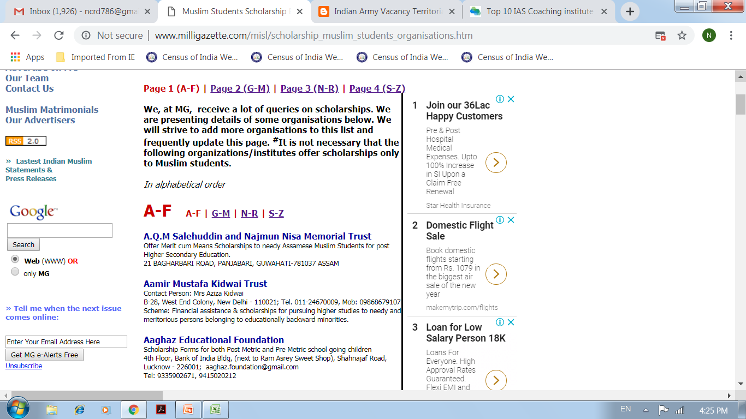
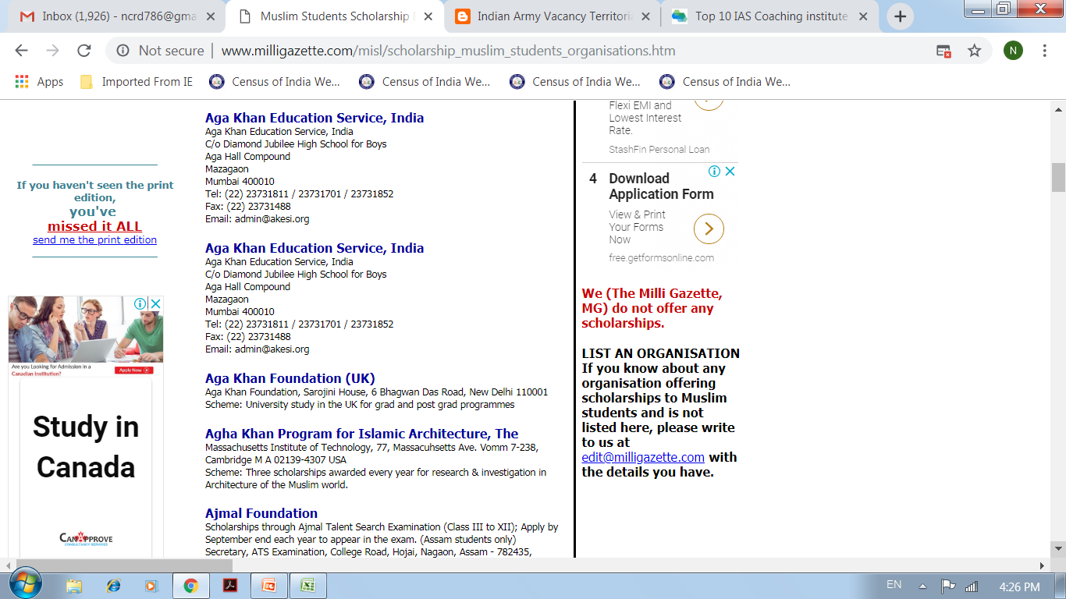

Slide 294
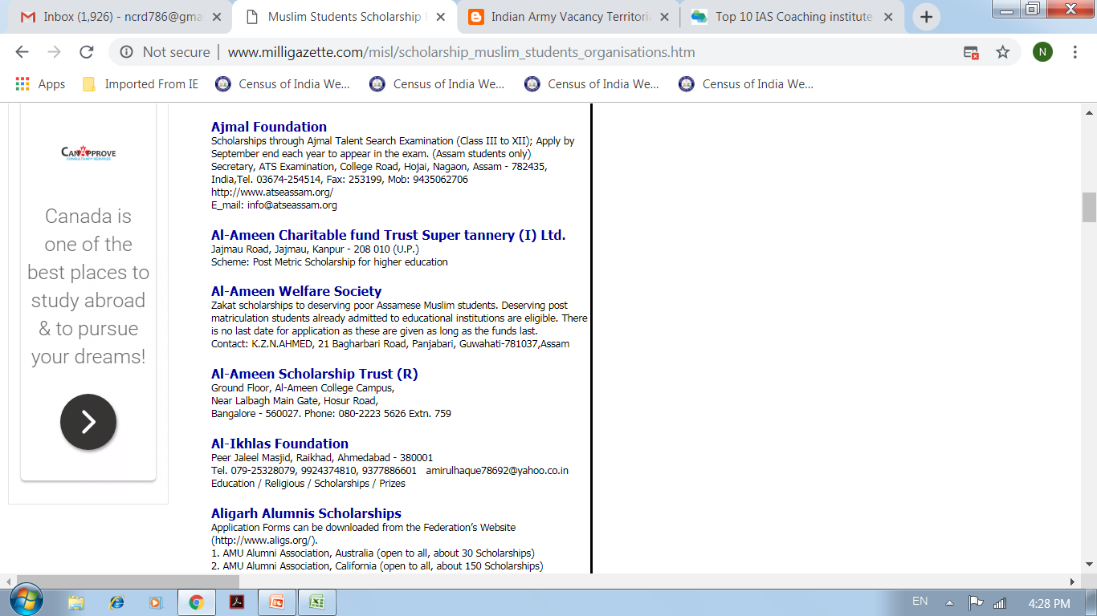
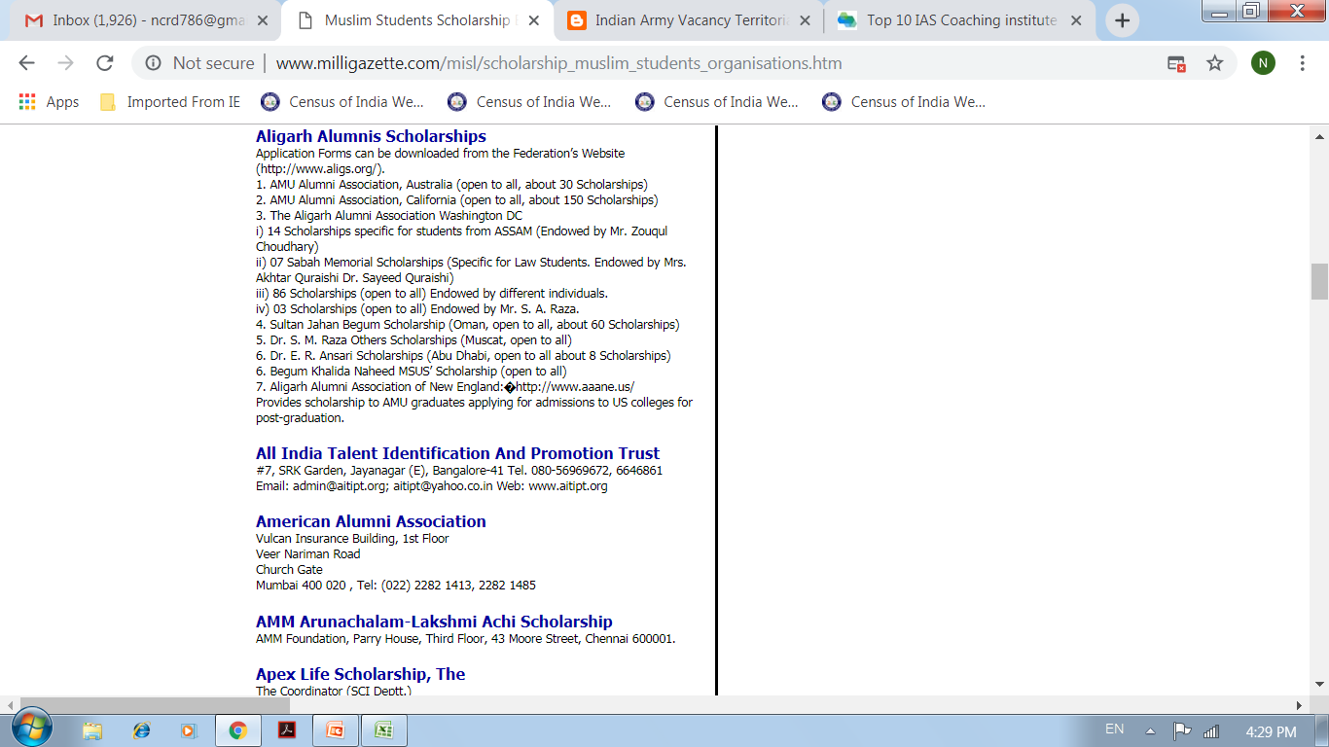

Slide 295
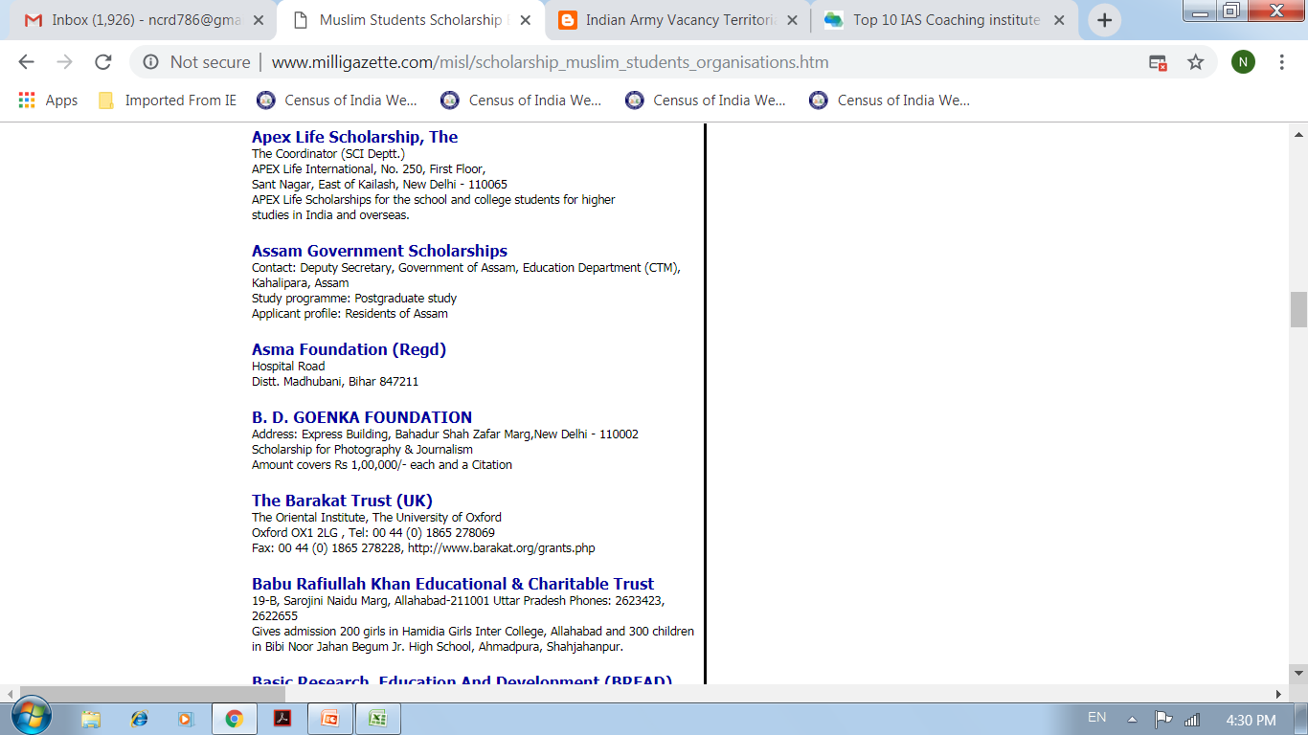
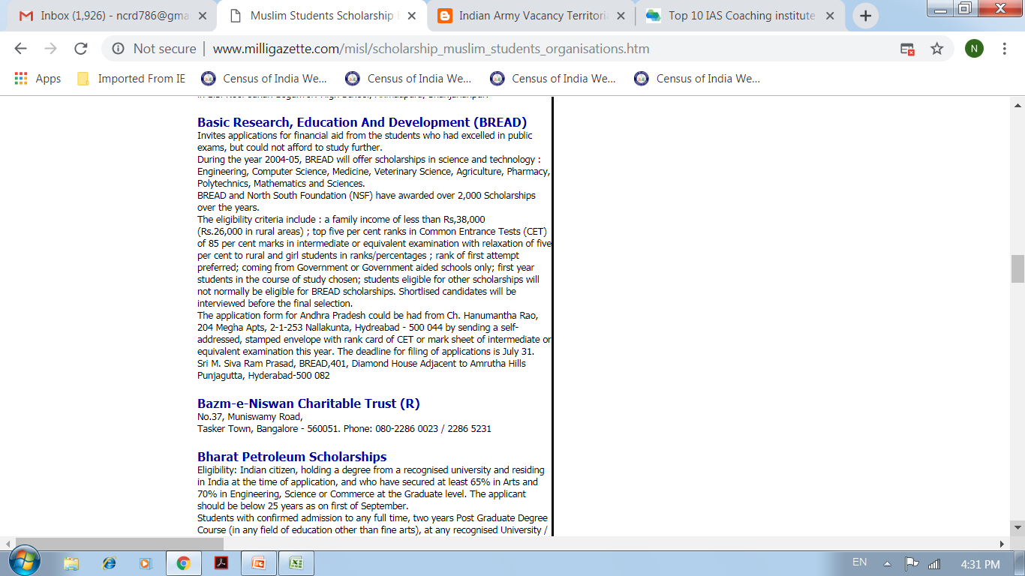

Slide 296
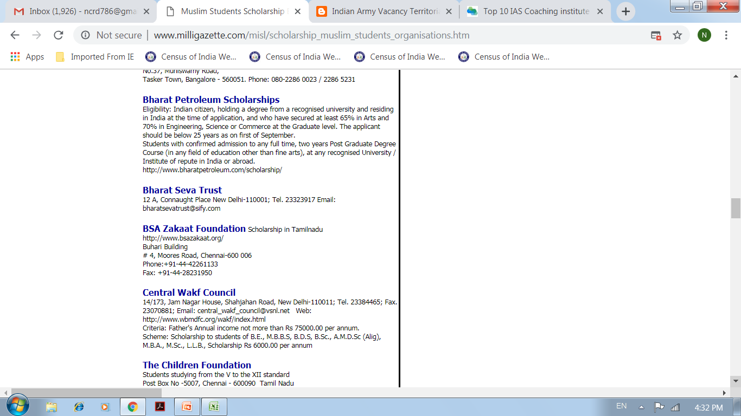
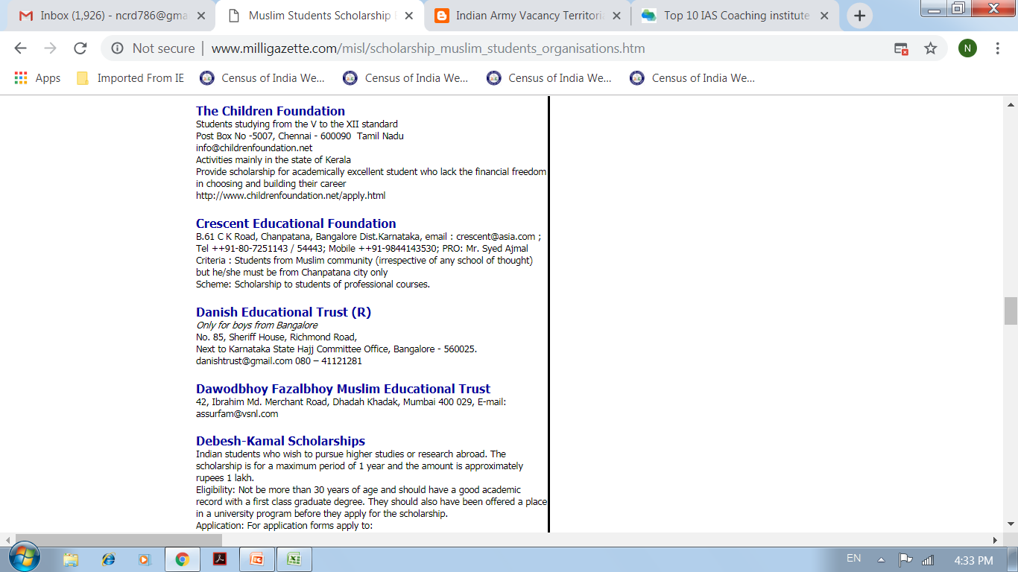

Slide 297
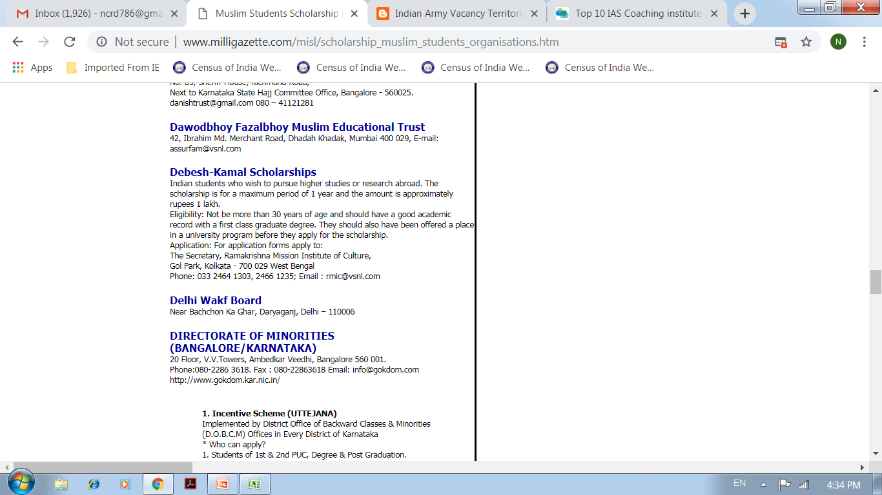
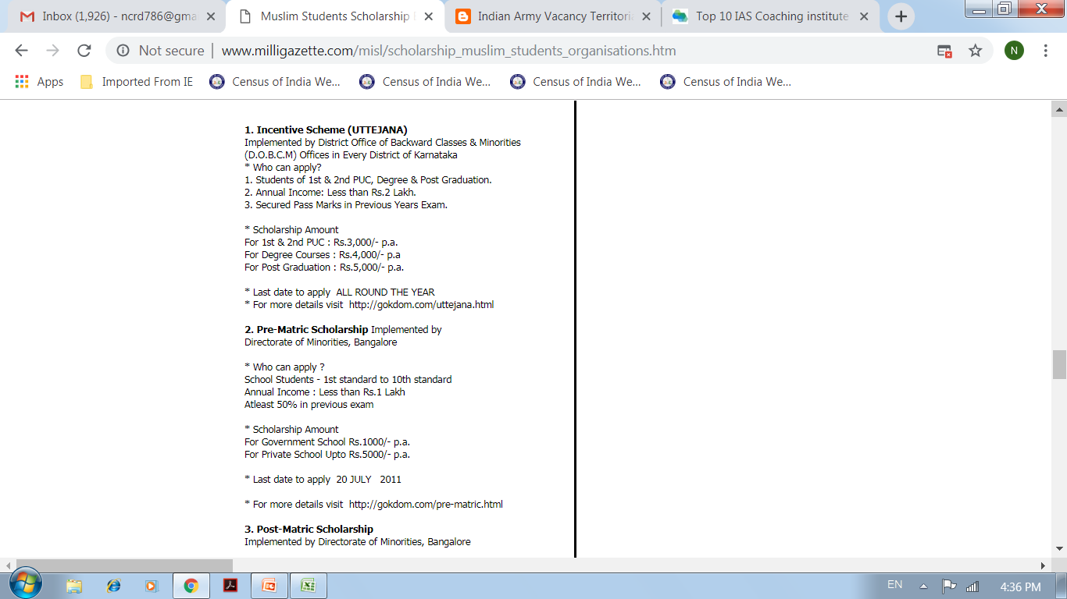

Slide 298
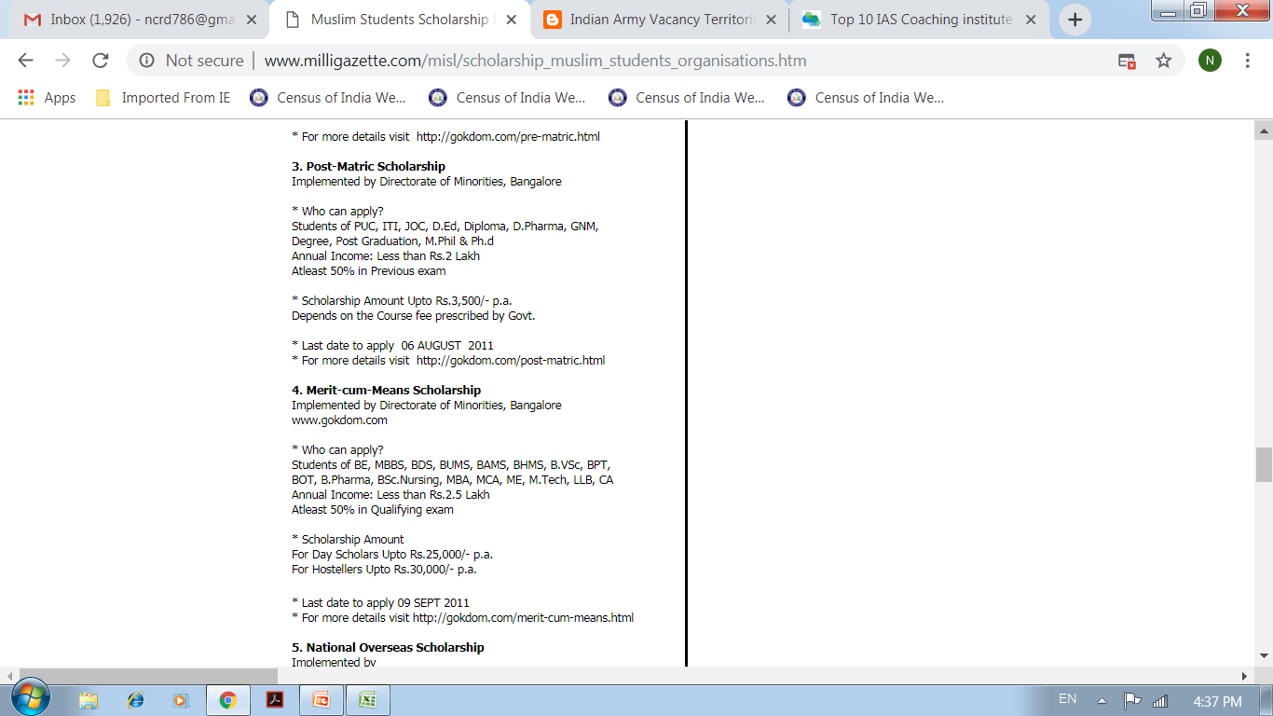
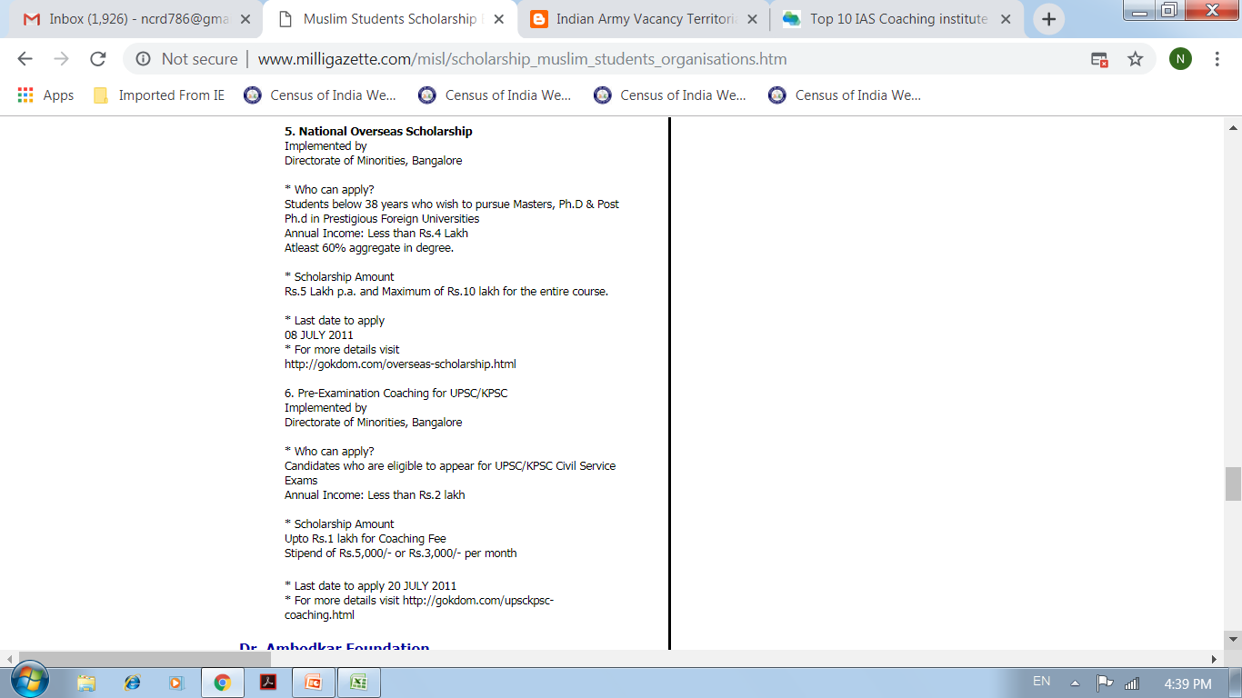

Slide 299
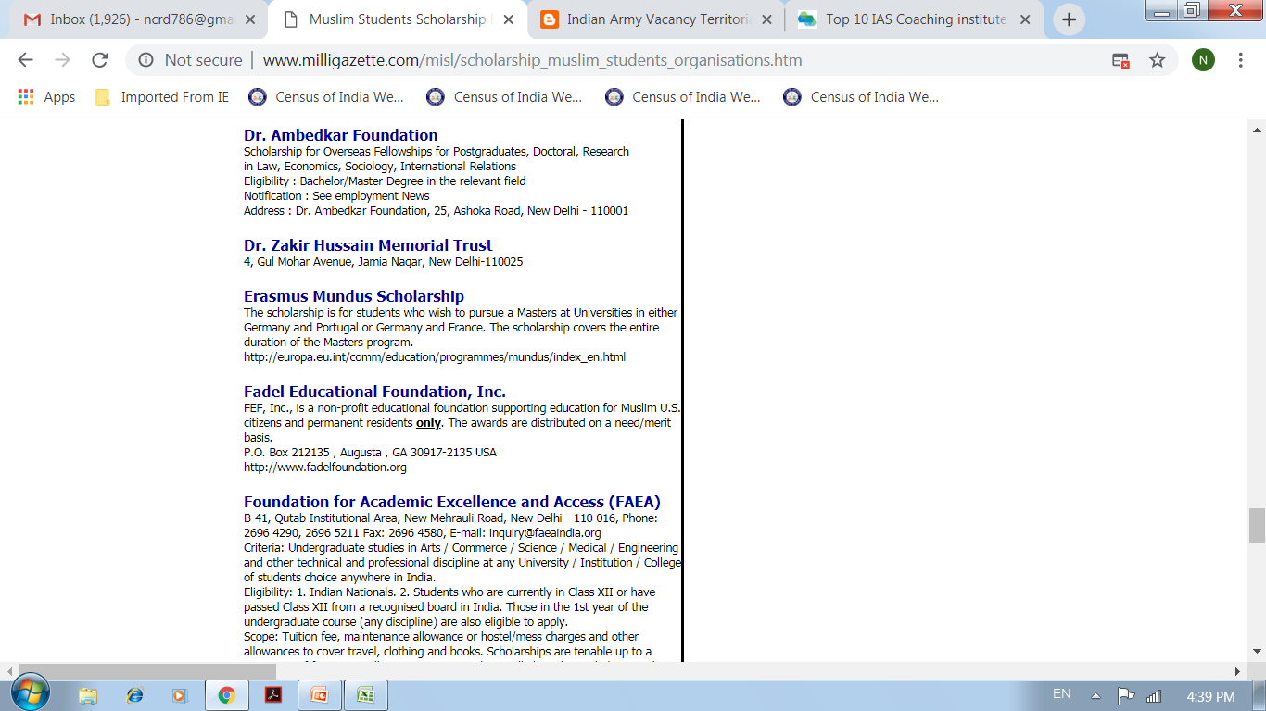
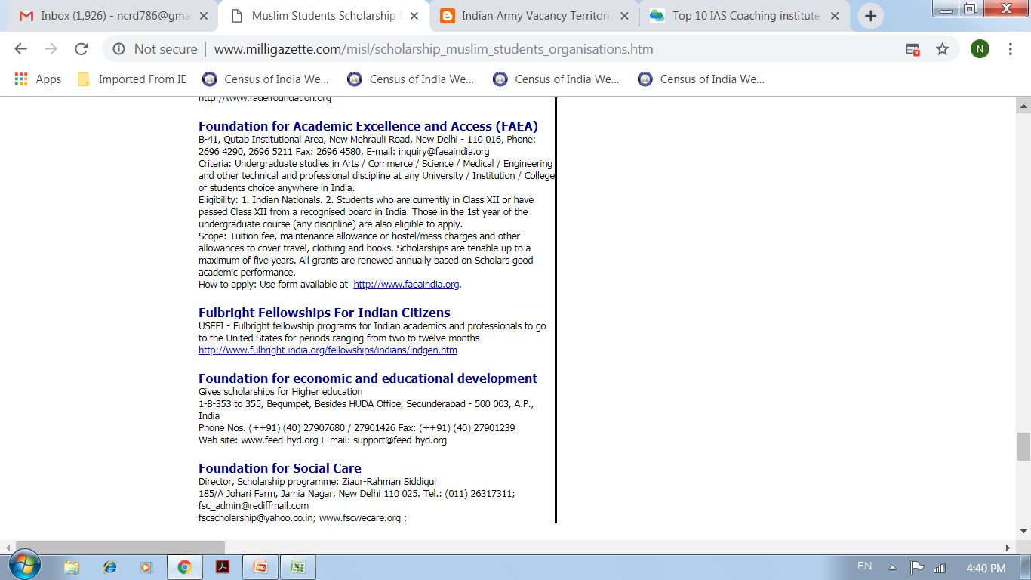

Slide 300
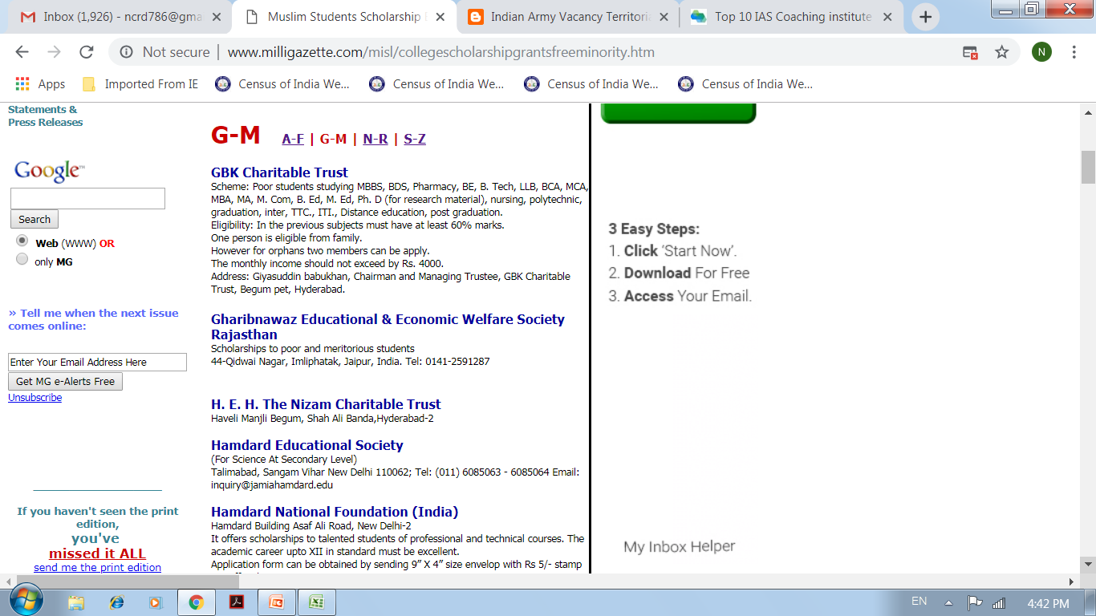
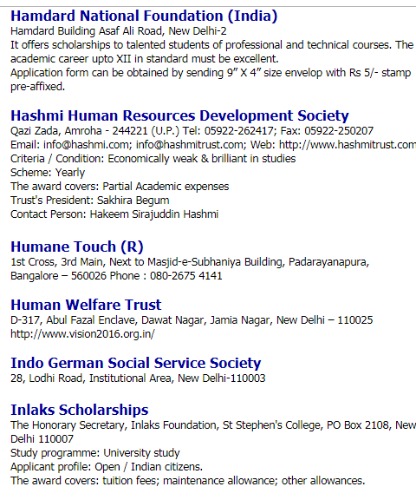

Slide 301
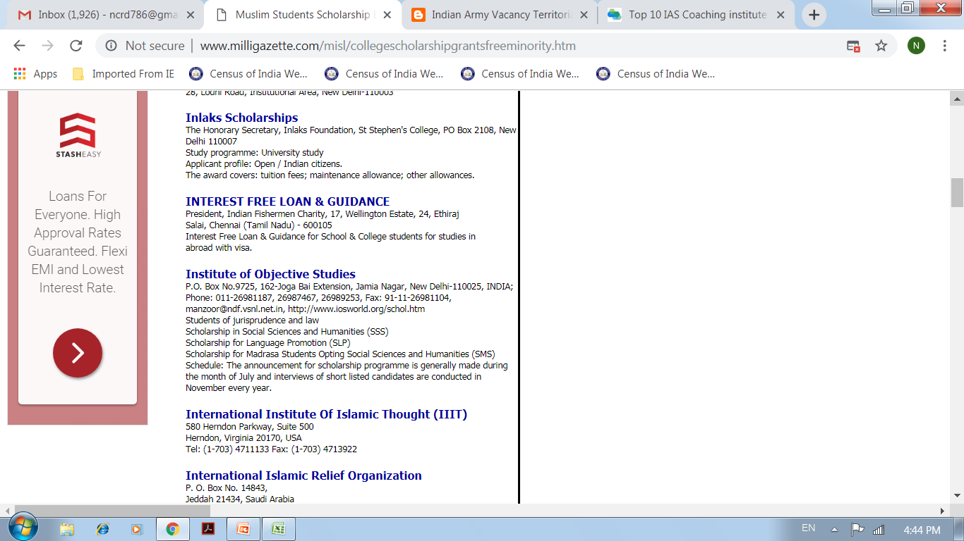
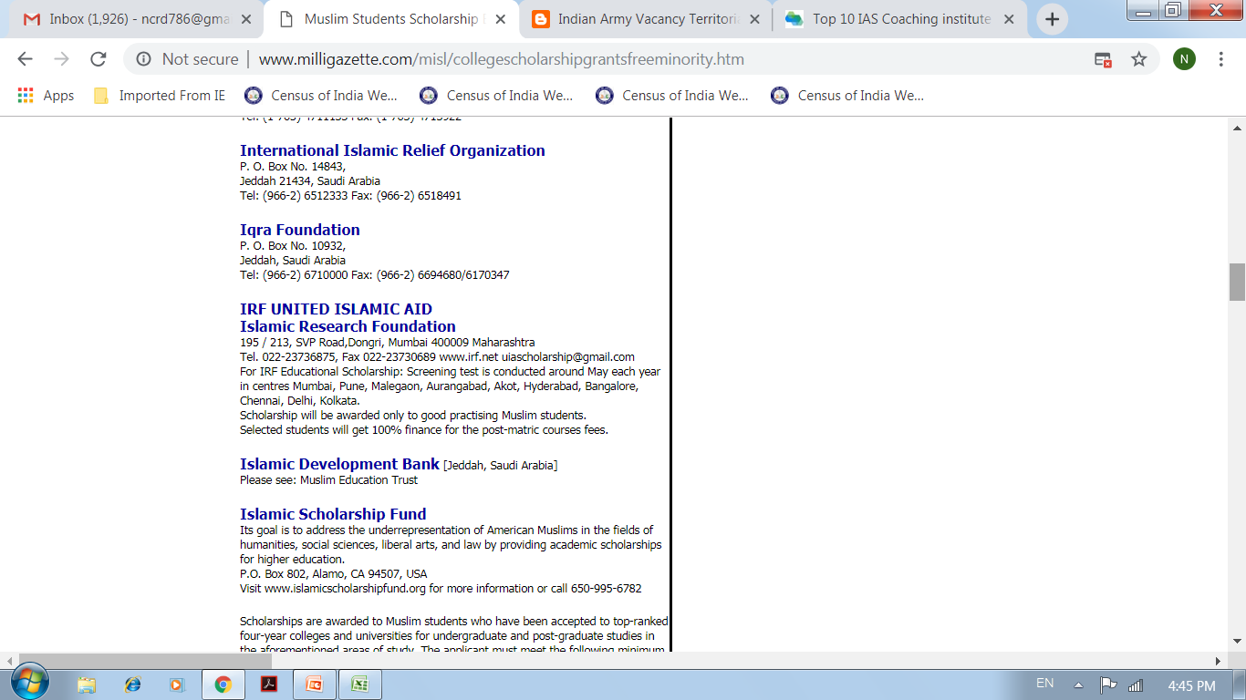

Slide 302
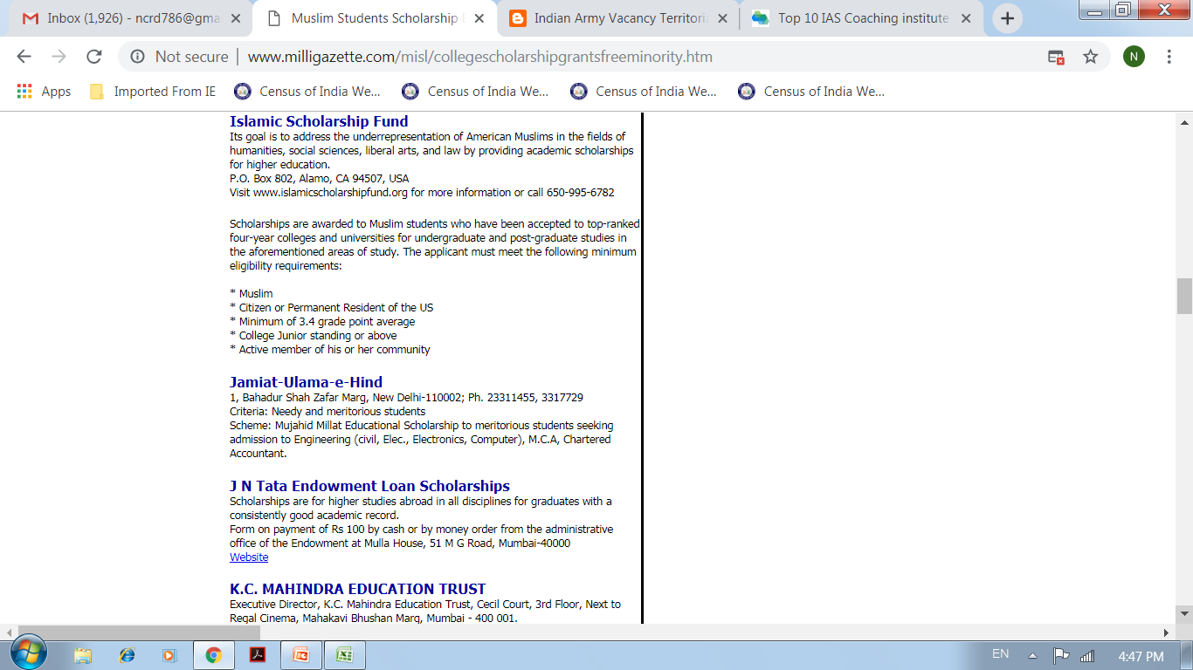
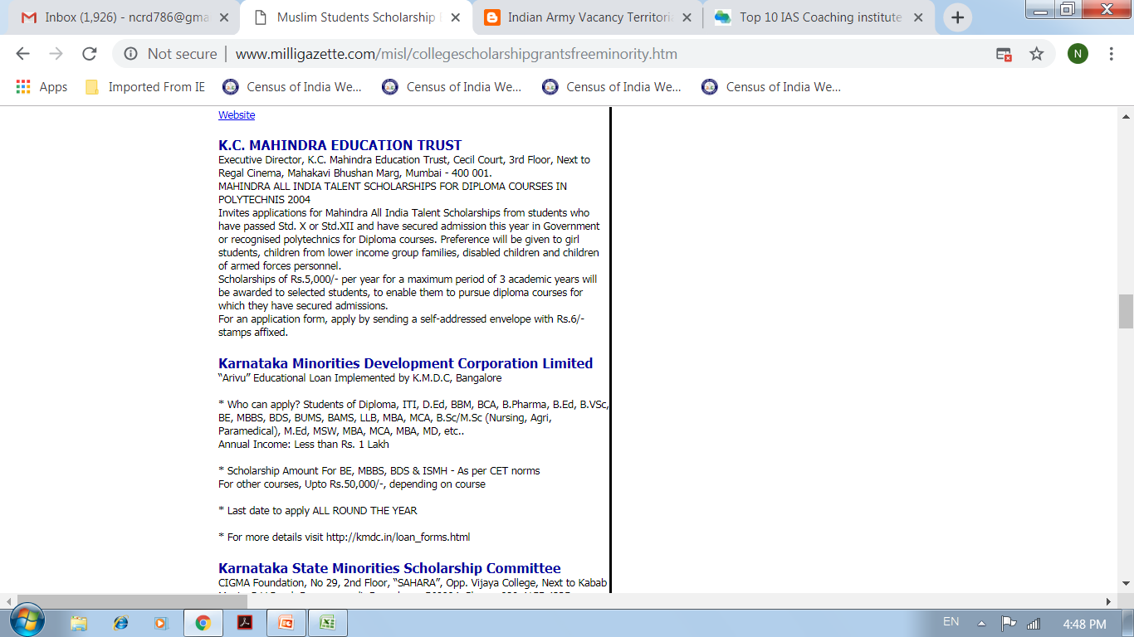

Slide 303
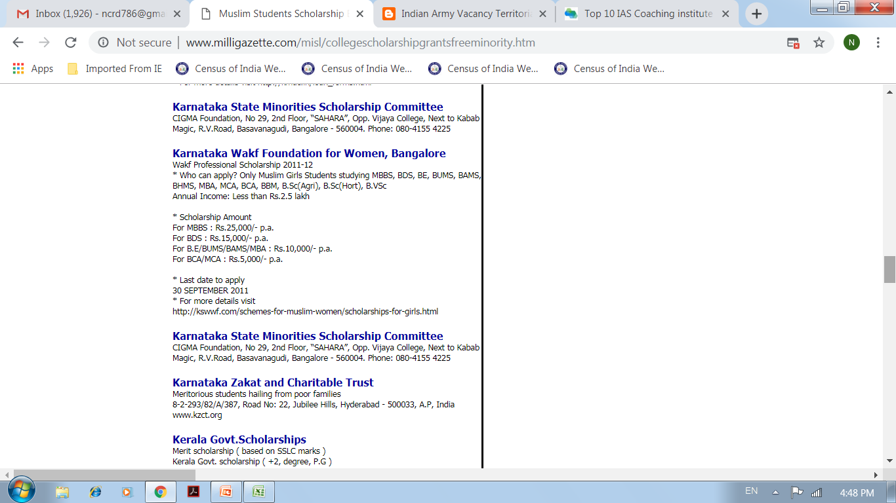
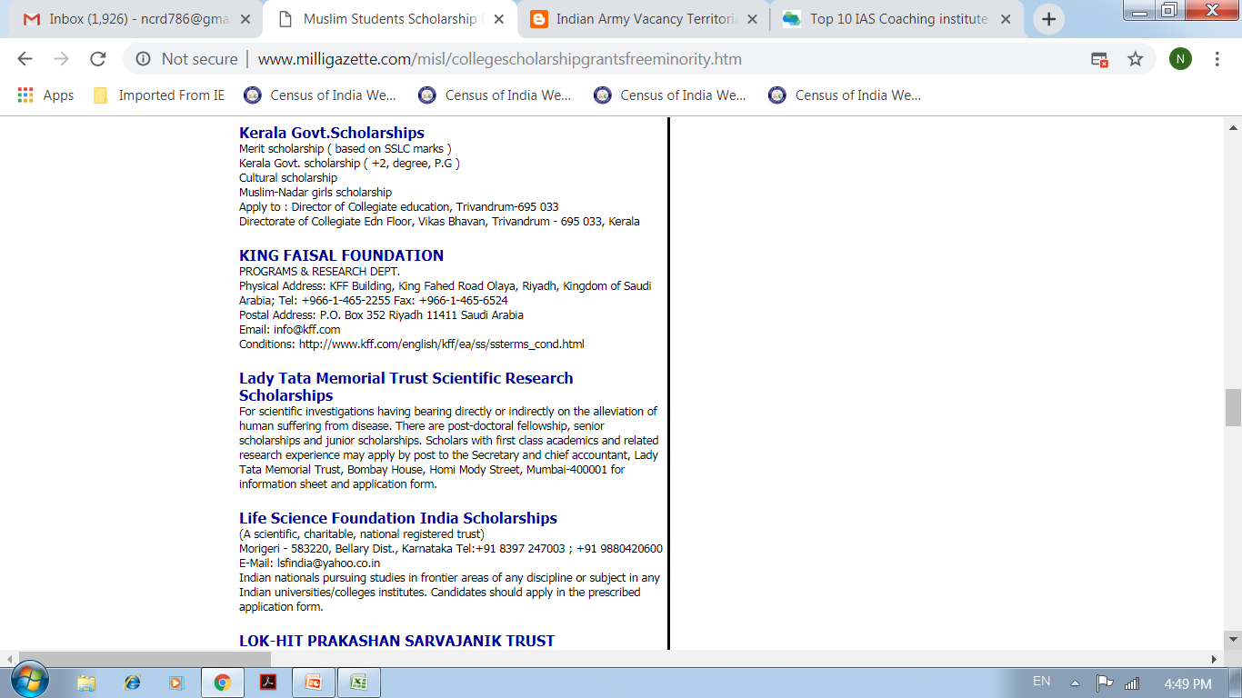

Slide 304
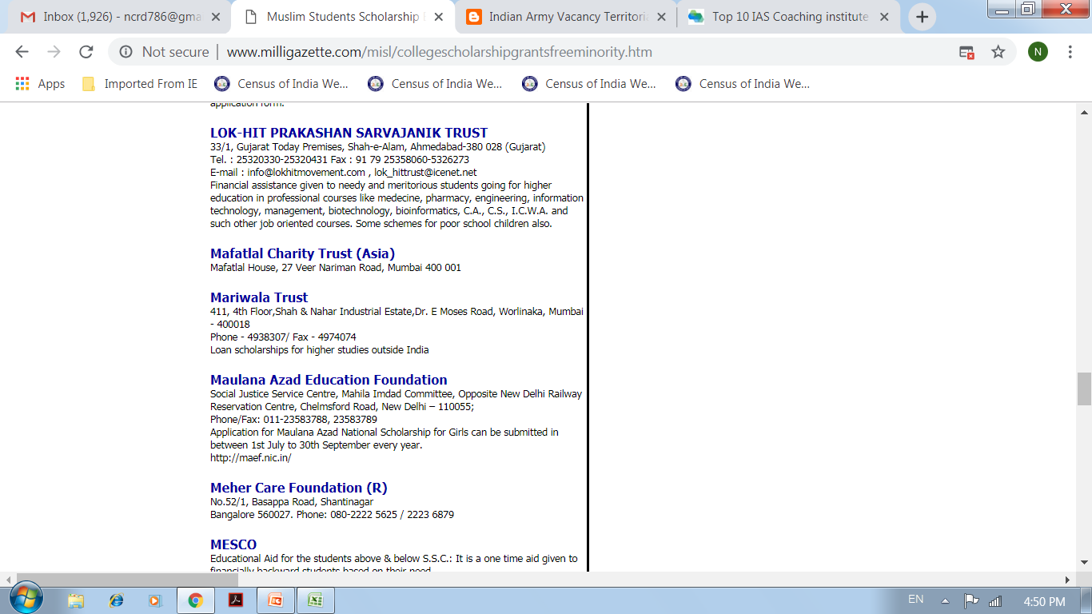
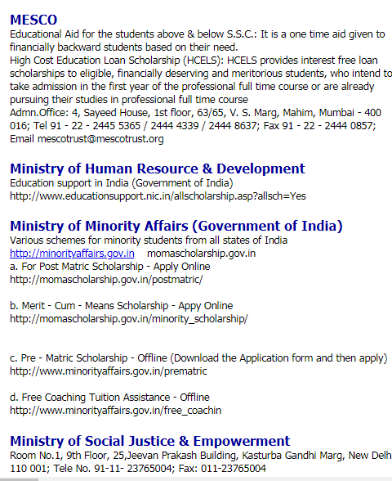

Slide 305
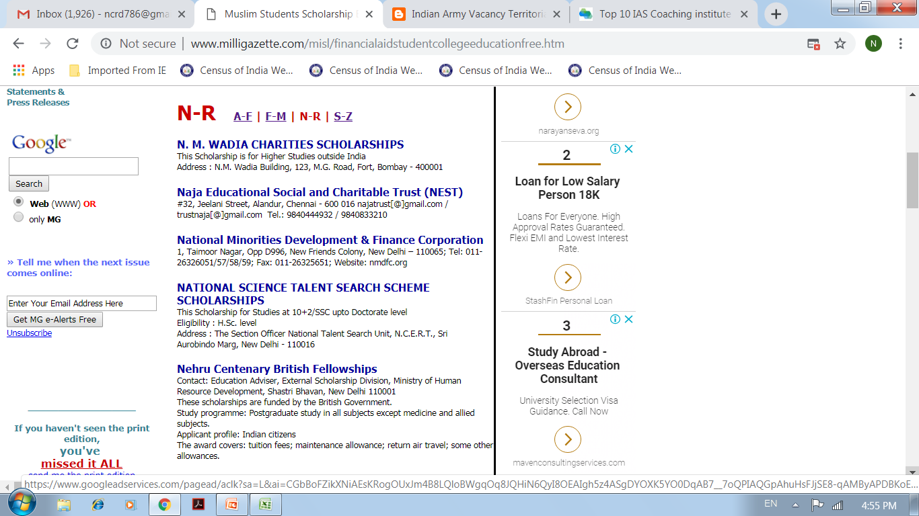
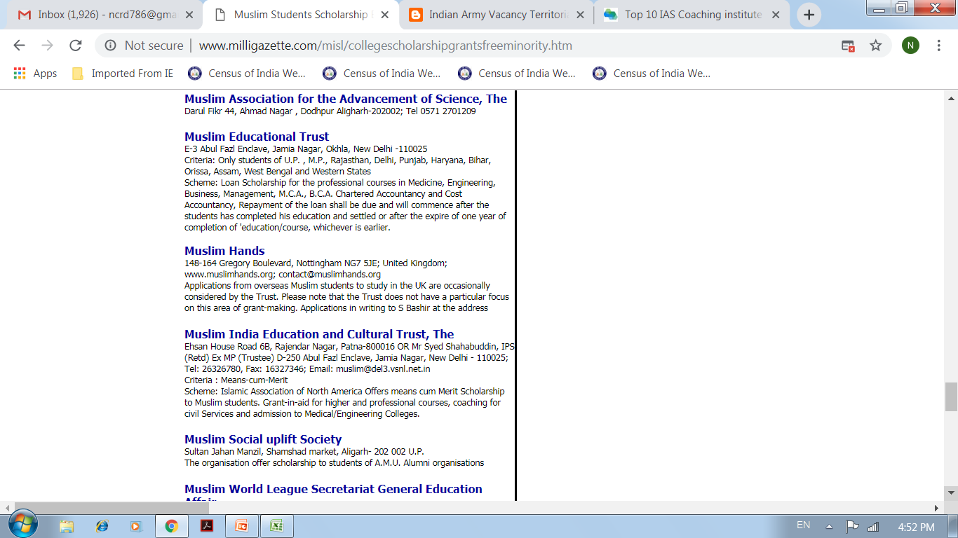


Slide 306




Slide 307



Slide 308



Slide 309



Slide 310
SCHOLARSHIPS
FOR
STUDY ABROAD

Slide 311
CANADA
How much does it cost to Study in Canada?
S.no. | Study program | Average annual fee (in CAD*)
1 | Undergraduate program | $13,000 to $20,000 per year
2 | Postgraduate master's degree | $17,000 to $25,000 per year
3 | Doctoral degree | $7,000 to $15,000 per year
4 | MBA | $30,000 to $40,000 per year

Slide 312
TOP COURSES TO STUDY IN CANADA
Artificial Intelligence
Pharmacy
Human Resource Management
Data Analysis
Business
Architecture
Computer Science
Nursing and Midwifery
Dental Studies

Slide 313
Scholarships to study in Canada
S. No. | Name of the scholarship | Description
1 | Shastri Indo-Canadian Institute | Offers various fellowships at different levels from graduate to post-doctorate and from research to training fellowships
 |  | Shastri Research Student Fellowship: For students enrolled in Bachelors, Masters, M.Phil degree programmes in recognised Indian universities or institutions to undertake research in their interested areas/ fields in a Canadian university
 |  | Eligible students can also pursue an e-course (module/part of a course), or do an e-internship at Canadian universities, which falls under SICI network
 |  | The value of this fellowship is CAD 500-1,000 (expenses that are not provided by the applicant’s home institution, and related to subscription of online meeting software, internet connection, telephone bills, affiliation fee or registration fee to access library or lab facility will be considered, if any)
 |  | The duration is up to 8-12 weeks for students
 |  | (Source: https://www.shastriinstitute.org/SRSF-Student-2020-21)

Slide 314
S. No. | Name of the scholarship | Description
2 | Canadian Commonwealth Scholarship and Fellowship Plan | This scheme identifies students with high intellect from Commonwealth countries applying to programs of advanced study and research at the Master and PhD level
 |  | The award comprises travel, living allowance and the compulsory tuition fees
 |  | It includes Graduate Students Exchanges (GSEP), which provide $10,000 for transportation, living and other expenses in Canada for 5-6 months
 |  | (Source: https://www.collegesearch.in/study-in-canada)

Slide 315
S. No. | Name of the scholarship | Description
3 | Ontario Graduate Scholarship Program | For graduate students in a wide variety of disciplines
 |  | As a pre-requisite to applying, students must accept an offer from a university in Ontario and obtain a valid study permit
 |  | The scholarship amount is $5,000 per session. So, you may receive $10,000 (two consecutive sessions); $15,000 (three consecutive sessions). In all, the unit will limit itself to one-third of the cost of the total award to be received by you
 |  | Each award is tenable for one year (two to three academic sessions). The value and duration are determined by the awarding graduate unit and detailed of which will be mentioned in your offer letter
 |  | Deadlines are set by the current or proposed graduate unit
 |  | (Source:https://www.sgs.utoronto.ca/awards/ontario-graduate-scholarship/#section_1)
4 | National Research Council of Canada (NRCC) | Research associateship is offered to master’s degree holders in engineering and PhD holders in natural science or engineering disciplines
 |  | (Please connect with your IDP counsellor for more information)

Slide 316
S. No. | Name of the scholarship | Description
5 | Quebec Provincial Government Scholarship | For students studying in Quebec
 |  | Financial assistance to students at master’s level or above
 |  | Each application is assessed on its merit
 |  | Value and duration are determined as per the level of study:
 |  | Doctoral program: $25,000 a year and duration is up to 3 years with a possible extension to it of 12 months
 |  | Postdoctoral scholarships: $35,000 for one year and can’t be renewed
 |  | Short-term research or professional development scholarship: $3,000 each month for 4 months
 |  | (Source:http://www.education.gouv.qc.ca/en/references/studying-in-quebec/merit-scholarships/)

Slide 317
S. No. | Name of the scholarship | Description
6 | Ontario Trillium Scholarship | First announced in November 2010 for doctoral students from around the world to study in Ontario
 |  | Each scholarship is worth $40,000 annually, renewable for a maximum of four years
 |  | 75 scholarships are awarded each year
 |  | Ontario universities are responsible for selecting and awarding the scholarship to international PhD students based on merit and program criteria
 |  | (Source: https://grad.uwo.ca/finances/external_funding/ots.html)
7 | Partnership Grants by Social Sciences and Humanities Research Council of Canada | For PhD candidates
 |  | Supports new or existing research initiatives in social sciences and humanities
 |  | Worth up to CAD 20,000
 |  | Duration: 4 to 7 years
 |  | (Source:https://www.sshrc-crsh.gc.ca/funding-financement/programs-programmes/partnership_grants_stage1-subventions_partenariat_etape1-eng.aspx)

Slide 318
S. No. | Name of the scholarship | Description
8 | Banting Postdoctoral Fellowships | Offered by the Canadian government to international students to pursue postgraduate program within the natural science, social sciences or healthcare research
 |  | This Postdoctoral Fellowship is worth $70,000 per year (taxable) for two years
 |  | Deadline for this scholarship is 1st October 2020
 |  | (Source:https://www.educanada.ca/scholarships-bourses/news-nouvelles/2020/2020-06-01.aspx?lang=eng)
9 | Vanier Canada Graduate Scholarships | This scholarship is awarded by Government of Canada to meritorious students who aspire to pursue a doctoral degree at a Canadian institution
 |  | Duration is for 3 years (non-renewable) and amount is 50,000 CAD per year
 |  | Deadline is November 3, 2020
 |  | (Source:https://www.educanada.ca/scholarships-bourses/news-nouvelles/2020/2020-06-24.aspx?lang=eng)

Slide 319
S. No. | Name of the scholarship | Description
10 | Anne Vallee Ecological Fund | These scholarships are designated for international students to support them undertake animal research at master or doctoral program in Québec or British Columbia University
 |  | This fund offers two $1,500 scholarship
 |  | (Source: https://www.grad.ubc.ca/awards/anne-vallee-ecological-fund)
11 | Trudeau Scholarships and Fellowships | These are offered to international students at doctorate level for some specific Canadian institutions
 |  | The amount is $40,000 each year for three years; and $20,000 each year for three years, as research and travel allowance
 |  | Deadline: Mid Fall Session, your IDP counsellor can help you with the application process
 |  | (Source: https://www.mcgill.ca/gps/funding/students/trudeau)

Slide 320
U S A
Exams for USA
International English Language Testing System [IELTS]
Test of English as a Foreign Language [TOEFL]
Pearson Test of English [PTE]
Graduate Record Examination [GRE]
Graduate Management Admission Test [GMAT]
Scholastic Aptitude Test [SAT]

Slide 321
Top Universities for International Students
Rankings (US News 2020) | Name of the Institute | Acceptance Rate
1 | Princeton University | 5.50%
2 | Harvard University | 4.70%
3 (tie) | Columbia University | 5.90%
3 (tie) | Massachusetts Institute of Technology | 6.70%
3 (tie) | Yale University | 6.30%
6 (tie) | Stanford University | 4.40%
6 (tie) | University of Chicago | 7.30%
6 (tie) | University of Pennsylvania | 8.40%
9 | Northwestern University | 8.50%

Slide 322
Popular Courses to Study in USA
MS | MS in Engineering Management
MBA | M.Arch
MBBS | Masters in Cybersecurity
MS in Data Science | B.Tech
Masters in Business Analytics | Masters in Economics
Masters in Finance | Masters in Supply Chain Management
MS in Computer Science | Masters in Mechanical Engineering
MS in Data Analytics | Masters in Project Management
Masters in Management | Masters in Information Systems
MS in Civil Engineering | B.Sc Computer Science
MS in Artificial Intelligence | Masters in International Business
BBA | Masters in Digital Marketing

Slide 323
Cost of Study in U S A
Tuition Fees |  | Amount (in USD, per year)
Average tuition Fees( UG) | Public 2-year colleges | 3,570
 | Public 4-year colleges | 9,970
 | Private 4-year college | 34,740
Average tuition Fees (PG) | Public institution | 25,000
 | Private institutions | 30,000
Health Insurance |  | 2,000 to 36,740
Cost of living
Type of Expenditure | Cost (in USD, per month
Food | 250 to 1,200
Transportation | 120 to 250
Utilities | 589
Internet pass | 66.17
Gas and Electricity | 165
Entertainment | 215
Books, Supplies and other Learning material | 200
Accommodation | 450 to 1,200
Living expenses for 1 year as Guarantee | 80,000

Slide 324
Scholarships in U S A
Name of Scholarships | Administered by | Benefits/Requirements | Amount
Federal Student Aid | US Department of Education | Offers scholarships, loans and work while study jobs | Depends upon the federal funds available
AAUW International Fellowship Program | - | Given to women pursuing graduate and post-graduate studies in USA on demonstration of academic excellence | 18,000 USD – 30,000 USD
Fulbright Student Program | Bi-national Fulbright Commissions or US Embassies | Operated in more than 155 countries worldwide, requirements differ across countries | Tuition fee, airfare, health insurance, and other expenses as per federal funds
Joint Japan World Bank Graduate Scholarship Program | - | Students pursuing a master’s degree in a topic related to ‘Development’; Citizenship of World Bank Member Developing Country | Full tuition fee, airfare, a monthly living stipend, and health insurance
Aga Khan Foundation International Scholarship Program | - | Awarded on a 50% grant and 50% loan basis to students pursuing masters in the USA; Applicants should be a national of a developing country | Assists in covering living cost and tuition fee

Slide 325
Asian Women in Business Scholarships Fund - Offering female students the chance to receive funding for an undergradute business degree taken at an accredited US university.
Chicago Booth School of Business - The Ramakrishna Family Scholarships and Akhtarali H. Tobaccowala Fellowship are both available for Indian students who apply to study a full-time MBA at the school.
Cornell University Tata Scholarship - Scholarships for Indian citizens who have been accepted to study an undergraduate program at Cornell University.
Fulbright-Nehru Research Fellowships - Offering funding to outstanding Indian students wishing to pursue study at any level within an accredited US institution. See individual scholarships for specific criteria.
S.N. Bose Scholarships Stuent Exchange Program for Indian Students - Opportunities for Indian researchers at master's level or higher to study a selected program in the field of science and technology at a university in the US.
Stanford Reliance Dhirubhai Fellowships for Indian students - Scholarships for Indian students to study at Standford Graduate School of Business on the MBA program. To be eligible students must return to India within two years of completing their studies.

Slide 326
UNITED KINGDOM
Exams for UK
International English Language Testing System [IELTS]
Test of English as a Foreign Language [TOEFL]
Pearson Test of English [PTE]
Graduate Record Examination [GRE]
Graduate Management Admission Test [GMAT]
Scholastic Aptitude Test [SAT]

Slide 327
Top universities in UK
Name of the Institute | THE World Rankings 2021 | THE UK Rankings 2021
University of Oxford | 1 | 1
University of Cambridge | 6 | 2
Imperial College London | 11 | 3
University College London (UCL) | 16 | 4
London School of Economics and Political Science | 27 | 5
University of Edinburgh | 30 | 6
King’s College London | 35 | 7
University of Manchester | 51 | 8
University of Warwick | 77 | 9
University of Bristol | 91 | 10

Slide 328
Popular Courses in UK
Popular Program | Best UK University for the course | Duration | Employment Rate
MBA | London School of Business | 15 to 21 months | 94%
Civil Engineering | Imperial College | 3 years | 78.40%
Masters (MS) in Law | University of Cambridge | 3 years | 93.30%
Medicine | University of Oxford | 5 to 6 years | 99.30%
Computer Science | University of Oxford | 3 years | 81.80%
MS in Psychology | University of Oxford | 3 years | 83.70%
Education | Durham University | 3 years | 95.20%
Masters (MS) in Architecture | University of Cambridge | 3 years | 86.30%

Slide 329
Tuition fees
Level of program |  | Estimated Fee (in GBP, per year)
Undergraduate level |  | 10,000 to 26,000 (58,600 for medical programs)
Postgraduate Level |  | 14,096 (21,767 and 18,914 for clinical and MBA courses, respectively)
Doctoral Level |  | 15,000 to 24,000
Cost of living in UK
Types of Expenses |  | Cost (in GBP, per month)
Housing |  | 500
Bills (electric/ gas/ water) |  | 40-50
Food |  | 160- 200
TV license |  | 12.56 (or 150.50 per year)
Mobile phone |  | 15-50
Clothes and Leisure |  | 40-50
Books & supplies |  | 30
Socializing |  | 120
Transportation |  | 35-40
Visa Application Fee (international candidates) |  | 348 (one-time fee)

Slide 330
Scholarships in UK
Name of Scholarship | Level of study | Countries eligible | Eligibility criteria | Applications open | Amount
Chevening Scholarships | Master’s | 144; around 700 scholarships per year | - | - | -
Commonwealth Scholarships | Master’s and PhD | 62 commonwealth nations | commonwealth citizen, refugee or British protected person and at least 2:1 Honours degree | August before the course is due to start | Covers tuition fees, a monthly living allowance and travel costs
Saltire Scholarships | Master's | Canada, India, Pakistan, USA and China | - | October, till May | 50 scholarships worth 8,200 GBP
The Australia Foundation Trust | All levels | - | Australian citizens entitled to live and study in the UK | - | 10,251 GBP
Mackenzie King Memorial Scholarships | Master's/PhD | - | Degree from any Canadian university with a minimum grade A, across all courses | January | 8,710 GBP worth scholarships plus travel allowances
China- Great Scholarships | Postgraduate | - | Offer for a course at any one of the participating universities | Varies across institutions | Total 150 scholarships worth 10,24,667 GBP
BAFTA Scholarships | Master's | - | Chinese national seeking to study a postgraduate course in the field of film, television or games | March (closes in June) | 10,246 GBP as tuition fee plus additional living expenses
Inlaks Scholarship | All levels (but you must have an undergraduate degree) | - | Undergraduate degree, offer letter from a ‘topranking' institution | January - April | -

Slide 331
British Council GREAT scholarships for Indian Students - A selection of scholarships are offered by the British Council, to support Indian students applying to study abroad in the UK.
Charles Wallace India Trust Scholarships - For Indian students who wish to study in the UK. Open to doctoral students, research students and visiting fellows.
Heriot Watt SML International Merit Scholarships for Idian Students - Open to Indian students at postgraduate level studying at Heriot Watt University in the UK on a taught program within the School of Energy, Geoscience, Infrastructure and Society.
LSE Commonwealth Shared Scholarship Scheme (CSSS) - Five awards are available to international students from commonwealth countries (inclding India) to study at postgraduate level at the London School of Economics and Political Science (LSE).
Ms. Agatha Harrison Memorial Fellowship at St. Antomy's College - Indian government fellowship offered to Indian students pursuing study at the University of Oxford's St. Antony's College in the field of history, economics and political science. Only available to high-achieving postgraduate research students.
Oxford and Cambride Society of India (OCSI) Scholarships - Open to Indian students at any degree level to study at Oxford University or the University of Cambridge in the UK
Saltire Scholarships - Scholarships for students from Canada, the US, India and China to study in Scotland at any degree level.
Sir Ratan Tata Fellowships for South Asian Students at LSE - Scholarships for social science students from South Asia to study at the London School of Economics (LSE) in the UK within the LSE Asia Research Centre (ARC).

Slide 332
Sussex India Scholarships - Oppartunities to gain funding at the University of Sussex in the UUK for Indian students at Master's Degree level.
University of Bournemouth Business School Dean's Scholarships for Master Students - A total of five scholarships for international students to study a taught master's program at Bournemouth University in the UK. Open to students from Russia, Turkey, Nigeria, China, India, South Korea for a 50 percent tuition fee reduction.
University of Lincoin India Scholarships - Scholarships are available for high-achieving India postgraducate students, offered in the form of £50,000 tuitaion fee reductions.
University of Oxford Felix Scholarships for Indian Students - Graduate funding opportunities for Indian students studying at the University of Oxford.
University of Sheffield - A range of scholarships for undergraduate and postgraduate Indian students who show strong academic potential.
University of Southampton LLM Iinternational Scholarships - International scholarships to study law at postgraduate level at the U K's University of Southampton. Open to all students from outside of the European Union.
UWE International Scholarships - UWE Bristol University in the UK is offering undergraduate and postgraduate tuitoin fee discount scholarships for students from several ountries, including India.
Gates Cambridge Scholarships
Clarendon Scholarships University of Oxford
Warwick Chancellor's International Scholarships
Westminister Full International Scholarship

Slide 333
SWEDEN
Exams for Sweden
International English Language Testing System [IELTS]
Test of English as a Foreign Language [TOEFL]
Pearson Test of English [PTE]
Graduate Record Examination [GRE]
Graduate Management Admission Test [GMAT]
Scholastic Aptitude Test [SAT]

Slide 334
Top Universities to Study in Sweden
Rankings | Top Colleges | Fees
97 | Lund University | 1,00,000 - 2,00,000
98 | KTH Royal Institute of Technology | 3,10,000 - 5,20,000
124 | Uppsala University | 75,000 - 30,000
139 | Chalmers University of Technology | 75,000 - 95,000
181 | Stockholm University | 90,000 - 1,40,000
202 | University of Gothenburg | 1,04,000 to 4,42,000
333 | Umea University | 93,000 to 2,92,000
362 | Linkoping University | 80,000 to 4,40,000

Slide 335
Popular Programs to Study in Sweden
Program | Tuition Fees (SEK) | Tuition Fees (INR)
MBA in Sweden | 81,200 to 495,000 | 6.2- 40 lakhs
MS in Sweden | 80,000 to 130000 | 6- 10 lakhs
Bachelors in Sweden | 75,000 to 440000 | 6- 36 Lakhs
Social Sciences and Humanities | 80,000 to 110000 | 6-9 lakhs
Technical and Natural Sciences | 120,000 to 145000 | 9.9-12 lakhs
Architecture and Design | 190,000 to 295000 | 15-24 lakhs
Cost of Study in Sweden
Expense Type | Cost in SEK | Cost in INR
Applications | 900 | 746
Bachelors in Sweden | 75,000 to 440,000/yr | 6- 36 Lakhs
Social Sciences and Humanities | 80,000 to 110,000/yr | 6-9 lakhs
Technical and Natural Sciences | 120,000 to 145,000/yr | 9.9-12 lakhs
Architecture and Design | 190,000 to 295,000/yr | 15-24 lakhs
MBA in Sweden | 81,200 to 495,000/yr | 6.2- 40 lakhs
MS in Sweden | 80,000 to 130,000/yr | 6- 10 lakhs
Monthly Expense | 8514 | 70,500
Textbooks | 750/month | 6,200
Student Union (if joined) | 50-350 | 414-2,900

Slide 336
Accommodation when Studying in Sweden
Expense Type | Cost in SEK | Cost in INR
Food | 2000 | 16,500
Accommodation | 4170 | 34,500
Local Travel | 550 | 4,550
Phone/Internet | 300 | 2,480
Miscellaneous | 1494 | 12,300
Scholarships in Sweden
Scholarship | Award | University/College
BTH Prospective Scholarship | 50% tuition fees waiver | Blekinge Institute of Technology
IPOET Scholarships | 75% tuition fees waiver | Chalmers University of Technology
KTH Scholarship | Covers full tuition fees | KTH Royal Institute of Technology
Karlstad University Global Scholarship | Up to 100% waiver | Karlstad University
Lund University Global Scholarship | Covers up to 25% to 75% tuition | Lund University
Linnaeus University Scholarship | Covers up to 75% of tuition | Linnaeus University
Linkoping University Scholarship | Covers 25% to 75% of tuition | Linkoping University
Halmstad University of Scholarships | Covers up to 25% to 50% of tuition | Halmstad University

Slide 337
SINGAPORE
Exams for Singapore
International English Language Testing System [IELTS]
Test of English as a Foreign Language [TOEFL]
Pearson Test of English [PTE]
Graduate Record Examination [GRE]
Graduate Management Admission Test [GMAT]
Scholastic Aptitude Test [SAT]
Study in Singapore: Top Universities for International Students
Universities | Fees Per Annum (SGD)
National University of Singapore (NUS) | 45,000
Nanyang Technological University (NTU) | 36,280
Singapore Institute of Management | 5,778
Singapore Management University | 48,150
James Cook University-Singapore | 51,360
Singapore University of Technology and Design | 51,700
TUM Asia | 20,425
Management Development Institute of Singapore | 24,220

Slide 338
Degree Courses to Study in Singapore
Masters/MS
MBA
MBB
Cost of Studying in Singapore
The average cost of pursuing bachelor's or undergraduate degrees in Singapore is around 19,000 SGD (~14,400 USD).
Masters Programs in Singapore cost around 20,000 SGD to 54,000 SGD.
The cost for some of the popular programs are:
MBA in Singapore 82,000 - 123,000 SGD
MBBS in Singapore: avg 28,000 SGD
BBA in Singapore 22,000 to 28,000 SGD/year

Slide 339
Cost of Living in Singapore
Expense-Type | Costs (in SGD)
Books | 150
Monthly rent (900sqft) in normal area | 2,636
Basic meal (lunch and dinner) | 12 for lunch and $54 for dinner
Food (cafe or bar) | 400
Internet 8mbps for a month | 43
1 min of prepaid tariff (without any plans) | 0.25
Entertainment | 200
Monthly ticket for public transport | 91
Utilities like electricity, gas, etc (monthly cost) | 160

Slide 340
STUDY IN SINGAPORE WITH SCHOLARSHIPS
Singapore International Graduate Awards: Available for international students with excellent academic records at the undergraduate level, and who are also interested in research work. Offers financial support for up to 4 years of Ph.D. studies including full tuition fees waiver, monthly stipend, settlement allowance, and airfare grant.
INSEAD-Syngenta MBA Scholarships - for Developing Country Leaders: Available for students from an emerging economy pursuing MBA. Offers award money of 32,000 SGD
ADB-Japan Scholarship - Program for Developing Countries in Asia and Pacific: Offered to international students from ADB borrowing member country pursuing masters or doctoral program in a university at Singapore. Waivers full tuition fees, a monthly subsistence and housing allowance, allowance for books, medical insurance, and travel expenses for a period of one year.
Singapore Government Scholarships for Southeast Asians: Offered to meritorious students from ASEAN countries enrolled in undergraduate programs at a University in Singapore. Awards full tuition fees waiver, a living allowance of 43000 SGD per annum, and accommodation fee.
SIA Youth Scholarship - Offered to students from ASEAN countries pursuing their pre-university degrees. SIA Youth Scholarships (https://collegedunia.com/scholarship/142-sia-youth-scholarship) offer hostel allowance, medical cover expenses, airfare, and school fees.
NUS Science and Technology Scholarships - Offered to Asian freshmen at NUS, wavering full-tuition, 6000 SGD for living allowance, and 2000 SGD one-time allowance. NUS Science and Technology Scholarship (https://collegedunia.com/scholarship/286-nus-science- andtechnology- undergraduate-scholarship) is limited in number.
Tuition Grant by the Ministry of Education - The grant covers complete tuition fees. However, one of the major conditions on this grant is, the graduating student has to sign a bond that they will work in Singapore for three years.
DST A-STAR Call for Singapore - India Joint Research Grants - Grants for Indian researchers within the fields of science and technology to study in Singapore. Sponsored by the Indian government and A*Star Singapore.

Slide 341
NEW ZELAND
Exams for New zealand
International English Language Testing System [IELTS]
Test of English as a Foreign Language [TOEFL]
Pearson Test of English [PTE]
Graduate Record Examination [GRE]
Graduate Management Admission Test [GMAT]
Scholastic Aptitude Test [SAT]

Slide 342
Top Universities and Popular Programs to Study in New Zealand
Rank | University | Popular UG Programs | Popular PG Programs
#83 | The University of Auckland | Bachelor of commerce, engineering, computer science | Masters in data science, computer science, management
#176 | University of Otago | Bachelor of science, arts, commerce | Master of public health, data science, professional
#215 | Victoria University of Wellington | Bachelor of science, commerce, nursing | Masters of computer science, professional accounting, and professional business analytics
#227 | University of Canterbury | Bachelor of computer science, engineering, science | Masters of engineering studies, business information systems, business management
#266 | University of Waikato | Bachelor of science, business, engineering | Master of information technology, management, engineering
#287 | Massey University | Bachelor of business, arts, aviation | Master of analytics, public health, education
#356 | Lincoln University | Bachelor of commerce, science, agriculture | Master of science, arts, tourism management
#442 | Auckland University of Technology | Bachelor of arts, information technology, construction project management | Master of creative technologies, construction management, engineering

Slide 343
Tuition Fees to Study in New Zealand
Courses | Program Fees (NZD)
MBA in New Zealand | 36,000 to 58,000
Masters in Computer Science | 35,000 to 53,000
MBBS in New Zealand | 150,000 to 160,000
Masters in Civil Engineering | 38,000 to 45,000
Masters in Public Health in New Zealand | 20,000 to 80,000
Masters in Mechanical Engineering | 38,000 to 53,000
Cost of Living in New Zealand
Accommodation: 565 to 640 NZD/week for a 3-4 bedroom apartment in Auckland.
Food: Weekly costs spent by a student on food are:
Auckland- 71 NZD
Wellington- 68 NZD
Christchurch- 70 NZD
Dunedin- 68 NZD
Prepaid mobile plans start at 19 NZD.
Transport passes: 79 NZD
Recreation & Culture: 64 NZD
Other Expenses like alcohol, clothing, and all together with the above-mentioned expenses total to around 12,000 NZD weekly.

Slide 344
Scholarships to Study in New Zealand
Scholarship | Award | Eligibility
New Zealand International Doctoral Research Scholarship | 600 NZD/year for 3 - years | Offered to Indian Students who wish to study PhD in New Zealand
University of Otago International Masters Research Scholarship | 15,000 NZD stipend | International students pursuing first masters research program from University of Otago
UC International First-Year Scholarships | 10,000 to 20,000 NZD | UG program at University of Canterbury
Eamon Molloy Memorial Scholarship | 15,000 NZD | Offered to Asian Students enrolling in University of Canterbury;
New Zealand Excellence Awards | 5,000 NZD | Offered to Indian students enrolled with New Zealand Universities
Guardian Trust’s Masters Scholarship in Commerce | 16,500 NZD | Offered to students applying with FT and PT courses with University of Canterbury

Slide 345
MALAYSIA
Exams for Malaysia
International English Language Testing System [IELTS]
Test of English as a Foreign Language [TOEFL]
Pearson Test of English [PTE]
Graduate Record Examination [GRE]
Graduate Management Admission Test [GMAT]
Scholastic Aptitude Test [SAT]

Slide 346
Study in Malaysia: Top universities for international students
Name of the institute | THE World Rankings 2020 | The Malaysia Rankings 2020 | City/Area
University of Malaya | 301–350 | 1 | Kuala Lumpur
Universiti Tunku Abdul Rahman (UTAR) | 501–600 | 2 | Petaling Jaya
Universiti Kebangsaan Malaysia | 601–800 | =3 | Selangor
Universiti Malaysia Perlis | 601–800 | =3 | Arau
Universiti Putra Malaysia | 601–800 | =3 | Selangor
Universiti Sains Malaysia | 601–800 | =3 | Pulau Pinang
Universiti Teknologi Malaysia | 601–800 | =3 | Johor
Universiti Teknologi Petronas | 601–800 | =3 | Seri Iskandar
Universiti Tenaga Nasional (UNITEN) | 801–1000 (tel:801–1000) | =9 | Selangor
Universiti Utara Malaysia | 801–1000 (tel:801–1000) | =9 | Kedah Darul Aman

Slide 347
Best courses to study in Malaysia
Popular Program | Best Malaysian University for the course | Top recruiters post degree
Business Administration | AIMST University/International Islamic University | Google, IBM, Hong Leong
Architecture | Infrastructure University Kuala Lumpur | SAA, Hoda design, Greenland Fortune Global
Computer Science | Universiti Teknologi Petronas/ Universiti Kebangsaan Malaysia | Google, Grab, Facebook
Mechanical Engineering | Infrastructure University Kuala Lumpur/Universiti Teknologi Petronas | Apple, Boeing, Erics
Psychology | Universiti Kebangsaan Malaysia, Raffles University | Columbia Asia Hospitals, Rekindle
Law | International Islamic University Malaysia, Universiti Kebangsaan Malaysia | Baker McKenzie, DLA Piper, Latham & Watkins

Slide 348
Study in Malaysia Cost
Level of Education | Tuition Fee (in MYR, per year)
Undergraduate Programs | 25,000 to 60,000
Graduate Programs | 30, 000 to 45,000
Diploma Programs | 20,000 to 30,000
Cost of Living in Malaysia
Type of Expenditure | Cost (in MYR, per month)
Accommodation and utilities | 2,475
Food and supplies | 400 to 500
Health insurance | 400 to 600 (per year)
Phone and internet | 125
Personal Expenses | 125 to 450
Travel costs | 100 to 300
Books and Supplies | 200

Slide 349
Scholarships to study in Malaysia
Name of the scholarship | Eligibility | Benefits | Portal
Malaysian International Scholarship (MIS) | International students looking to study an undergraduate/graduate program in Malaysia | Air tickets, installation and Termination grant, thesis allowance, books and travel expenses | Malaysian Ministry of Higher Education portal
Malaysian Commonwealth Scholarship | Malaysian Commonwealth Scholarship | Air tickets, approved tuition fees, annual grant for books, travel expenses, monthly maintenance and allowance | Malaysian Ministry of Higher Education portal
Heriot-Watt- Velesto Petroleum Engineering Scholarship | International students wanting to pursue their undergraduate studies in petroleum engineering | 100% or 50% tuition fee waiver at Malaysia campus | Heriot-Watt University website
Malaysian Technical Cooperation Program Scholarships (MTCP) | Local and international students with PhD duration of 36 months and master’s duration of 12-24 months | Air tickets, approved tuition fees, annual grant for books, travel expenses, monthly maintenance and allowance | MTCP online portal
The Jeffrey Cheah Foundation-Sunway Group Scholarship | Students studying engineering, healthsciences and business/management courses below 21 years of age. Both, local andoverseas students | Air tickets, approved tuition fees, annual grant for books, travel expenses, monthly maintenance and allowance | Jeffery Cheah Foundation website

Slide 350
Top universities for international students
Name of the institute | THE World Rankings 2021 | THE German Rankings 2021 | International Student Population
Ludwig Maximilian University of Munich | 32 | 1 | 17%
Technical University of Munich | 41 | 2 | 27%
Heidelberg University | 42 | 3 | 18.60%
Charité - Universitätsmedizin Berlin | 75 | 4 | 19%
University of Tübingen | 78 | 5 | 14%
Humboldt University of Berlin | 80 | 6 | 18%
University of Freiburg | 83 | 7 | 23%
RWTH Aachen University | 107 | 8 | 21%
University of Bonn | 114 | 9 | 13%
Free University of Berlin | 118 | 10 | 21%

Slide 351
Popular Program | Best German University for the course | Total Students in program in Germany
Engineering (Mechanical Engineering) | Technical University of Munich | 71,352
Business Management (MBA) | University of Mannheim | 52,168
Humanities | Humboldt University of Berlin | 37,619
Computer Sciences | Technical University of Munich | 20,000
Mathematics | University of Bonn | 10,000
Fine and Applied Arts | Technical University of Berlin | 24,412

Slide 352
Tution Fee
Level of Education | Tuition Fee (in EUR, per year)
Undergraduate Programs | 500 (public) to 20,000 (private sector)
Graduate Programs | 20,000 (public) to 30,000 (private sector)
Doctoral Programs | Free of Cost (250 EUR administrative fee, per sem)
Cost of Living
Type of Expenditure | Cost (in EUR, per month)
Accommodation and utilities | 300 to 500
Food and supplies | 200 to 250
Health insurance | 100
Phone and internet | 30
Leisure and hobbies | 50 to 100
Travel costs (car and public transport) | 94
Books and Supplies | 20 to 25

Slide 353
Scholarships to study in Germany for International students
Name of Scholarship | Eligibility | Amount (per month)
Konrad-Adenauer-Stiftung Scholarships in Germany | International Students International doctoral candidate looking to pursue masters/doctorate at a German university | 1,091 EUR2
Heinrich Boll Scholarships in Germany for InternationalStudents | International students who appeared for their university entrance qualification, outside Germany and wish to pursue a Masters or Ph.D. Degree in Germany | 842 EUR (Masters) and 991 EUR (PhD)
German Studies Research Grant | Graduates and doctoral students from North America whose research works are focussed on German cultural studies | 1,277 to 2,555 EUR
Development-Related Postgraduate Courses (EPOS) | Graduates with a minimum professional experience of 2 years; outstanding academic achievement | 1,217 EUR (Masters) and 1,388 EUR (PhD)
RISE Germany - Research Internships in Science and Engineering | Science and Engineering undergraduates who have completed at least 2 years of study | 743 EUR

Slide 354
AUSTRALIA
Exams for Australia
International English Language Testing System [IELTS]
Test of English as a Foreign Language [TOEFL]
Pearson Test of English [PTE]
Graduate Record Examination [GRE]
Graduate Management Admission Test [GMAT]
Scholastic Aptitude Test [SAT]
Popular Programs to Study in Australia
BBA in Australia
BBA in Australia
Bachelor of Mechanical Engineering
MBA in Australia
MS in Australia
Masters in Business Analytics

Slide 355
Cost of Studying in Australia
Sector/Program | Yearly Fees (AUD)
School | 7800-30,000
ELICOS | 300/per week (yearly fees depends on duration of program)
VET | 4,000-22,000
Undergraduate Programs | 20,000-45,000
Postgraduate Programs | 20,000-50,000
Doctoral Programs | 18,000-42,000
Cost of Living in Australia
Expense Type | Cost (AUD)
Groceries Cost | 140-280/week
Phone & Internet | 15-30/week
Car (post-purchase) | 150-260/week
Gas & Electricity | 10-20
Entertainment | 80-150
Overall Additional Funds Required to Study in Australia
Singles (Student/Guardian) | 21,000/year
Partner Accompanying You | 7,362/year
Child Coming with You | 3,152/year

Slide 356
Scholarships for International Students to Study in Australia
Scholarship | Eligibility | Award | Application
Australian Awards | Citizens from Asia, Pacific, Middle East and Africa | Full tuition fee, establishment allowance, OSHC, Return air travel, etc | Online Application Scholarships Information System
Australian Government Research Training Program | Students pursuing Masters or Research Program in Australia | RTP tuition fee payment for Higher Degree Research Student, RTP Stipend to pay for living expenses, RTP Allowances to pay ancillary costs of HDR students | Apply through RTP website
Endeavor PG Scholarship Awards | International students pursuing Masters or Ph.D. courses in Australia | Tuition fee, travel allowance, establishment allowance, monthly stipend, and health insurance | Apply through international education website of Australian Government
Deakin International Scholarships | International students enrolled in coursework programs | 25% reduction in tuition | Additional application through Deakin University
Melbourne Graduate Scholarship | Enroll for eligible masters program at University of Melbourne | 25-100% tuition waiver | Additional application through University of Melbourne

Slide 357
University of Adelaide Ashok Khurana Scholarship for Indian Students - Scholarships available for Indian students who are undertaking postgraducate study in selected fields at the University of Adelaide.
India Global Leaders Scholarship - Full-tuition international scholarships for Indian students studying a coursework master's degree or undeergraduate degree within the Faculty of Business, Economics and Law at the University of Queensland in Australia. Excludes MBAs.
University of New South Wales (UNSW Sydney) Future India Scholarship - A scholarship for an Indian citizen who has been accepted to study an undergraduate or prostgraduate degree at UNS Sydney. As part of your application youll need to submit a short video of you discussing how the scholarship will help you reach your goals.
Univesity of Queensland Postgraduate Coursework Scholarships - Another set of scholarships from the Universtiy of Queensland, this fund is open to students from India or Latin America to undertake coursework-based postgraduate study in biology- related subjects.
Adelaide Scholarships International
University of Sydney International Research Scholarships

Slide 358
1. JAPAN - Aichi Scholarship Program for Asian Student in Japan - Various scholarships for Indian student studying at graduate level in Aichi Prefectural grovernment-approved manufacturing programs in Japan.
3. HONG KONG - Hinrich Full MA Scholarship in International Journalism at HKBU - Open to citizens from India, Cambodia, Indonesia, Vietnam and Philippines, offering scholarships to study the Masters of Arts in International Journalism program at Hong Kong Baptis Universtiy in Hong Kong.
4. THAILAND - HM King's and HM Queen's Scholarships for Asian Students in Thailand - Thai government shcolarships for Indian citizens to study in Thailand at master's level within engineering and technology, manaement or environment and development at the Asian Institute of Technology (AIT).
IRELAND - UCD Global Graduate Scholarships for Indian Student in Ireland - Funding opportunities for Indian students at graduate level studeying at University College Dublin in Ireland.
THE NETHERLAND - Orange Tulip Scholarship - Grants are available for Indian students to study in the Netherlands at bachelors or master's level at selected participating universities.
FRANCE - Campus France Charpak Scholarship - A scholarship for an Indian national to study in France at master's level. You should be 30 or under and be a current student or currently employed in India. There is also a Raman Charpak Scholarship available for PhD students to carry out part of their research work at a French institution for up to six months.
To study anywhere:
Joint Japan World Bank Scholarshps
ADB Japan Scholarship Program
Rotary Foundation Global Study Grants
OFID Scholarship Award
Inlaks shivdasani Foundation Scholarships

